Slide 1
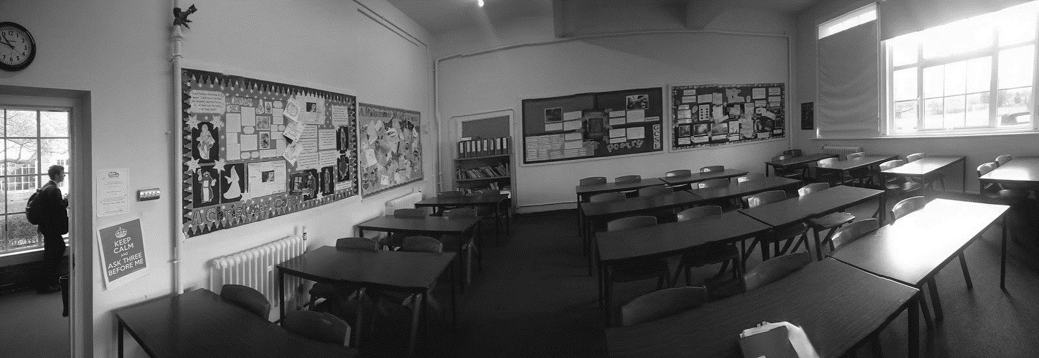

Slide 2
Educating the educators
2019 Annual Conference
Theme 5 Workgroup
Digital Skills: where we are at
#digitalskillsmatter
Notes:
The aim of this session today is to form the work group that will develop the gap report which is a key part of the University of Gloucestershire’s Theme 5 work.
The workgroup will contribute towards improving the gap report so that it can be used to inform future discussions and planning by the IoC and its’ partners.
The gap report that we have currently in draft form focussed on secondary schools assuming that they were the main source of inputs (students) to HEI, who then provide outputs (graduates) to industry. We felt that this was a good place to jump-in and begin our gap analysis.
Already we know that we do not have the students voices or teachers voices and we are limited to secondary schools and have not information from Further Education Colleges and Primary schools. This is something that could be discussed today.
We will use the current information we have as outlined in the current draft version of the gap report as a starting point for discussion.

Slide 3
Report objectives
Collate relevant documentation and information
Provide a picture of the wider educational landscape
Describe the way in which teaching and learning occurs
Create a resource to inform our next step
#digitalskillsmatter
Notes:
The gap report we have produced is an early exploration into digital skills in the secondary phase. It is required because any work that aims to increase participation or diversity in digital skills beyond HE level needs to look ‘back’ down the educational ‘pipeline’. It is from analysing this pipeline that we might attempt to develop insights and remove opaqueness that might be present in terms of the teaching and learning of digital skills. The clearer we are the more we know. From this clear view of digital skills we might then establish more effectively, where we are at.
There are several factors at structural level that create the conditions under which computer science teaching and learning ‘gets done’.
The report we have produced brings together reports and materials that portray an initial picture of digital skills in schools.

Slide 4
Early findings
Teachers are hard to reach
Each school does its own ‘thing’
External factors govern schools (and teachers)
Computer science teachers in short supply
No evidence of teaching excellence
Qualifications problematic
Opportunities exist in other subjects
3 strategies aimed at digital skills
#digitalskillsmatter
Notes:
Teachers have other priorities - teaching, planning, marking, lesson observations, learning walks, reports, effort grades, tutoring, meetings and so on - opening dialogue is another time demand. Speaking face to face whilst in school proved more fruitful, catching them on the downtime for example or in class teaching.
Interpretation of the POS occurs based on local situation - Academy, School? Qualified staff, non-specialist, GCSE or no GCSE.
Ofsted, KS3 levels, new GCSE (9-1), funding, recruitment and retention, accountability, examination performance, performance management, performance related pay and so on.
ICT teaching - was a shortage subject up to 2014 and many schools made do with non-qualified staff (staff with no A level or degree in the subject). Qualified staff were rare. But ICT teachers had received much CPD via LA and national strategies and so on. Working together because of the similarity of the curriculum. Qualifications were abused in some instances. Now the few ICT teachers who were qualified have had the bar raised higher and are asked to teach computer science - meaning that many who got away with a Business IT or similar qualification now cannot teach computing and be called qualified. Graduates in computing don’t go into teaching historically. So the pot to pick from just got a whole lot smaller.
Ofsted have not produced any inspection reports since 2014 of CS in schools. Either through whole school or subject inspections.
Qualifications are too narrow and contain too much content. This doesn’t make them rigorous it makes them prone to lillypad learning and opens students and teachers up to cheating because they simply don't know the answers.
Other subjects might prove fruitful in terms of meeting the demand of the shortage because our small poll and from conversations with others - leads me to think that this might work. UoG are launching a new Edtech BSc in 2020 with this in mind and will cover cyber, ICT, and computer science alongside education theory.
There are 3 major funded strategies each aiming to resolve the issues in computer science.

Slide 5
Higher education
Mismatch between Industry skills and graduate skills
Issues may lie earlier in educational pipeline
What additional knowledge do we need?
Where should our focus be?
Do we need FE, Primary?
Do we need to consult with students and teachers?
#digitalskillsmatter
Notes:
Three documents have been instrumental in generating the current focus on digital skills in the UK. The Shadbolt review, The Review of Digital skills and the Wakeham review.
In summary they collectively describe a worryingly bleak picture of digital skills outlining; higher unemployment levels for computer science graduates, a potential massive shortage of skilled workers and graduates not having soft and work readiness skills. Hence why we are here.
They alluded to these issues originating earlier in the education system, and so this is why we have begun our gap report in the secondary phase. This assumption of ‘pipeline problems’ needs to be investigated so we started our gap analysis in the secondary phase of education.
What additional knowledge do we need?
Where should our focus be?
Do we need FE, Primary?
Do we need to consult with students and teachers?

Slide 6
Teachers and schools
Trainee teacher shortfalls
Retention is poor, large numbers leave
Computer Science shortage acute
Disparity of teaching
What else do we need to know?
Will more knowledge make a difference to what we do?
Where should our gap report focus in light of these issues?
#digitalskillsmatter
Notes:
Here we looked at the MAC report, Shut down or restart and After the Reboot documents. Three key documents for computer science.
The MAC report stated that other occupations offered greater salaries than teaching computer science – the skills to teach computer science translate to a higher salary in industry.
The teacher recruitment and retention strategy outlines that by 2025 there will be 15% more children in schools and that currently 20% of teachers leave in the first two years and 33% leave within 5 years.
It also tells us that student misbehaviour is the greatest source of stress and that workload is unmanageable.
After the reboot tells us that there is a shortage of suitably qualified computer science teachers and that insufficient guidance and CPD was available for the reformed curriculum and GCSEs.
It also tells us about low levels of girls participating and that disparities can be seen in terms of what is taught, how it is taught and the outcomes for students.
What else do we need to know?
Will more knowledge make a difference to what we do?
Where should our gap report focus be in light of these issues?

Slide 7
Teaching, learning, assessment
ICT was ‘problematic’
New curriculum, GCSEs (2014)
Teacher development required
Challenges still remain
GCSE NEA rules broken, cheating and malpractice
Do we need any more information in this area?
What information do we need?
Do we know enough about these areas in FE and Primary?
#digitalskillsmatter
Notes:
The Restart report (2013) tells us that ICT (Prior to the 2014 reforms) was problematic and finding qualified teachers was hard, it also tells us that non-specialist teachers were often used. A level numbers were in decline and outlined challenges such as recruitment, CPD and skills of teachers.
The new subject of computer science aimed to resolve the problems of ICT. However, many issues still remain and are relevant despite the reforms.
Literature (Sentence, 2015) tells us that computer science requires a strong pedagogical approach and that alternative techniques such as unplugged activities work well.
Exam boards tell us that there are large numbers of malpractice cases specifically in computer science and some boards have had significant issues with managing coursework components - OCR tried to withdraw a whole cohorts coursework to make it null. They have adjusted their assessment now so that it is examination only.
Do we need any more information in this area?
What information do we need?
Do we know enough about qualifications, teaching and leaning and assessment in FE and Primary?

Slide 8
Qualification, Educators
Lack of ICT, Cyber Security in qualifications
GCSE now exam only (coursework not marked)
HE no requirement for A level Computer Science
Educators have reservations about computing only curriculum
Open to CPD
What additional information should we find in this area?
#digitalskillsmatter
Notes:
By looking at the programmes of study and examination specifications for GCSE and A level it can be seen that there is very little cyber security content or ICT / digital skills content. Digital skills content tends to be in other qualifications such as iMedia or Certificate in Digital Application specifications – which incidentally, are still popular in schools and count towards headline measures.
These were traditionally vocational style qualifications but over time have developed into academic (with exam) style courses – they are popular with boys and girls due the creative element of the content (web design, media products, animation, video etc).
A draft programme of study blended ICT, Digital literacy and computing together and educators were favourable towards it. However it was hastily re-written and presented finally computing only. Educators initially and subsequently, voiced concerns and expressed reservation about the swift and sweeping change from one extreme to another – from ICT to Computing.
Some concerns expressed were that CPD would be needed – this has been identified in the small poll we conducted and supported by STEM learning who are deploying a comprehensive CPD package for schools.
What additional information should we find in this area?

Slide 9
Ofsted and strategies
No inspection reports since 2014
Curriculum narrowing (to tests)
Impactful CPD concerns
NCSC, NCCE and IoC
Cyber priority for UK Gov
How can we get information on best practice in computer science?
Is this information going to be useful?
What else do we need to know?
#digitalskillsmatter
Notes:
Communication with an HMI via Twitter presented the strange situation that in trying to identify good practice somewhere he could find no Ofsted inspection data around computer science since the reforms of 2014.
However, more generally, Ofsted report that there is a narrowing of the curriculum with an overt focus on subjects.
NHS Mental Health report and House of Lords recommend focus on impact on young people of this narrowing and high stakes testing approach
The government have prioritised the cyber security sector and three large initiatives are currently operating.
How can we get information on best practice in computer science?
Is this information going to be useful?
What else do we need to know?

Slide 10
Next step…
What do we currently know?
Where can this knowledge be impactful?
Where else do we need to look?
What other information do we need?
#digitalskillsmatter
Notes:
Our current plan would be to speak with headteachers in schools to establish what their feelings are about development in this area. What are their issues and needs?
We would consider speaking with Heads of Departments of Computer Science and wider to other subjects to inform us of needs in the classroom.
Is the current programme of study in KS2, KS3 and 4 fit for purpose?
Has the reform worked - how do we know?

