Slide 1

Institute of Coding
Annual Conference March 2019

Slide 2
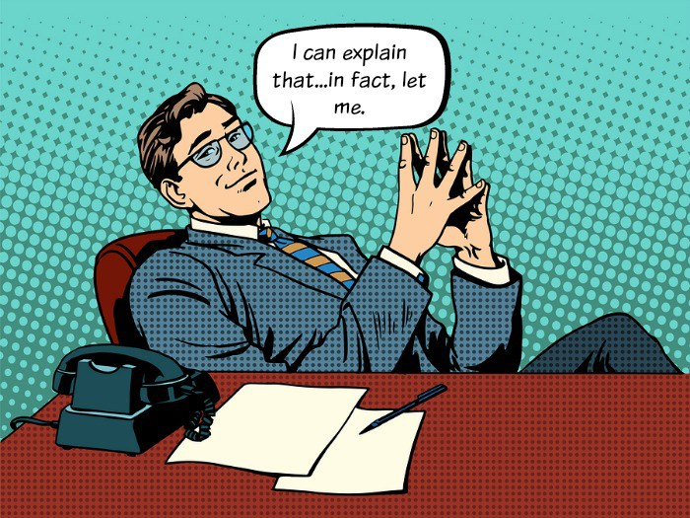
“Diversity is reality – Inclusion is a choice”*
I’m a six foot tall white male with blue eyes.
I hope that my closing remarks wont come across as mansplaining diversity.
We have seen that gender imbalance is a huge issue for the tech sector and education BUT…
I want us to take a diverse view of diversity.
*Steven Frost

Slide 3
Diversity initiatives should reflect the make up of our society.
We need to look to the edges to see where the innovation is happening.
Take a diverse view of what makes up diversity and look to proactively include many different groups it is not a monoculture:
Age
Ethnicity
Disability
Gender
Culture
Sexual Identity
Diversity is also intersectional

Slide 4
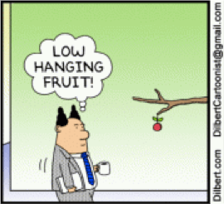
Challenge
t.
Don’t just go for the low hanging fruit.

Slide 5
Technology has the power to include or exclude.
We must work together to design courses that consciously help build a more inclusive society.
We will not create change by doing what we have always done.
Start work now on the stuff that looks difficult.

Slide 6
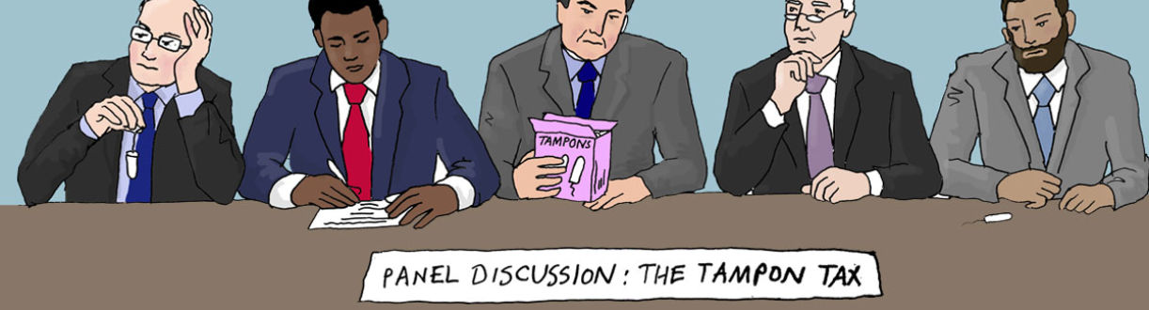
Please no more Manels
There is no need for all male panels, or working groups or anything…
Indeed we need proper representation across the board.
Look to disability as a driver for innovation.
Look to the older workers and returners for ideas.

Slide 7
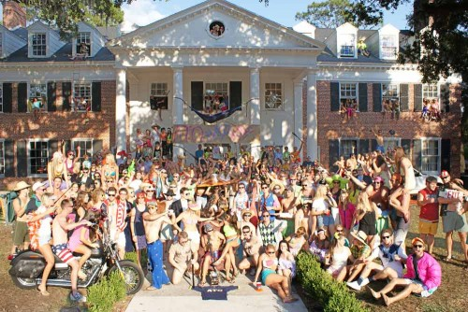
Co(llaborative)Working not Bro-Working
Lets design the places of study and places of work that people feel comfortable in.
Hint - it should not be modelled on a Frat house.
Understand that people work in different ways create spaces that cater for neurodiverse talent
The IOC is building business’s talent pipeline as part of this it’s imperative that we address exclusion in all parts of the process from applications to course materials to pedagogy.

Slide 8

Work with data but work with good diverse data.
Bad data leads to bad decisions and sometimes fatal bias.

Slide 9
Let’s break down the silos
Together we can help shape and influence a more diverse, inclusive and successful future where #DigitalSkillsMatter for everyone and not the privileged few.

