Slide 1
The Journey into the space?
Senior lecturer, M.sc. (tech) Pasi Tiihonen (pasi.tiihonen@lamk.fi)

Slide 2
A bit over 10 years ago in a UNI far, far away…
We had an idea to provide an opportunity for students to graduate as a bachelor of IT via entrepreneurship
After the first year of studies, they would establish a company and perform their studies as a team entrepreneur
We faced the final frontier – Space!
UNI said no no no and no
At last (probably thanks to the cleaning person, hopefully you found place for your rags and buckets) we got room!

Slide 3
Years go and learning by doing and ”real life” pojects emerge – need for students to interact!
Practically every student in LUAS will do several projects for (also) outside customers during their studies
There are many different variations, from single project to three 15 ECTS modules multidisciplinary service design team studies
”Traditional” class rooms are still needed but teams/projects can not utilize them. Something happened – new campus!

Slide 4
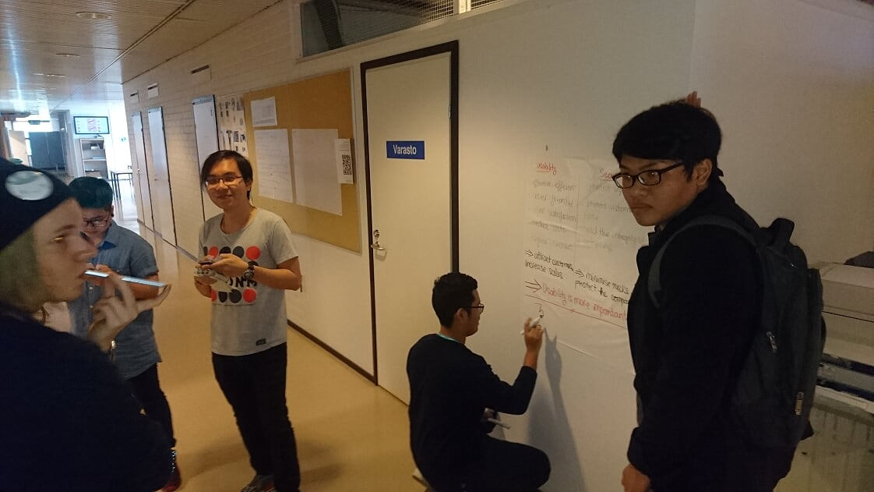

Slide 5
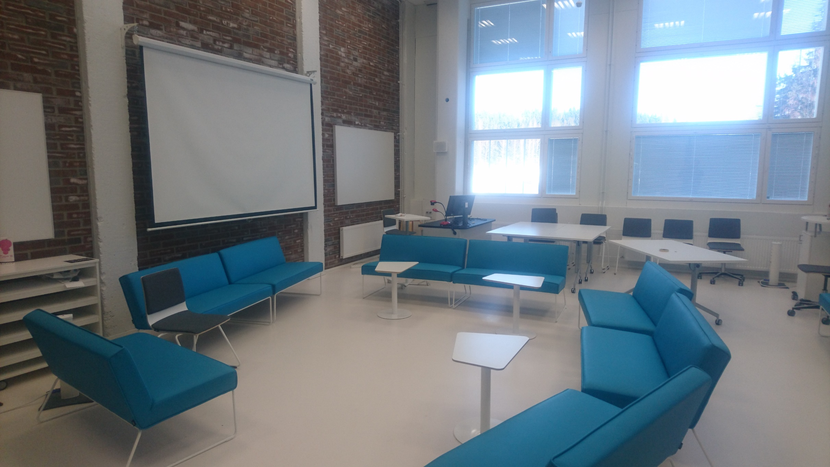

Slide 6
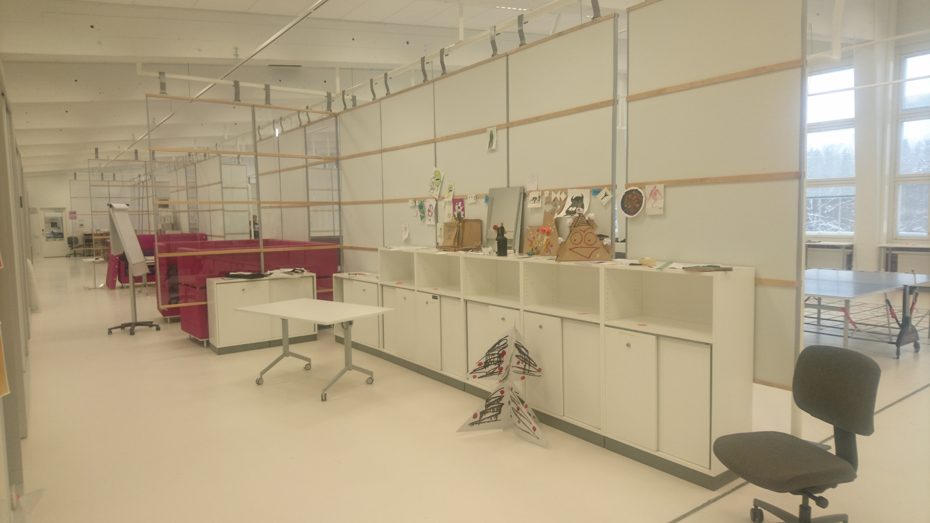

Slide 7
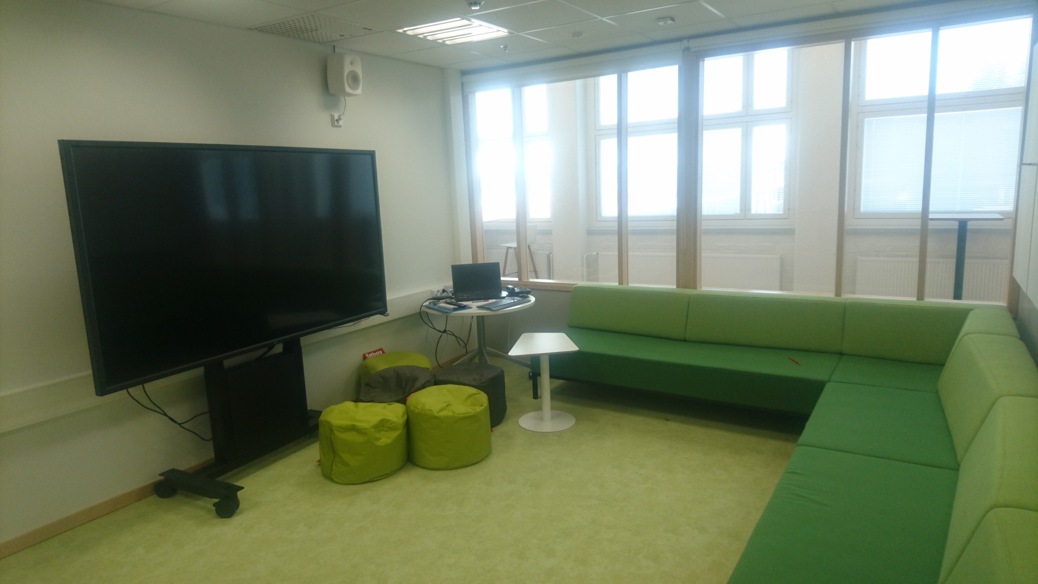

Slide 8
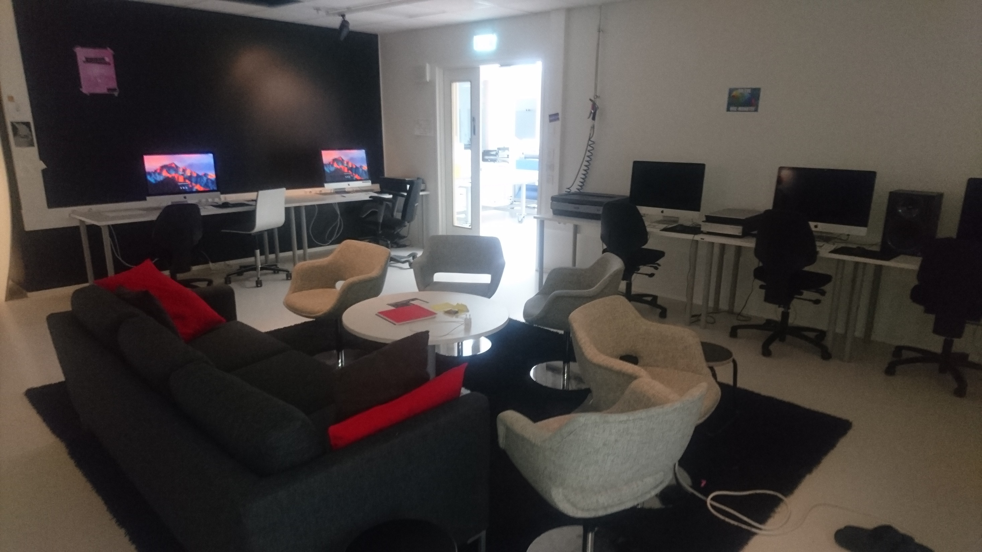

Slide 9
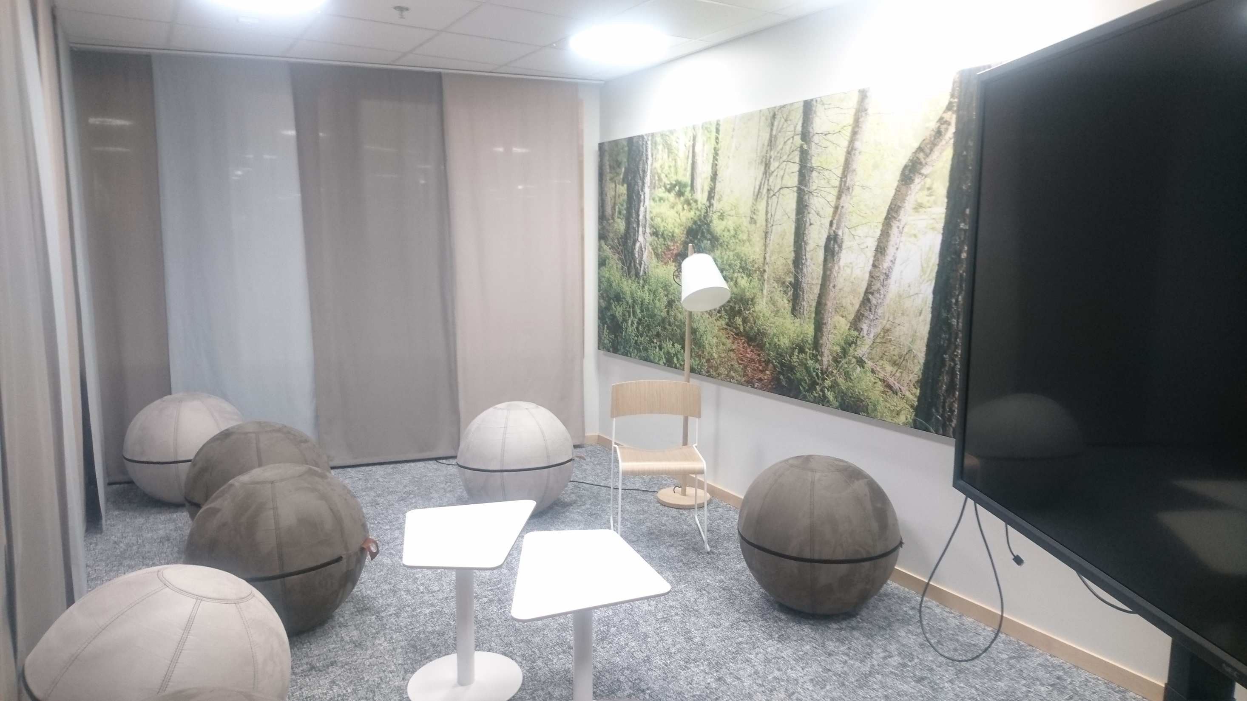

Slide 10
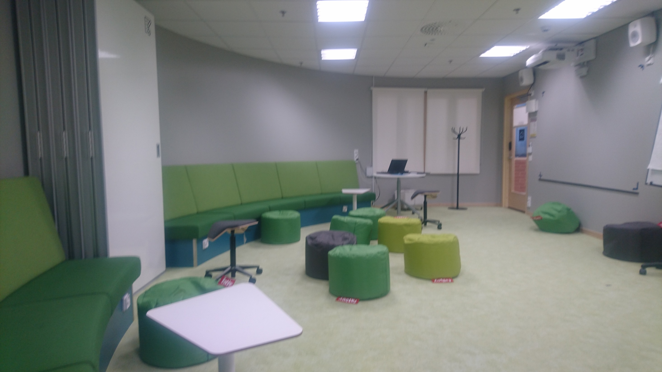

Slide 11
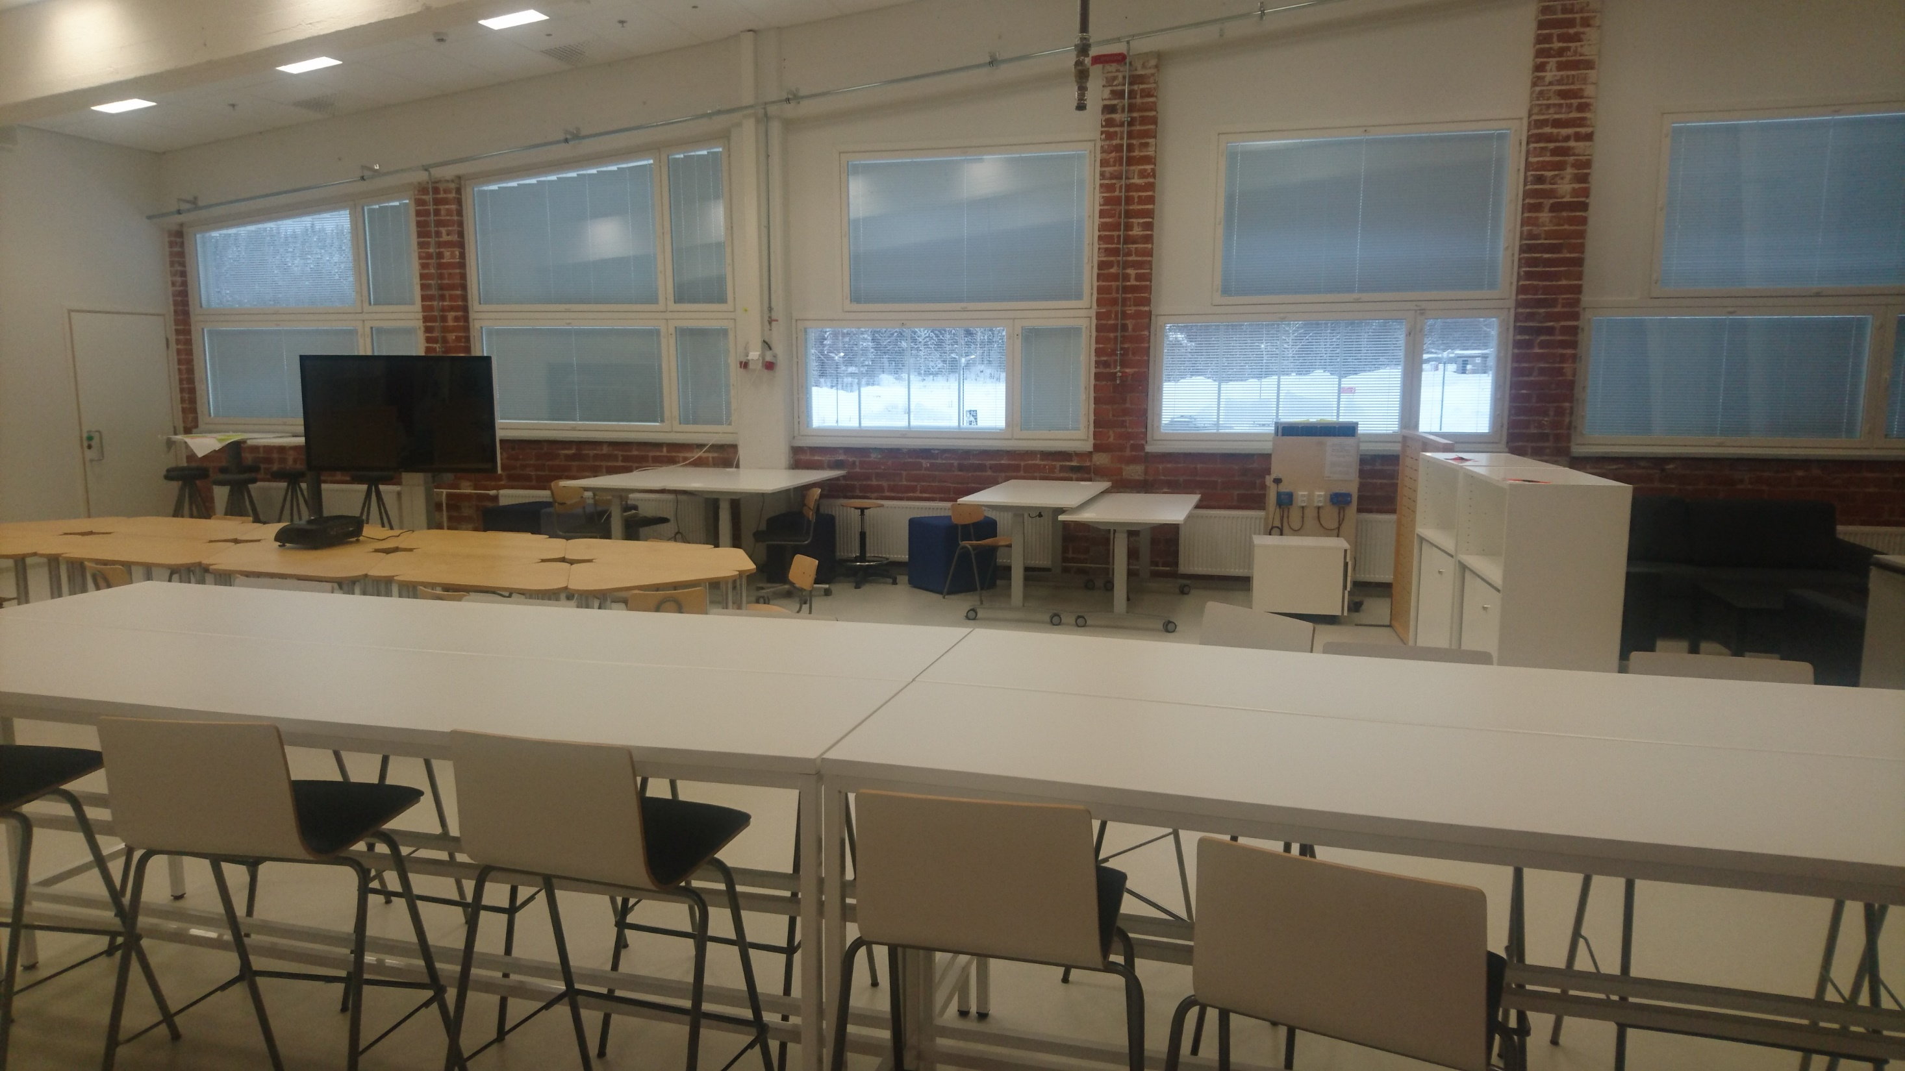

Slide 12
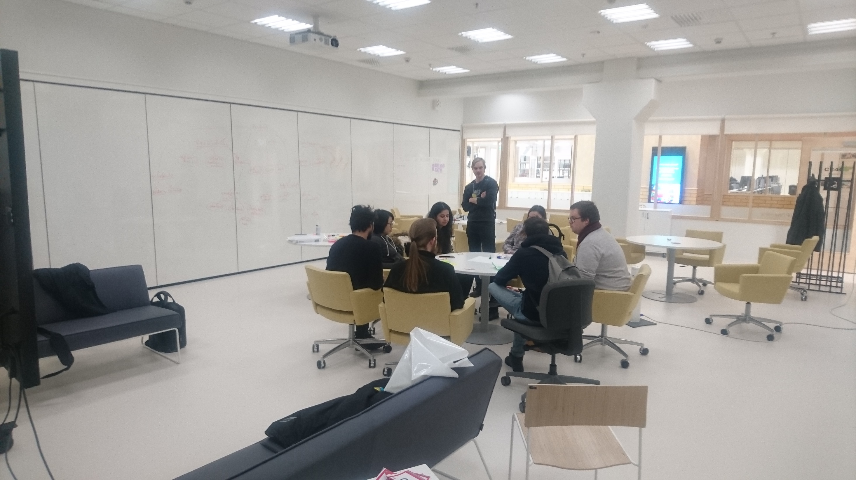

Slide 13
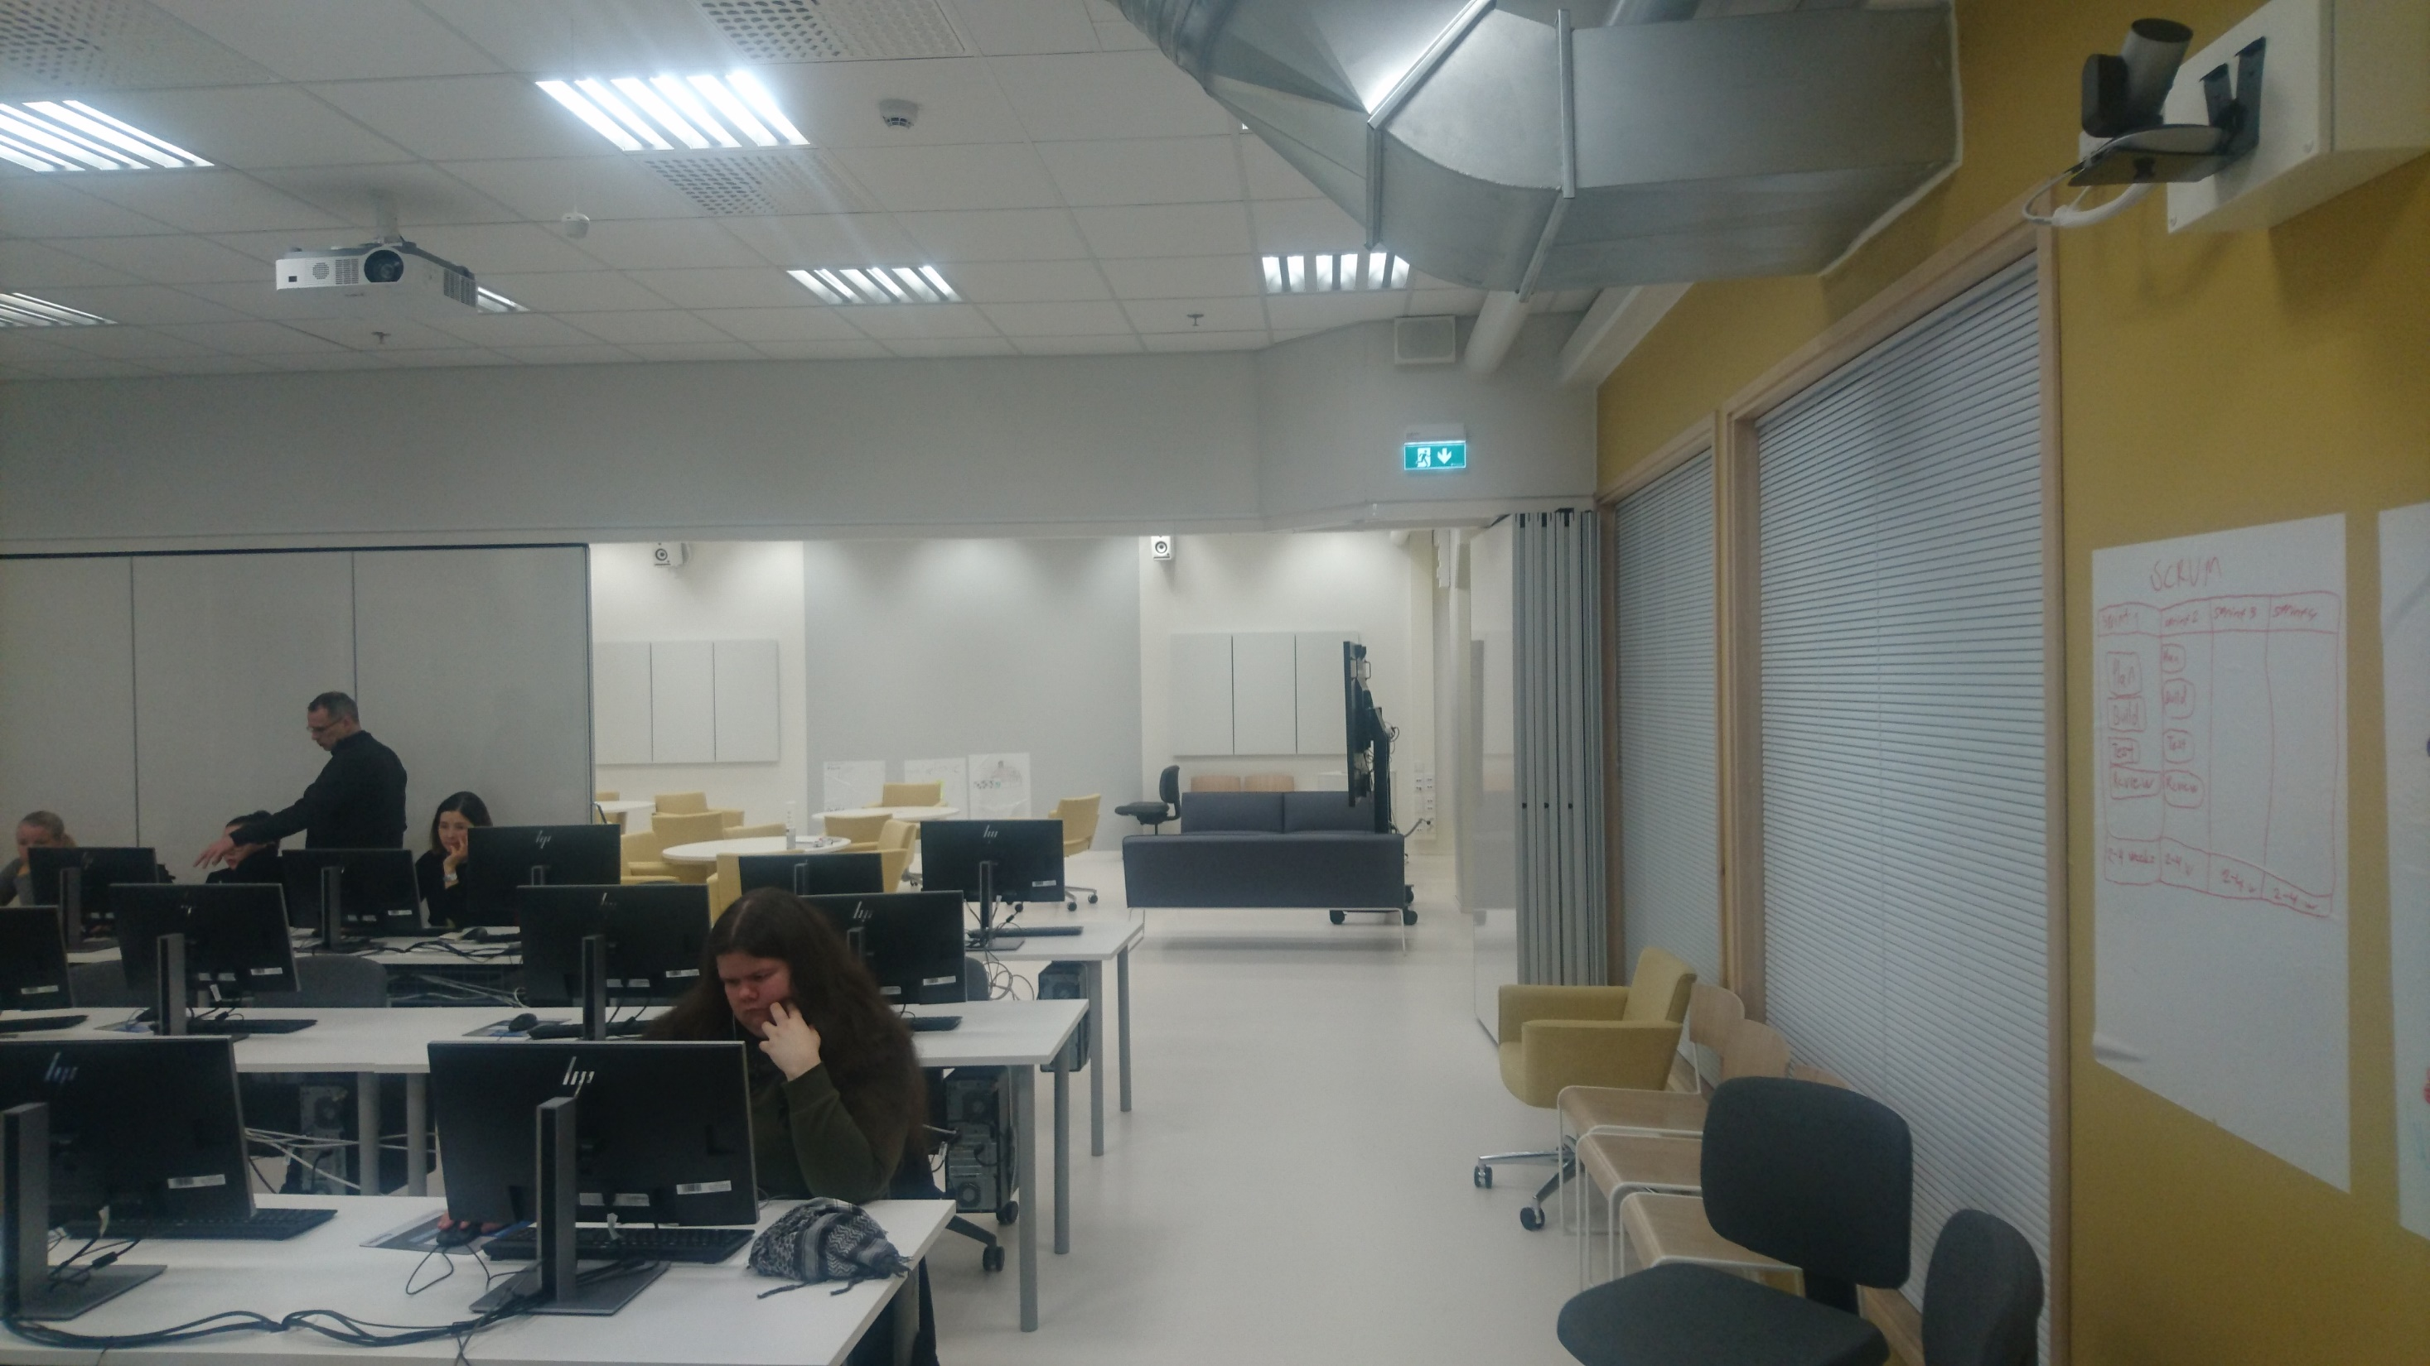

Slide 14
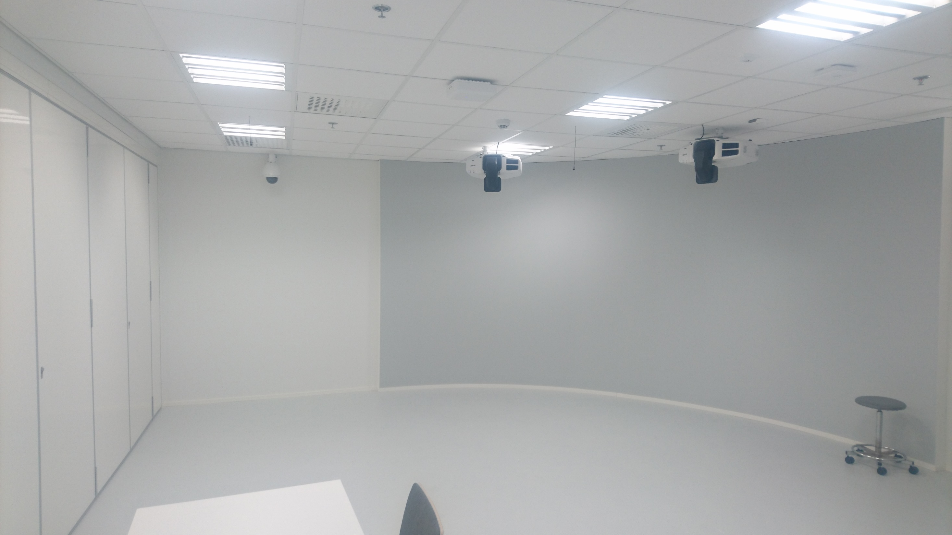

Slide 15
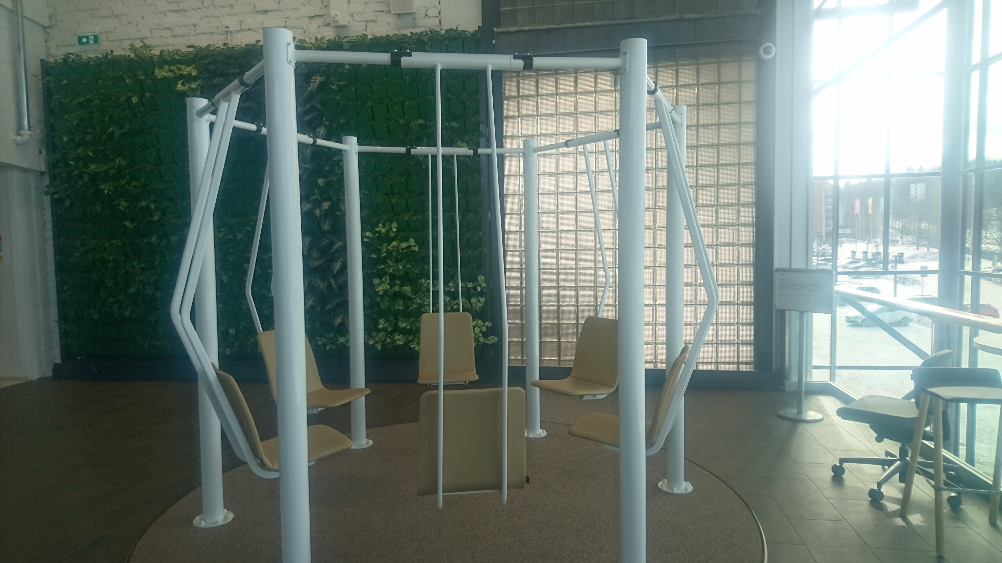

Slide 16
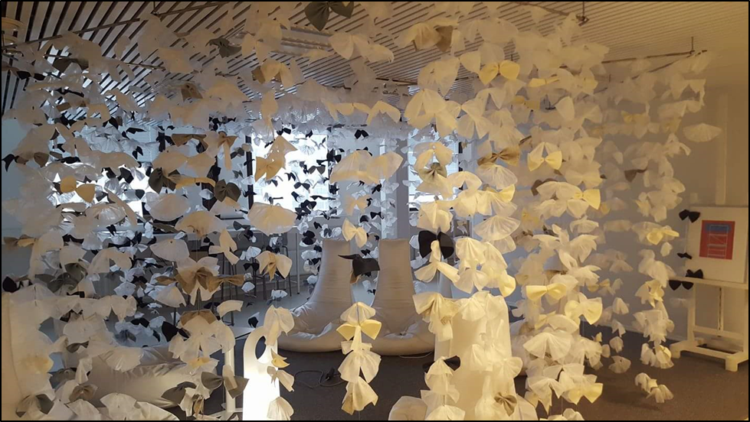

Slide 17
Back to basics?
Walls are only walls. Take away the ”shelter” – computers, tables, etc – humans must meet humans and interact
Put ”different” people together, create opportunities
Service Design: students from IT, business management, mechanical engineering, social & health care and arts & design -> always same ”finding” by students – we are thinking and working differently!

Slide 18
The end - may the force be with you
Thank you!
Come and chat, challenge my opinions if you like! Pasi.tiihonen@lamk.fi

