Slide 1
Business Development Workshop

Slide 2
Workshop Objectives
To understand some of the main challenges of engaging with industry/businesses
To identify the various avenues through which IoC can engage with local firms, businesses and other intermediaries in relation to course development research and innovative activity.
Sector focused activity
To explore opportunities to support business engagement

Slide 3
Deepak Farmah – Business Development Manager CU
Graduate of Coventry university (Automotive Engineering)
5 years as an Automotive Engineer (Honda and Aston Martin)
10 years' experience in Education – Teacher, Senior Manager and Ofsted inspector
Chair of the Innovation to Inspire Education Trust
Business Owner (Since 2015)
Why this role?
I am a Digital Technology advocate and enthusiast
To raise my business development portfolio in the digital economy
​

Slide 4
Louise Phipps – Business Development Manager
6 years experience in FE in a variety of BDM roles and as Apprenticeship Manager
5 years on various DWP contracts including Work Programme, Flexible New Deal and Pathways for private training organisations such as LearnDirect and Working Links
2 years as an Enterprise Advisor for the Growth Hub
Qualified in IAG, Management and LLB (Hons) Criminal Law
Why this role? Comfort zone

Slide 5
Task 1: Introduce yourself
Where are you from?
What is your job role?
What is your background?

Slide 6
Theme 3: Digitising the Professions
Sectors Coventry University engage with:
Engineering and Manufacturing
Automotive
Healthcare
Creative Industries
FinTech

Slide 7
Number of major challenges in university–industry interactions:
Lack of quality information about what is on offer from the IoC (internal and external)
Industry cannot see the relevance of the IoC in terms of the their business needs
Understanding the business/industry needs
Raising IoC awareness
Coordinating academic and industry collaboration
SMEs resources and time are limited

Slide 8
IoC Coventry University Industry Engagement
Clarity about the purpose of IoC
A consistent and clear business message (sector specific)
Expressing IoC benefits
Understand and promote the benefits of working with a national government initiative
Use alternative
/ intermediary organisations
By using other government initiates, trade associations and business support organisations to endorse IoC will force engagement
Time Management
Make yourself available and work around industry timing
Create long-term relationships
Use an internal customer management system
How to involve industry in course development
Organise workshops in collaboration with other organisation to get the right people in open discussion with academics

Slide 9
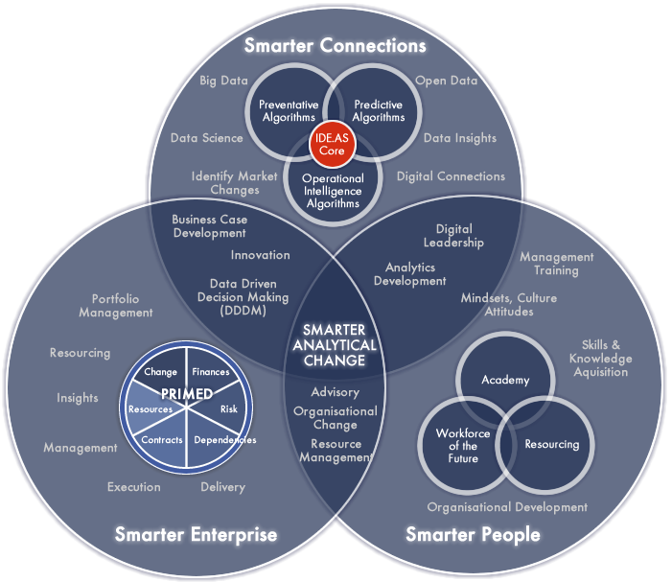

Slide 10
Methods of Engagement Manufacturing, Automotive, Engineering and FinTech
Internal workshops
Partnered workshops – Catapult
Speaking opportunities
Raising awareness internally
Utilising existing relationships
Exhibitions and conferences
Public Relation Management

Slide 11
Key Activity to Date Healthcare
GIANT Health
West Midlands Life Sciences Networking Group
West Midlands Digital Health Learning Community
Understand the Healthcare Sector
Private Sector Engagement
NHS Engagement
Health 2.0 West Midlands
Breakthrough in Healthcare Technology Conference
Digital Health Congress

Slide 12
Current Opportunities & Pipeline
Health Education England
UHCW
George Eliot
Lloyds Pharmacy
Wellbeing Teams
EIT Digital Summer Schools
16th March – Introduction to Cyber Security for Healthcare Professionals

Slide 13
My Objectives
To raise the profile of the IoC through local, regional and national networking
To be the lead on Healthcare content development at Level 6 and 7 and be the link between industry and academics
To have a good understanding of the Healthcare sector, its barriers and its needs
To have a good understanding of digital technology and the capabilities within the IoC Coventry team and wider consortium
To ultimately support with the NHS long term digital strategy

Slide 14
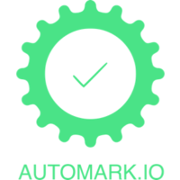
My IoC Aims & Objectives
To raise the profile of the IoC through local, regional and national networking and marketing
To be the lead on Automotive and Manufacturing Level 6 and 7 qualification development opportunities and be the link between industry and academics
Be the first point of contact for new businesses within the sector wanting to engage with IoC CU or are seeking digital transformation.
To manage customer and partner relationships
To actively seek out opportunities to support digital skills growth in industry.
To develop a diagnostics tool kit

Slide 15
Task 2 : Key Objectives
Identify your 5 key objectives and discuss

Slide 16
Task 3: Collaborative approach
What opportunities are there for collaboration across the consortium?

Slide 17
Deepak Farmah
dfarmah@cueltd.co.uk
07392 096215
Louise Phipps
lphipps@cueltd.co.uk
07392 096318

