Slide 1
Institute of Coding Annual Conference Workshop Data Science for Everyone – Training for the Future and Meeting the Industry Need
Dr Huseyin Seker
Northumbria University
e-mail: huseyin.seker@northumbria.ac.uk

Slide 2
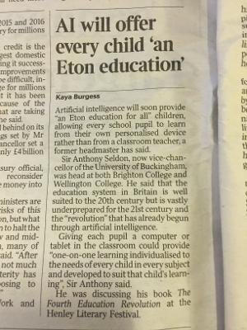
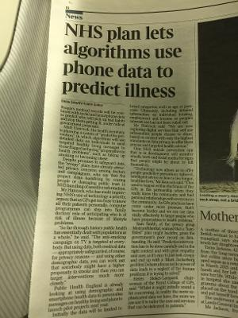
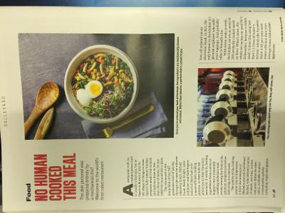
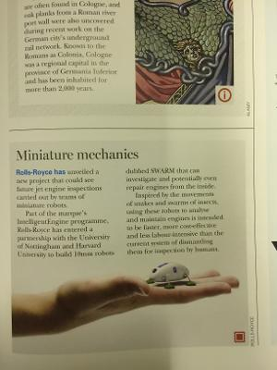
THE TIMES; 6 Oct 2018
THE TIMES; 6 Oct 2018

Slide 3
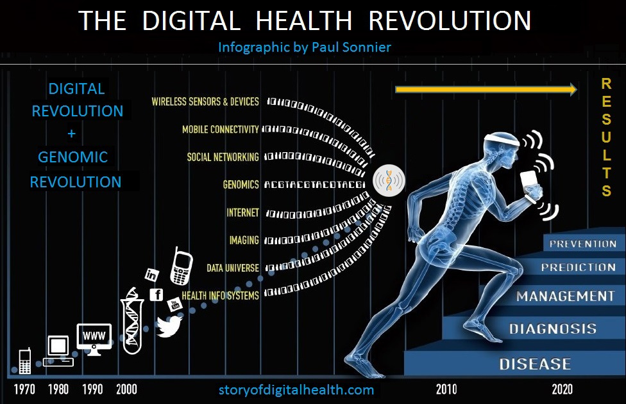

Slide 4
The Ebers papyrus c. 1550 BC is believed to be a copy from Old Kingdom, 3000–2500 BC

Slide 5
“In fact, research firm Gartner reports that 90 percent of large companies will hire a CDO by the end of 2019, many of them at healthcare organizations”
Ray Wang, principal analyst and founder of Constellation Research. “I think we'll have chief data officers for some time because we're inundated with so much data, and what we really want is to make better decisions.”

Slide 6
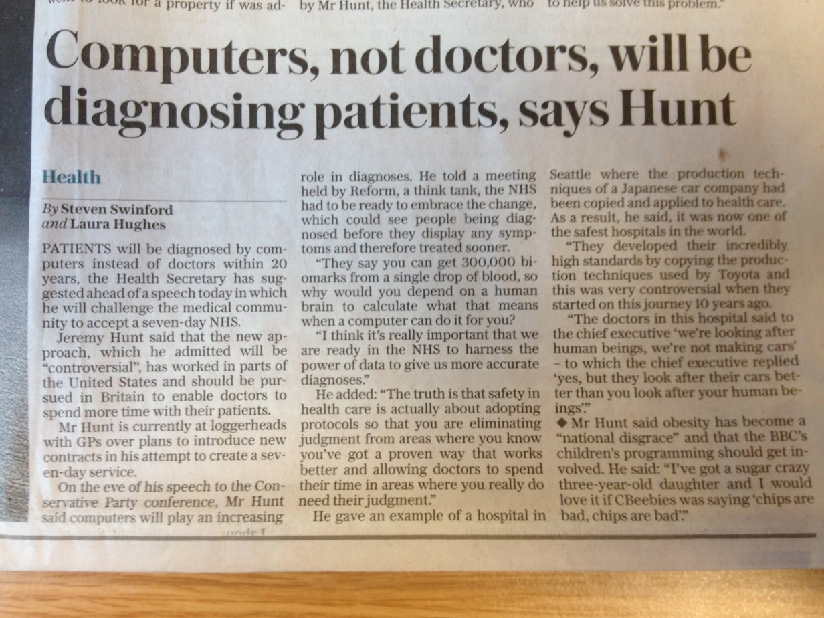
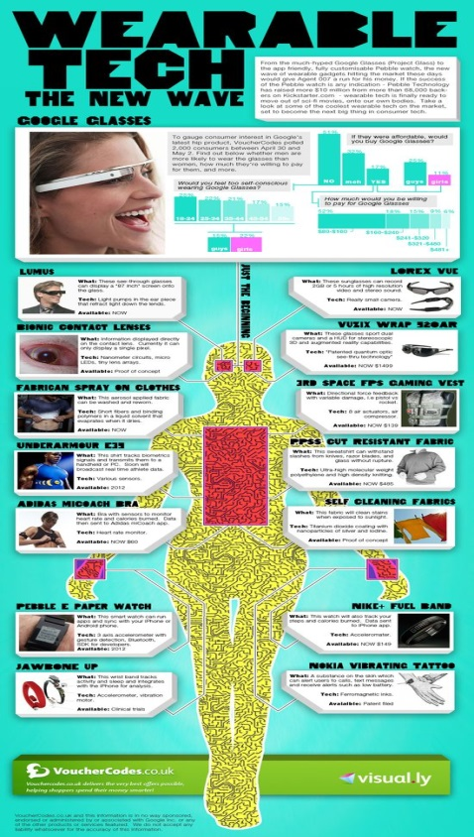
Big Data in Health:
From Bench to Bedside to Society
“They say you can get 300,000 biomarkers from a single drop of blood, so why would you depend on a human brain to calculate what that means when a computer can do it for you”
“I think it is really important that we are ready in the NHS to harness the power of data to give us more accurate diagnosis”
The Daily Telegraph, 06 Oct 2015

Slide 7
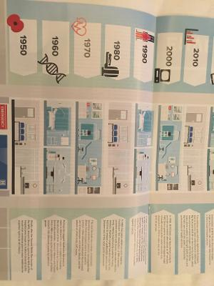
PAST, PRESENT and FUTURE

Slide 8
Data and
AI & Machine Learning
Paperless NHS
Digitalisation and Digital Health Records

Slide 9
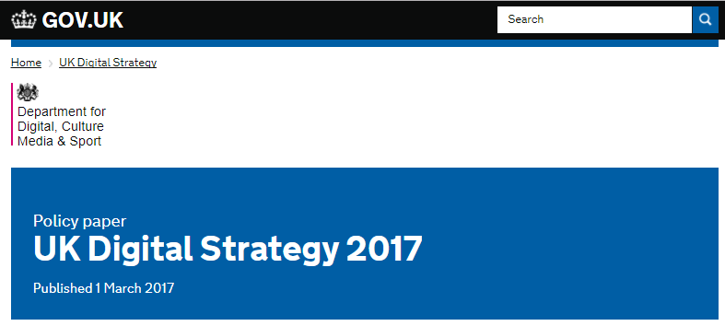
“…. it will close the digital divide - to ensure that everyone is able to access and use the digital services that could help them manage their lives, progress at work, improve their health and wellbeing, and connect to friends and family.”
The Rt Hon Karen Bradley MP
Secretary of State for Culture, Media and Sport

Slide 10
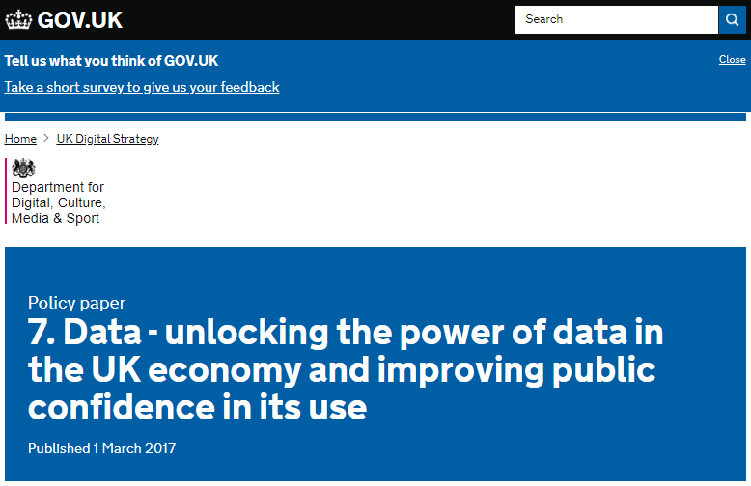
“…. it will close the digital divide - to ensure that everyone is able to access and use the digital services that could help them manage their lives, progress at work, improve their health and wellbeing, and connect to friends and family.”

Slide 11
UK Digital Strategy
Maintaining the UK government as a world leader in serving its citizens online
“From personalised services in health, to safer care for the elderly at home…”
Our 5G Strategy
“… it will also support the development of the Internet of Things: the rapidly-increasing number of connected devices, from connected cars to digital health applications.”
The Internet of Things and Smart Infrastructure
“NHS test beds, using IoT and health and care innovations to help people with dementia in Surrey and people with diabetes in the West of England”

Slide 12
The Digital Catapult
The Digital Catapult Centre is a space for technologists, creatives from business and academia to collaborate and develop their new ideas and showcase their products to the UK and the rest of the world.
Its new strategy outlines the key technologies it will focus on moving forward:
data-driven: new ways to work with personal data with more control and trust, applications of blockchain and smart contracts, cybersecurity particularly for emergent threats
connected: the Internet of Things, and associated enabling networking technologies such as Low-Power Wide-Area Networks (LPWAN) and 5G
intelligent: artificial intelligence and machine learning
immersive: augmented, virtual and mixed reality, haptics and related new forms of human machine interface

Slide 13
Maximising the impact of our specialist digital sectors
“the NHS Test Bed programme, which explores the potential of technologies such as mobile and wearable health self-management tools and monitoring devices”
The NHS produces a wealth of data with huge potential to improve decision making, clinical pathways and efficiencies. Access to this will be improved for both patients and professionals, whilst ensuring security and privacy

Slide 14
Embedding digital in public service delivery
Digital technologies and data are already helping to achieve these ambitions and we will invest £4.2 billion over the next five years in areas such as electronic patient records, apps and wearable devices, telehealth and assistive technologies
Data will be the key to the modern health and care system – but it must be used appropriately and lawfully, held safely and securely and in ways that maintain public trust and confidence
Developed a portal to help researchers and developers to find information about the UK healthcare data sets which are available for research

Slide 15
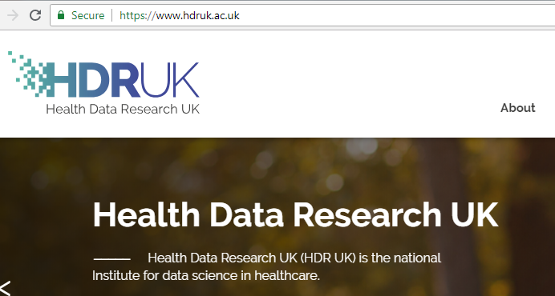
Embedding digital in public service delivery
Digital technologies and data are already helping to achieve these ambitions and we will invest £4.2 billion over the next five years in areas such as electronic patient records, apps and wearable devices, telehealth and assistive technologies
Data will be the key to the modern health and care system – but it must be used appropriately and lawfully, held safely and securely and in ways that maintain public trust and confidence
Developed a portal to help researchers and developers to find information about the UK healthcare data sets which are available for research

Slide 16
Grand Challenges
We will set Grand Challenges to put the United Kingdom at the forefront of the industries of the future:
AI and Data Economy - We will put the UK at the forefront of the artificial intelligence and data revolution

Slide 17
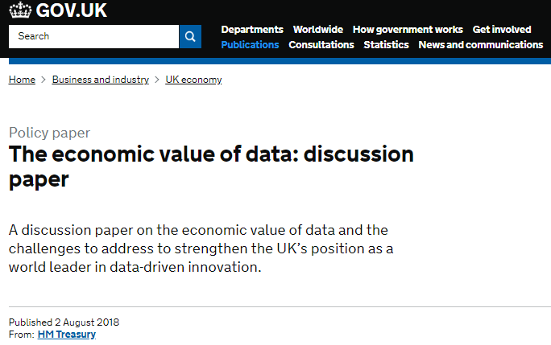
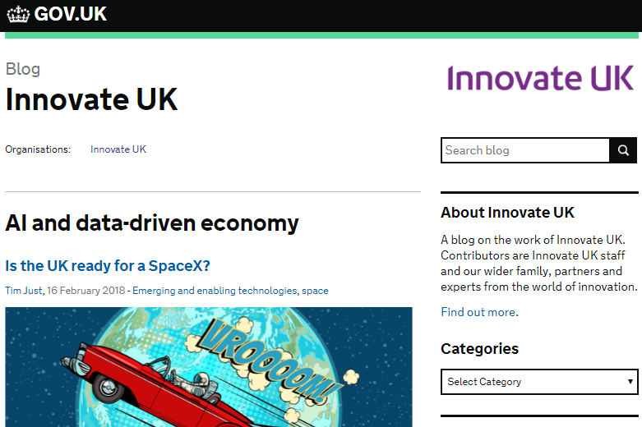
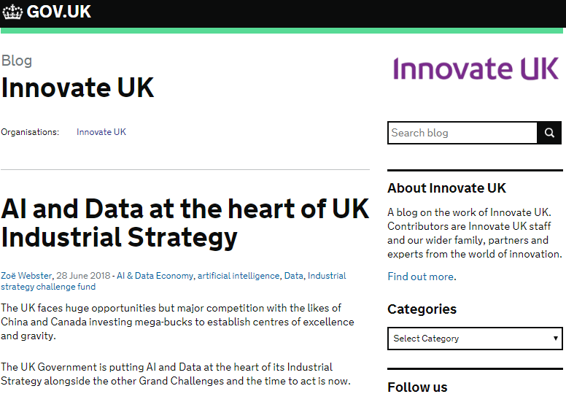
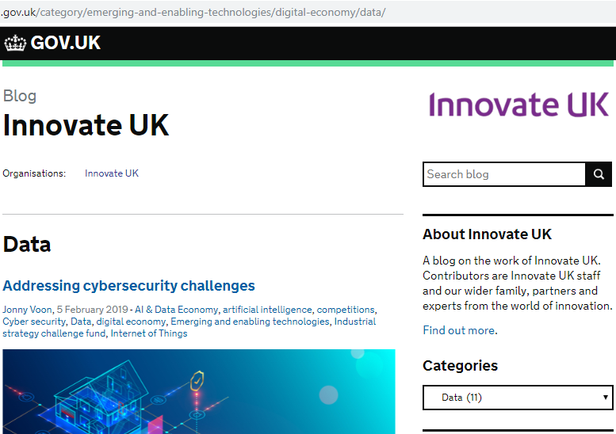

Slide 18
Skills Gap in Data Science
Organisations should invest on “big data strategies” and “data scientists” if they wish to remain in the business (Bernard Marr, Big Data Guru and Bestselling Author; Martijn Theuwissen, Co-founder of DataCamp)
According to IDC's prediction, the market for big data reaches $43.3 billion in 2017, growing 6 times faster than the overall IT market
The United States alone faces a shortage of
140K to 190K people with analytical expertise in big data mining
1.5 million managers and analysts with the skills to understand and make decisions based on the analysis of big data

Slide 19
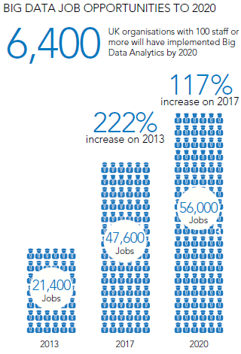

Slide 20
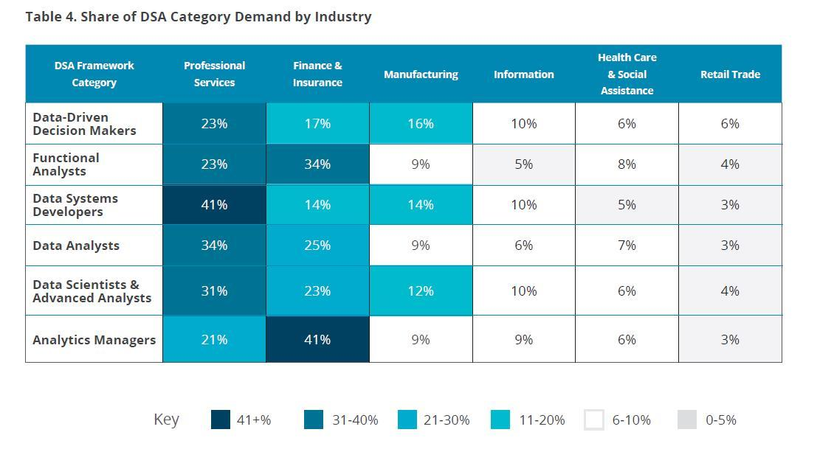
"By 2020, the number of jobs for all US data professionals will increase by 364,000 openings to 2,720,000” according to IBM
The fastest-growing roles are Data Scientists and Advanced Analysts, which are projected to see demand spike by 28% by 2020
https://blogs-images.forbes.com/louiscolumbus/files/2017/05/Data-Science-and-Analytics-Demand-by-industry.jpg

Slide 21
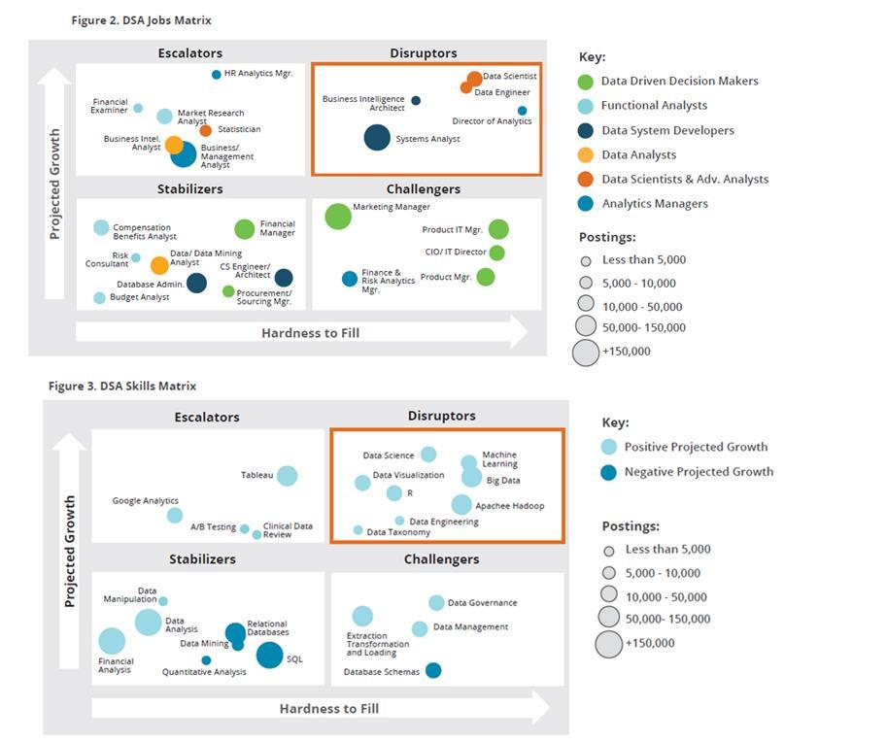
Data Science/Analytics Jobs Matrix
https://blogs-images.forbes.com/louiscolumbus/files/2017/05/Combined-graphic-of-skills.jpg
Notes:
Machine learning, big data, and data science skills are the most challenging to recruit for and potentially can create the greatest disruption to ongoing product development and go-to-market strategies if not filled. The study found that the high to cost to hire, a strong need for new training programs and the high risk to future productivity of these areas is one of the greatest challenges to organizations pursuing initiatives in these areas today

Slide 22
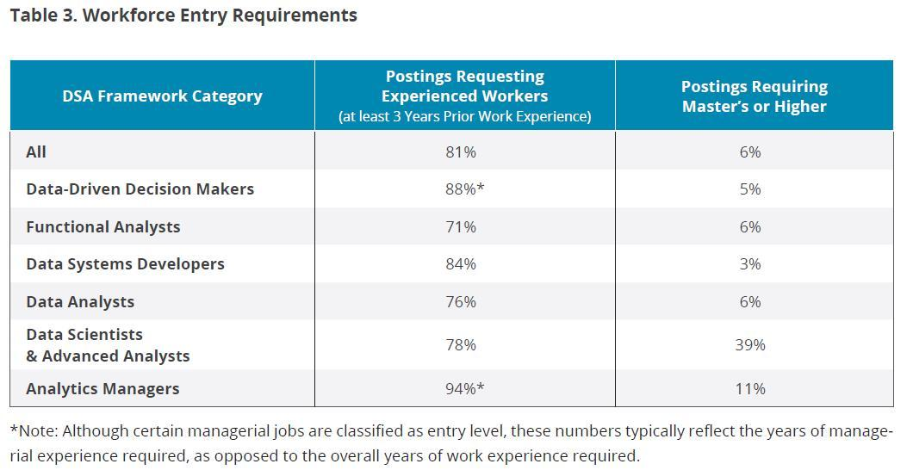
39% of Data Scientists and Advanced Analyst positions require a Master’s or PhD
https://blogs-images.forbes.com/louiscolumbus/files/2017/05/workforce-entry-requirements.jpg

Slide 23
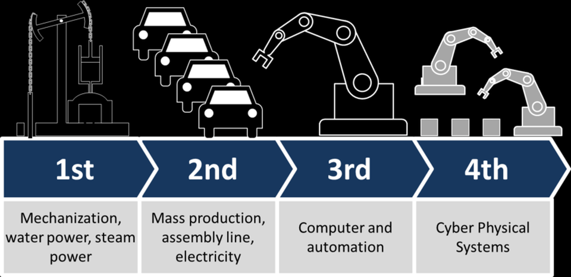
Data Analytics in the Age of the 4th Industry Revolution: Can the UK lead the Data-Driven World?
The first industrial revolution was sparked by the steam-powered North of England.
The second was pioneered by British industrialists who recycled World War II computer tech to count teacake sales
The creator of the third was a British academic, Sir Tim Berners-Lee, who brought us the World Wide Web
As the third revolution developed, the importance of one key component grew dramatically - data
THE FOURTH INDUSTRIAL REVOLUTION HAS ARRIVED - THE NEW ERA OF DATA-DRIVEN BUSINESS
World Wide Web
Data-driven Business

Slide 24
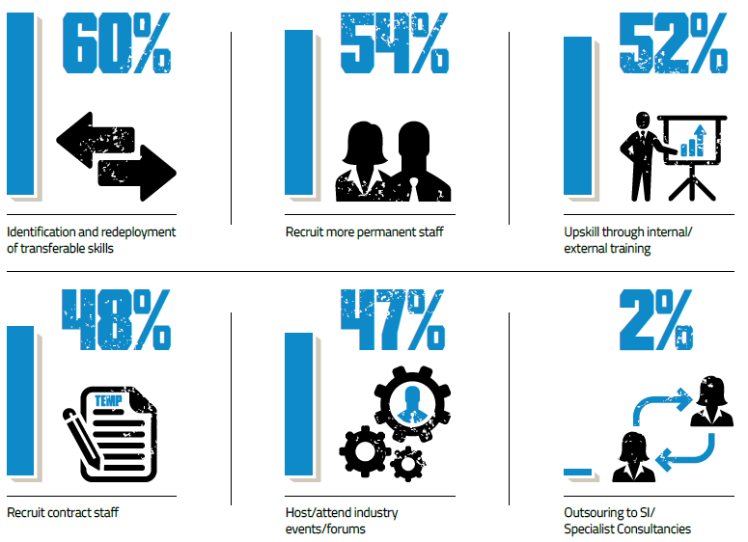
WHAT IS YOUR STRATEGY FOR OBTAINING THE SKILL SETS NEEDED IN THIS CONSTRICTED MARKET?
Hortonworks & 3rd Street Group: “The fourth industrial revolution report”

Slide 25
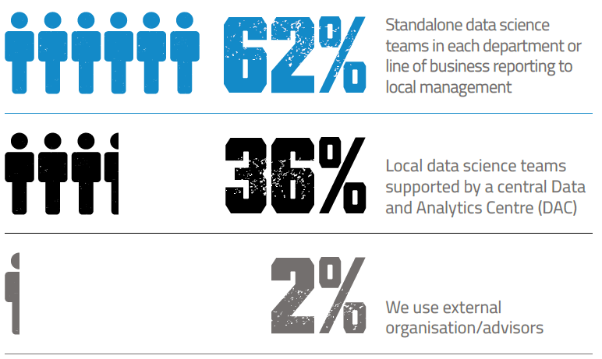
WHICH OF THE FOLLOWING IS CLOSEST TO YOUR COMPANY’S OPERATING MODEL FOR MANAGING DATA ANALYTICS PROJECTS ACROSS YOUR ORGANISATION?
Hortonworks & 3rd Street Group: “The fourth industrial revolution report”

Slide 26
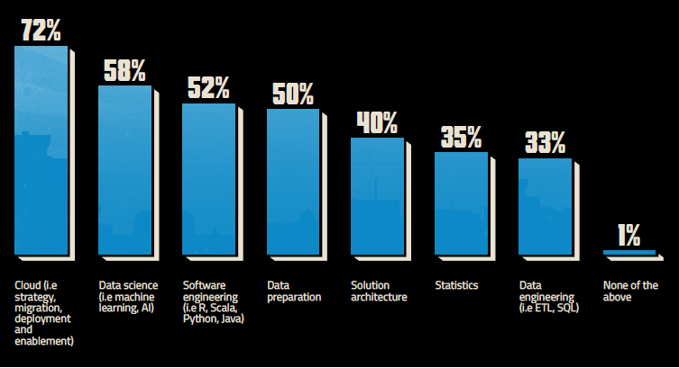
WHICH DATA-RELATED TECHNICAL SKILLS DO YOU NEED TO ACHIEVE YOUR BUSINESS GOALS?
Hortonworks & 3rd Street Group: “The fourth industrial revolution report”

Slide 27
Conclusions
Data-driven economy is one of the UK government’s highest priorities
(Almost) Every sector is being driven to become a data-driven one
There is a clear evidence that we have a (growing) skills gap in data science/analytics
We need to develop our (short and long term) strategy to help the nation to close the skills gap in data science/analytics
Not only IoC but also other organisations to work together to tackle this challenging problem

Slide 28
Contacts
Dr Huseyin Seker (Northumbria University IoC Academic Lead)
e-mail: huseyin.seker@northumbria.ac.uk
IoC Northrumbria University
e-mail: ioc@northumbria.ac.uk
Follow us
http://computing.unn.ac.uk/staff/yqqd6/events.html

