Slide 1
G E E K T A L E N T
Agility, Communication, Innovation and Problem Solving

Slide 2
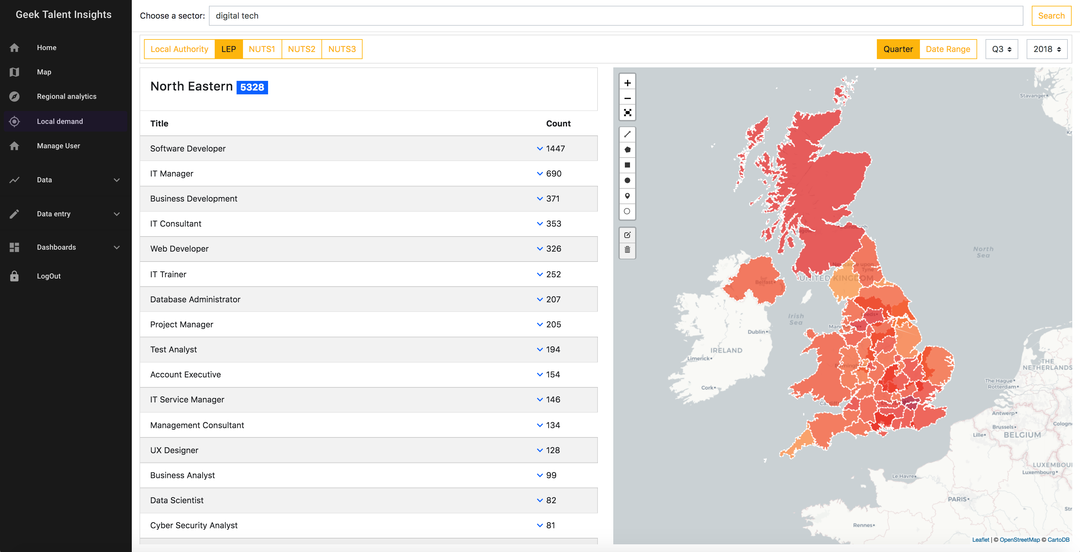
GoCareer – Insights into the job market

Slide 3
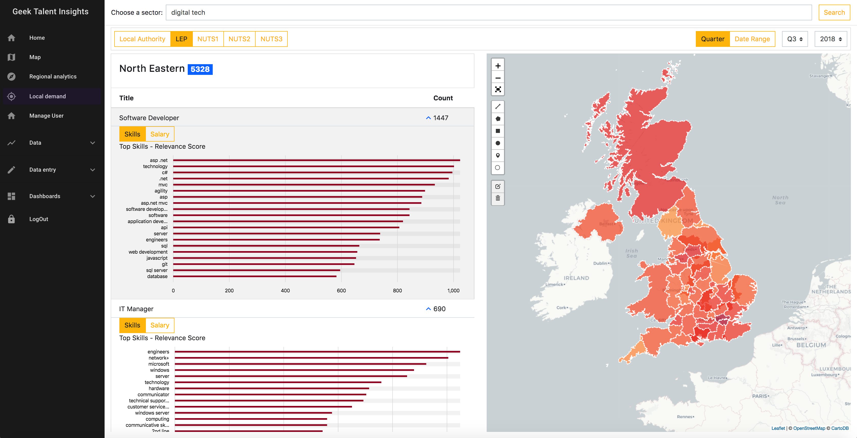
Detailed Skills and Capability view

Slide 4
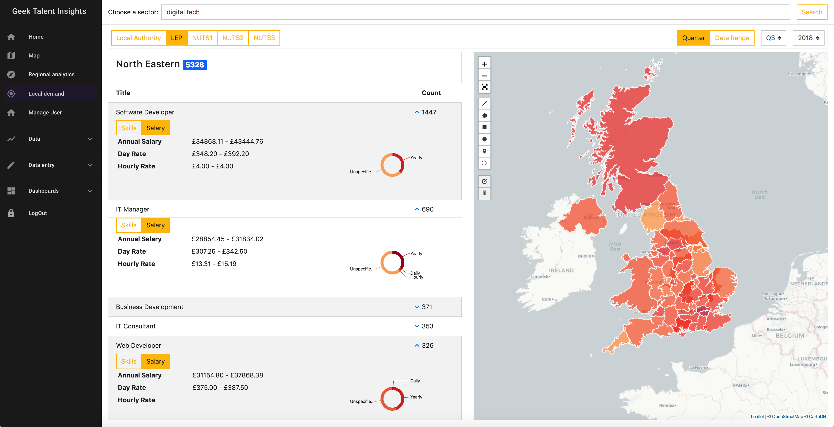
Up-to-date salary data

Slide 5
The changing workplace – tech megatrends
More acceptance within business functions of agile – Time to market Vs. Quality
Team dynamics changing, on-demand workforce
– some productivity tensions e.g. Interrupting the Flow
Rise in Flexible Working
Multi-skilling
General Acceptance of Agile in Business
New Roles/Disciplines
Cross–sector driven by cost reduction or quality improvement
e.g.
Analyst / Programmer or DevOps
Product Management
User Experience
Tech roles embedded within business

Slide 6
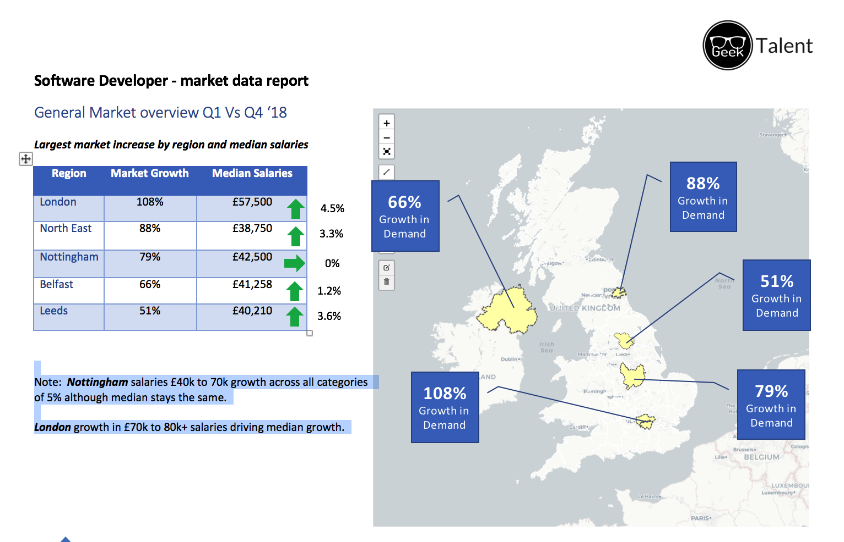
Huge Growth in demand for Software Dev’s

Slide 7
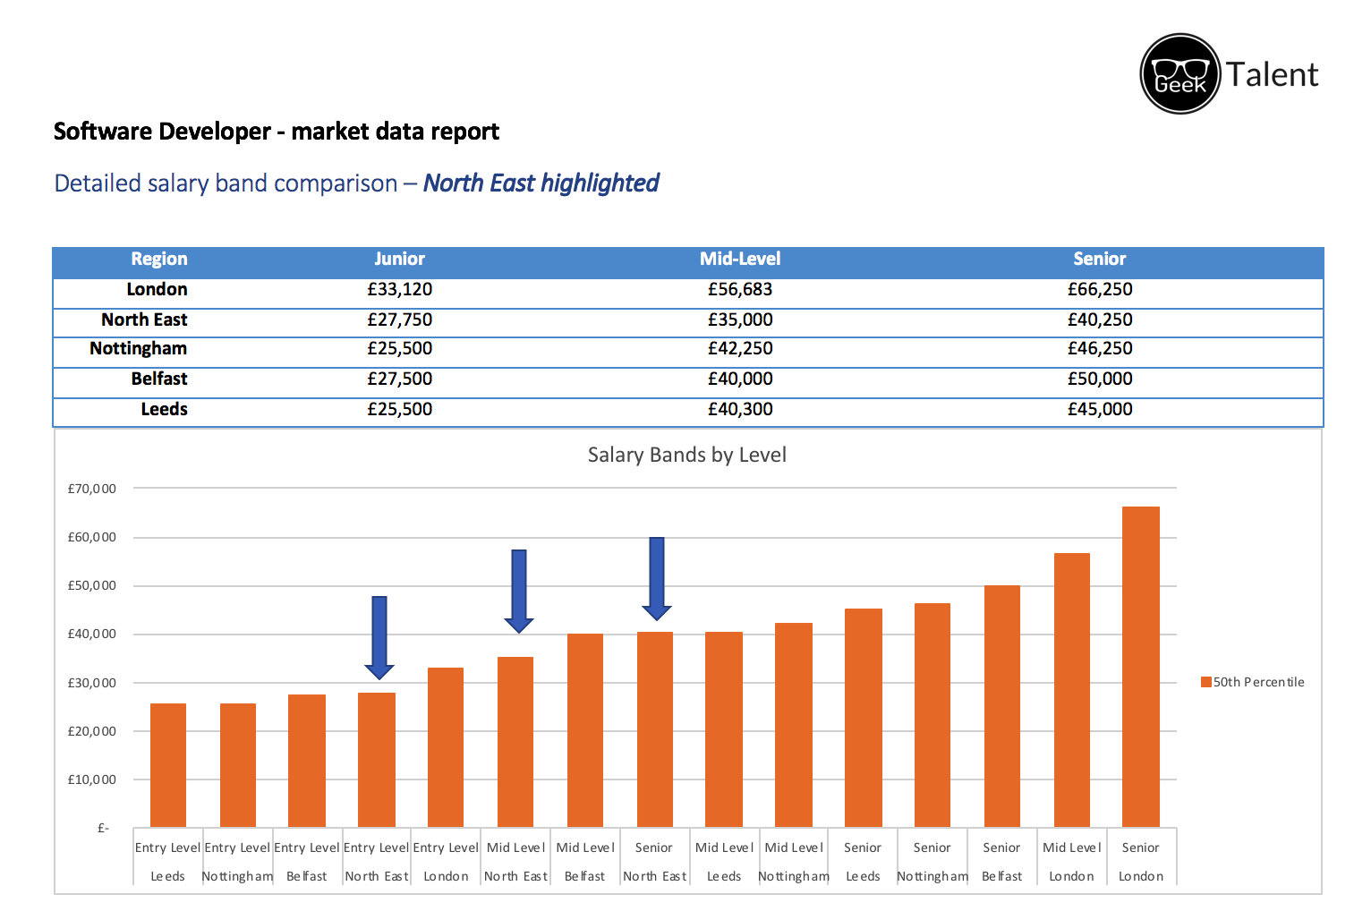
Junior / Mid-Level / Senior bands

Slide 8
Soft’er skills are rising in importance
Soft Skills account for around 5% of overall skills advertised in Job Adverts yet Agility, Communication Skills, Innovation and Problem Solving are frequently within the top 20 in-demand skills requested.

Slide 9
Team roles and top skills
Software
Developer
Project
Manager
Product
Manager
Agility
Communication Skills
Innovation
Problem Solving
Communication Skills
Agility
Team Management
Leadership
Innovation
Presentation
Motivation
Directing
Communication Skills
Innovation
Agility
Team Management
Presentation
Problem Solving
Leadership
Motivation

Slide 10
Open Questions
Are we doing enough to prepare students for the transition into the workplace?
Have we given enough time and focus between hard tech and softer skills required?
How will IOC help to drive changes needed?

