Slide 1
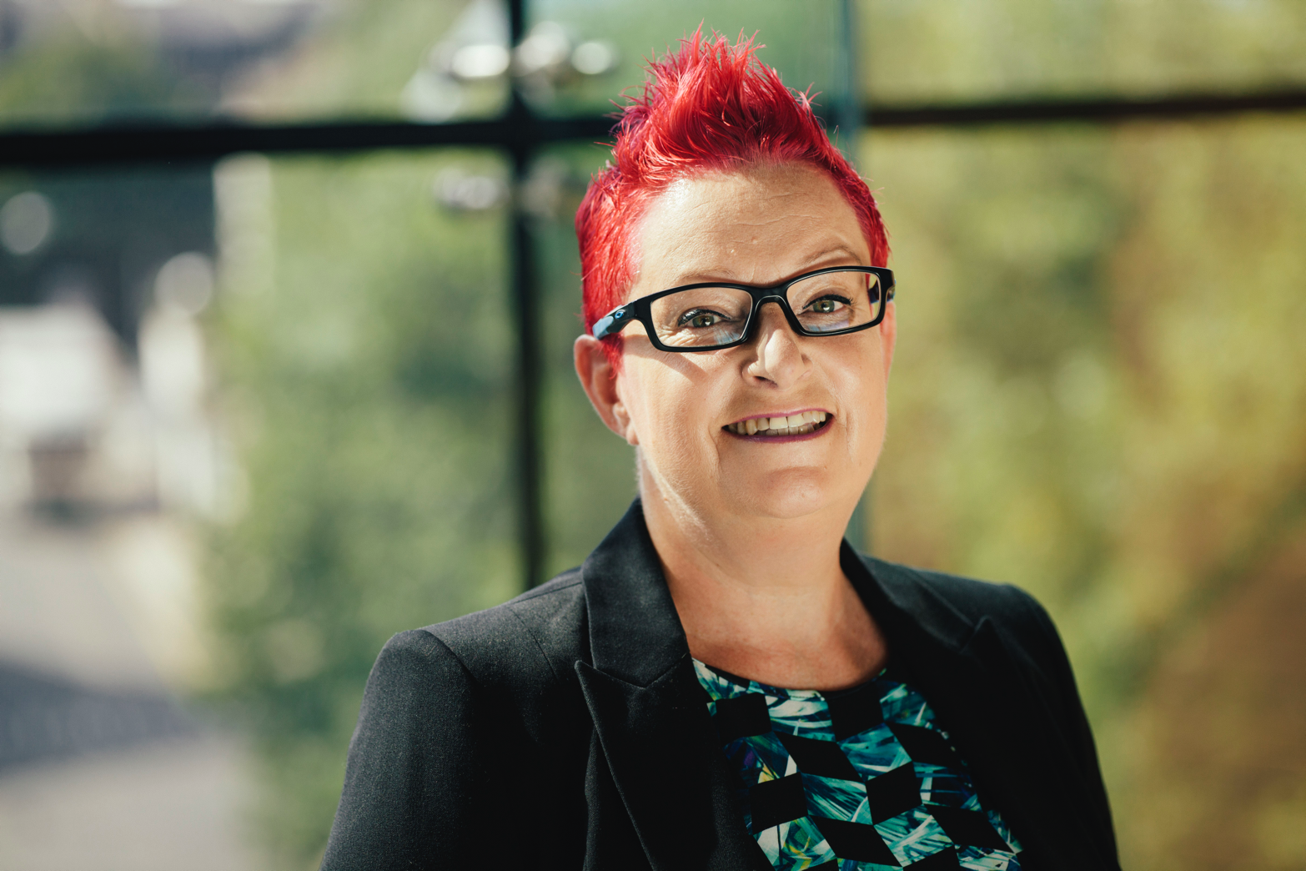
If I can do it,
so can you!
@Dr_Black
sueblack@gmail.com

Slide 2
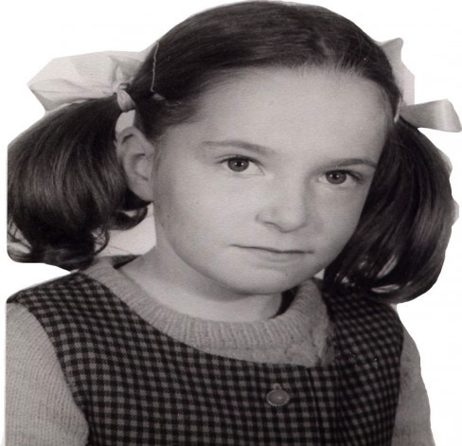

Slide 3
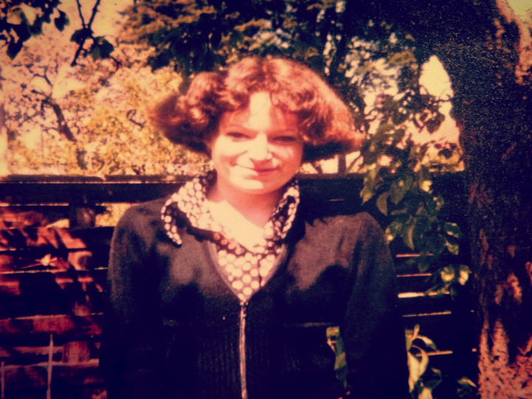

Slide 4
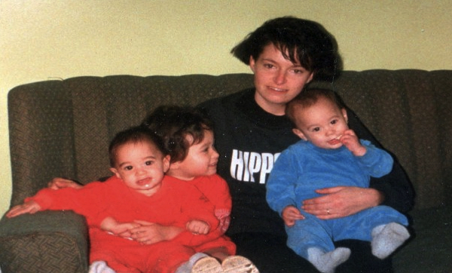
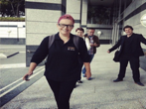

Slide 5
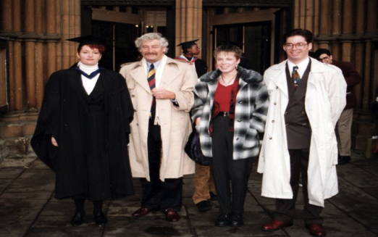

Slide 6
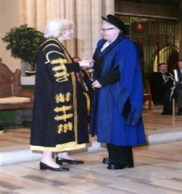
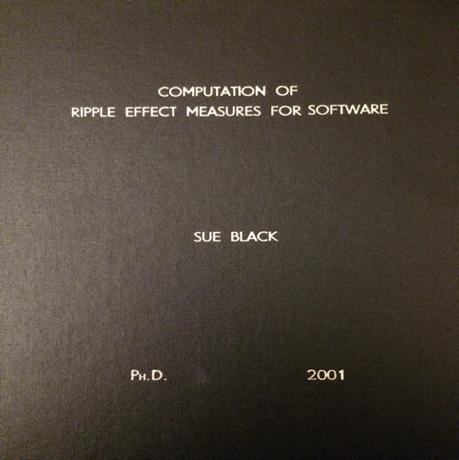

Slide 7
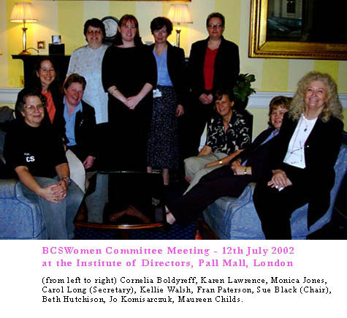

Slide 8
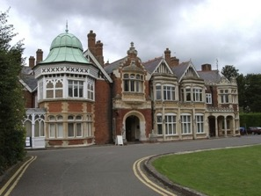
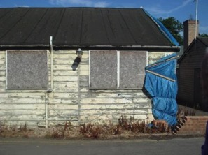
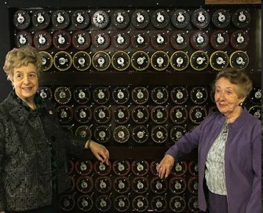
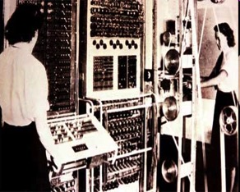
Bletchley Park
One of most important sites of 20th Century
Code breaking in WW2 saved 22 million lives
Enigma 158,184,000,000,000,000,000:1
First programmable, digital computer Colossus developed to break German code
Story kept secret until 1975
Struggled to survive 1992 - 2010
Now recognised as a site of truly international importance

Slide 9
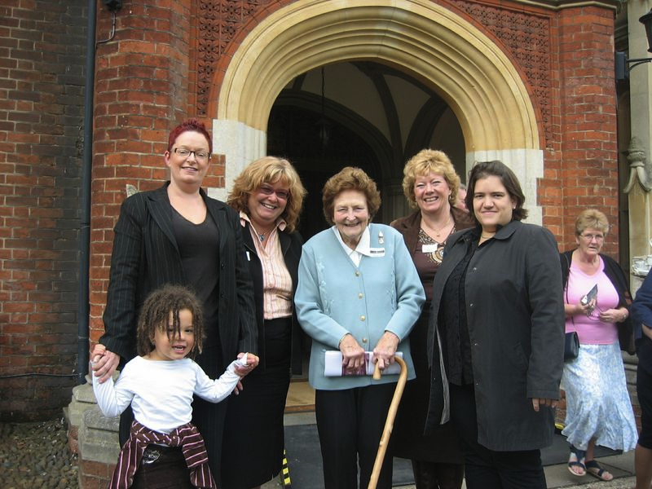

Slide 10
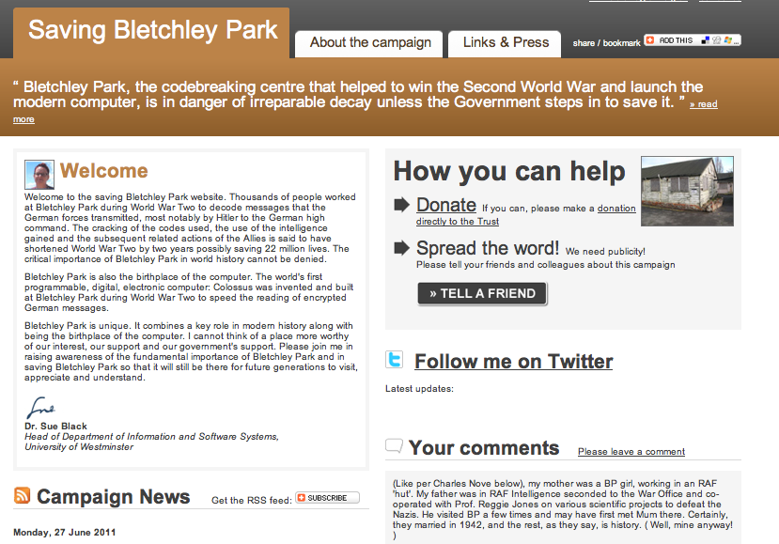

Slide 11
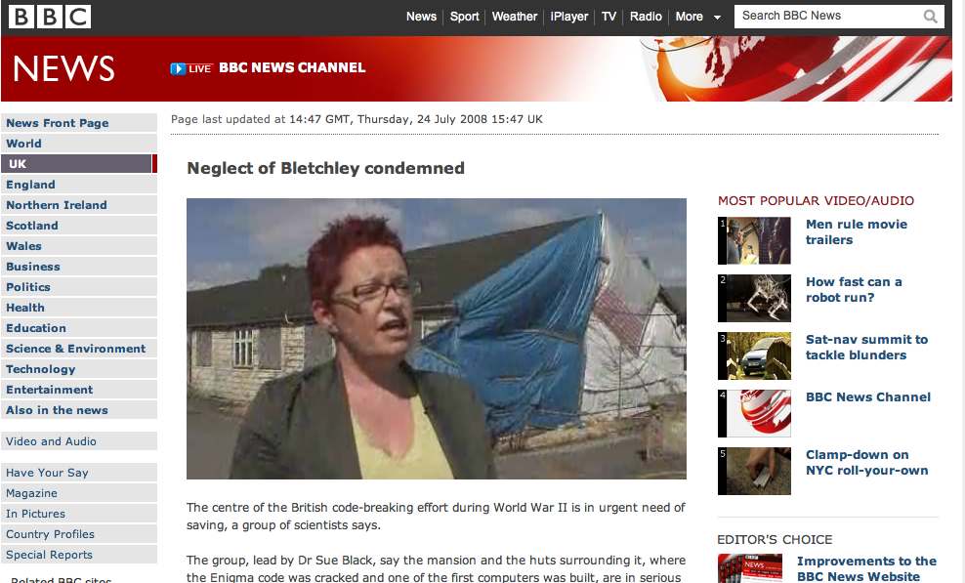

Slide 12
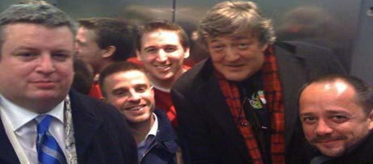
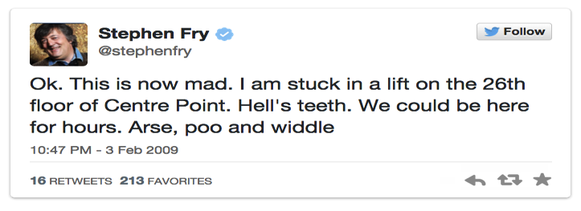

Slide 13
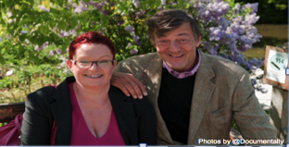
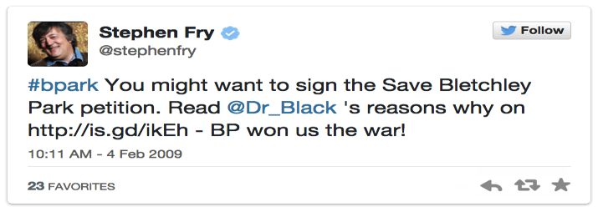

Slide 14
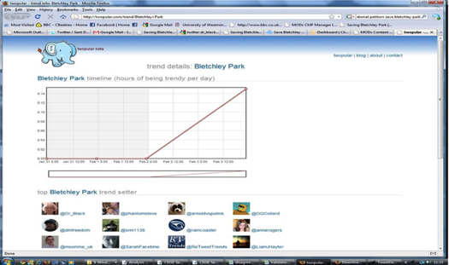
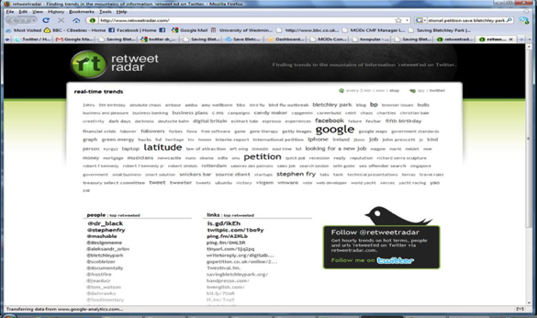
Notes:
I became the most RTed person on Twitter

Slide 15
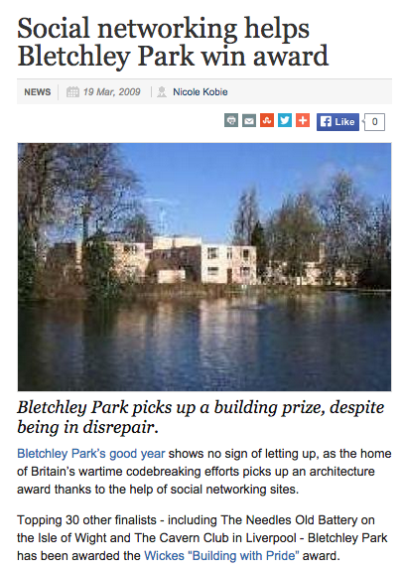
Notes:
1000S PEOPLE JOIN CAMPAIGN
Over time 1000s people got involved
I spent time relentlessly searching for people, chatting to people on twitter trying to find anyone that might be interested.
Every spare minute, in a queue, on hold on the phone, waiting for a train, even on the loo ;)
It was amazing to see so many people spotting opportunities, then letting me know. I’d then alert Bpark and put them in touch with whoever it was if I could get them to chat to me on Twitter. In those days most people responded whoever they were bcos it was a new and exciting thing
It was like we had a twitter taskforce spotting opportunities everywhere
This helped Bpark to win online competitions like the Building with Pride award, we got MK council to support Bpark, we got an EDM set up in Parliament, we crowdfunded a trip to the US for me and Bpark to present our “Can Twitter Save Bpark” paper at the Museums and the Web international conference.
It was such an exciting time

Slide 17
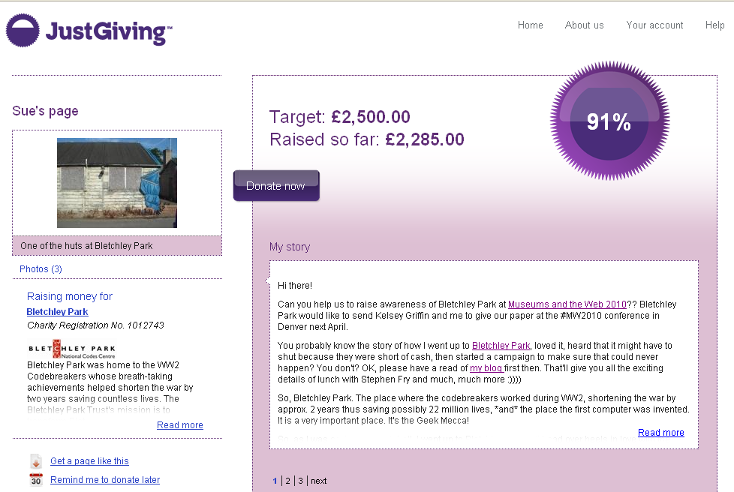

Slide 18
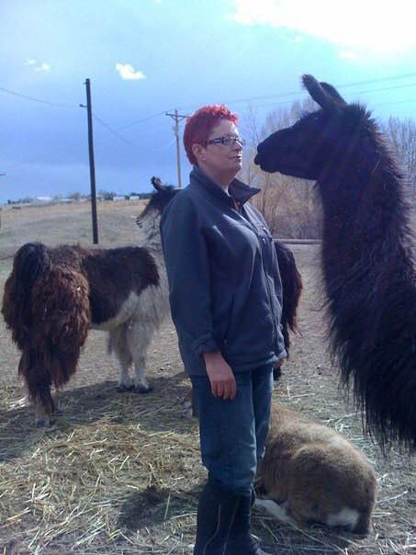

Slide 19
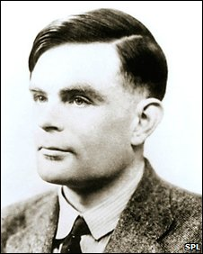
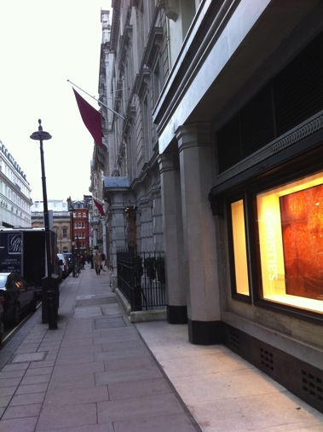
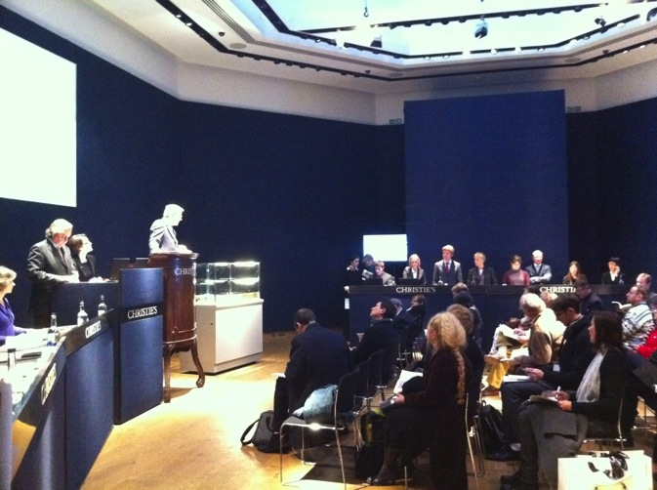
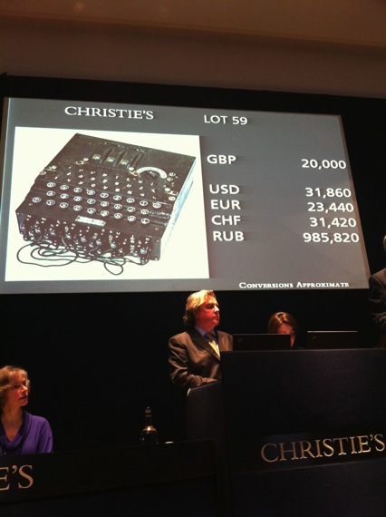
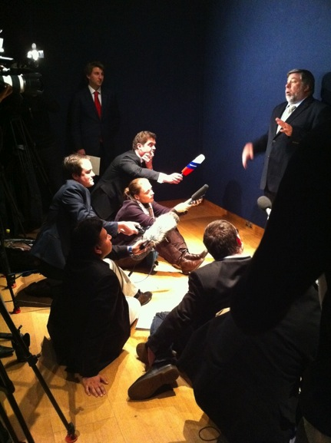
Notes:
The Turing papers came on sale in November 2010. I saw Gareth Halfacree tweeting that he had set up a just giving page, I checked on it a week before the papers were up for sale and saw that it had raised £20k. An amazing amount but not enough to buy the papers. I approached Google VP Megan Smith after a talk she had given asking for help. Simon Meacham from Google got in touch coincidentally the next day via twitter. Between them they got $100k from Google in 4 days over thanksgiving weekend. An amazing achievement ☺

Slide 20
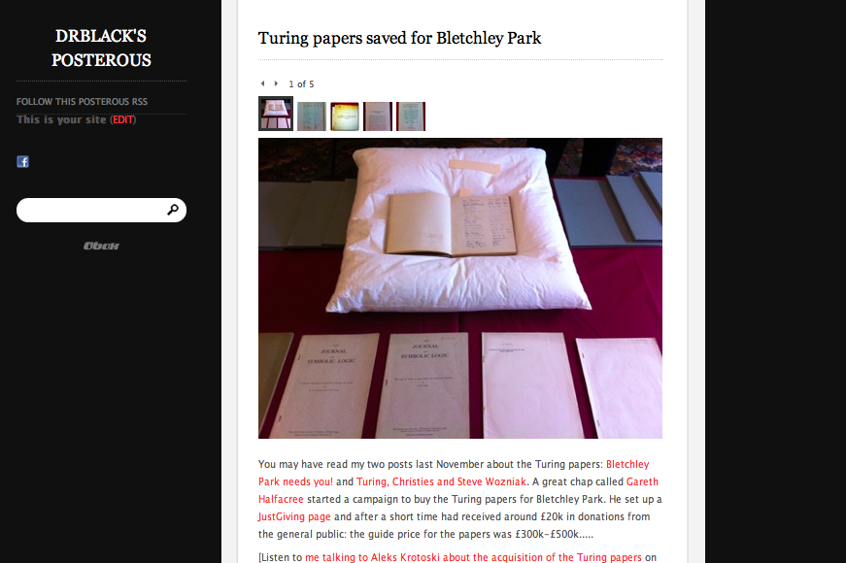
Notes:
The Turing papers were finally bought for Bletchley Park in Feb 2011 and unveiled in 2012

Slide 22
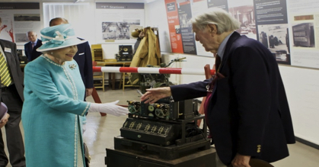

Slide 23
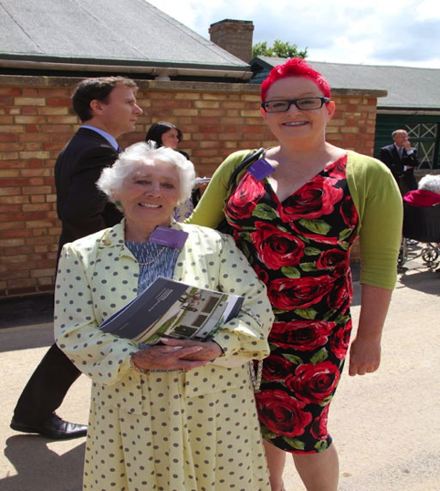
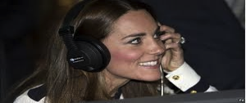
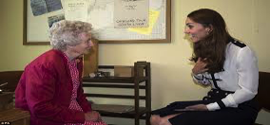
Notes:
R - The Duchess of Cambridge visited BP in 2014, possibly the most photographed woman in the world
L – With my friend Jean Valentine, BP Bombe operator on the day of the Duchess visit

Slide 24
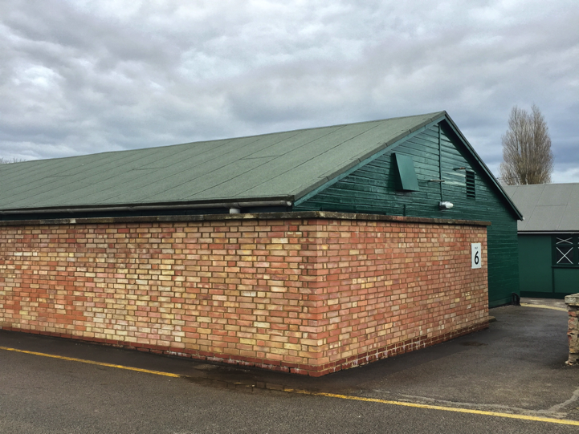
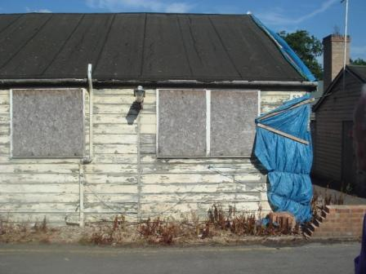
Hut 6
July 2008
April 2014

Slide 26
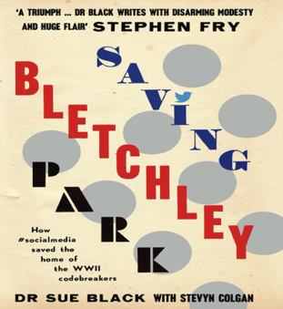
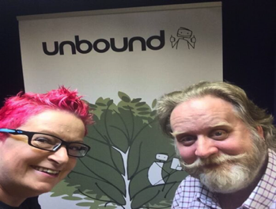

Slide 27
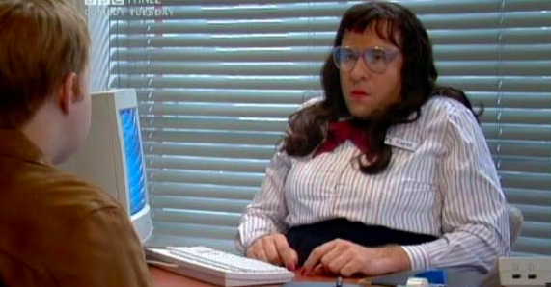

Slide 28
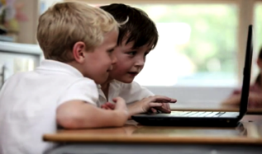
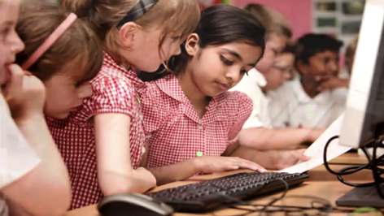
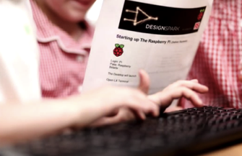

Slide 29
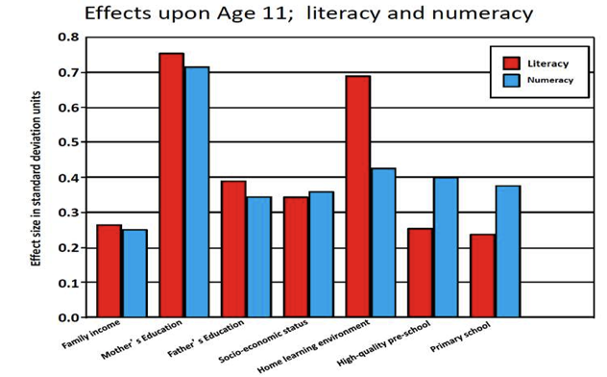

Slide 30
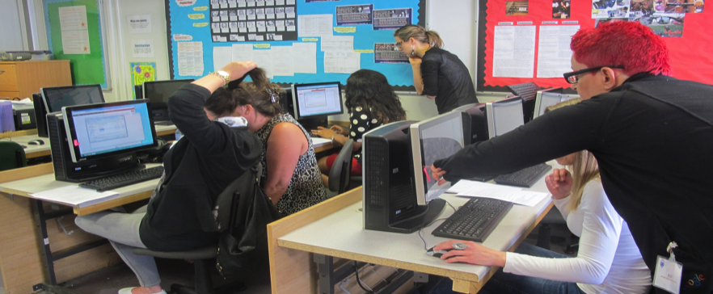
@techmumsHQ

Slide 31
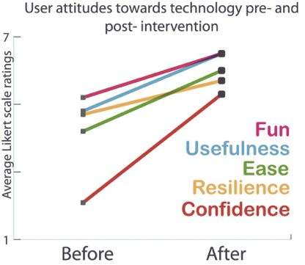

Slide 32
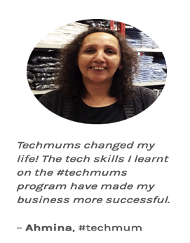
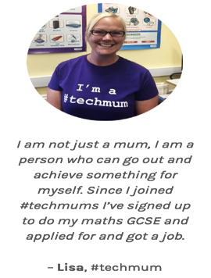

Slide 33
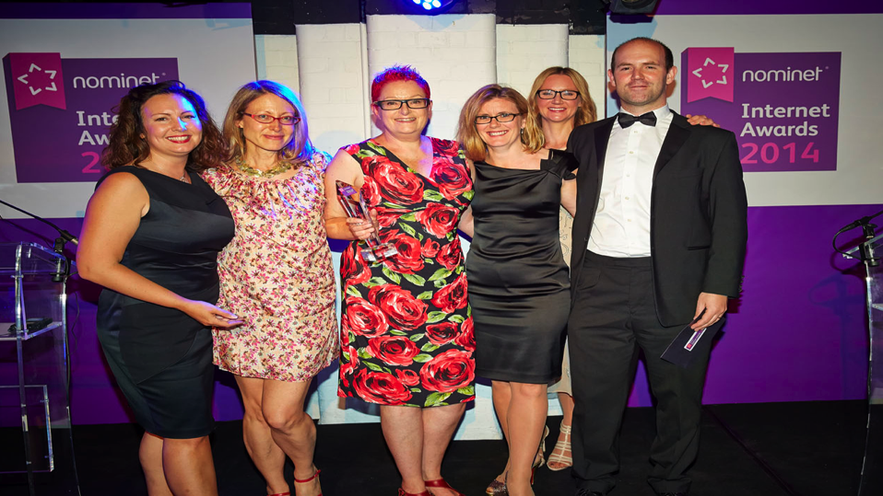

Slide 34
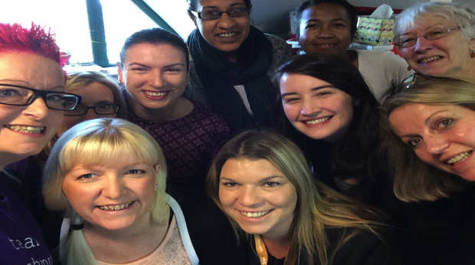

Slide 45
Notes:
http://www.universalchannel.co.uk/news/meet-sue-100-character-uncovered

Slide 47
2018 Winner!
BIMA
Advantage
award for
Inclusion and
Diversity

Slide 50
Current Focus
@Dr_Black

Slide 58
Future Projects Fund
Disruption
Diversity
Collaboration
The Ripple Effect
The journey of one thousand miles begins with a single step…

Slide 59
If I can do it,
so can you!
@Dr_Black
sueblack@gmail.com

