Slide 1
Addressing the gender imbalance in the digital and computing sectors Eliminating Barriers
Gillian Arnold
Director – Tectre
Chair – EU Women in IT Taskforce for CEPIS
Notes:
about yourself and how you came to be the Director of Tectre
whether you think it is difficult for women to rise to senior positions
about the BCS Women network - what it is, how it works
your own experience of networks : have they benefitted your own career, do they benefit others
what actions should we take collectively/individually to ‘make IT Happen for Women’
At this event we will explore the power of networks in enabling women to play an equal part in the IT workplace. We seek to raise awareness among women and girls of networks within the community and within companies such as the BCS, Deloitte and the BBC and to ask questions about how they work and what successes have been achieved.
Some are skeptical about women-only networks saying these groups are often used “more to placate women than to promote them” or express doubt that women’s networking groups “can help a young woman break into the boy’s club.”
The number of women in key roles in the technology industry has remained roughly unchanged for 10 years, according to a recent Gartner report. Will it remain the same for the next 10 years? How can we make IT happen for women?
In the tradition of Manchester Girl Geeks, this event will be fun and highly interactive including debate, flash talks and panel sessions.Understanding the impact of 'Unconscious Bias' is important to management within organisations which are trying to raise their levels of diversity. Gillian Arnold will outline the topic and how it can be introduced to the senior and middle management within a company to ensure that these senior figures, who wield the power to hire, appraise and fire, are fully aware of the impact of their underlying mind-set.

Slide 2
Does the glass ceiling still exist?

Slide 3
Women make up 47% of the UK workforce but 17% of the IT workforce
Less than 11% of IT Directors are female
Female IT Managers earn less than males – 22% Less!
58% of Fortune 500 CEO’s
are six foot tall or higher,
yet only 14.5% of the male
population are that height
Women(12.2%) and BAME(10%) employees are less likely to be identified as high potential than white males(20%)

Slide 4
BCS Women in IT Scorecard – IT Workforce

Slide 5
Gross weekly pay (median) for permanent, full-time IT specialist employees
 | Female full-time | Male full-time | Difference
 |  |  | (£) | (%)
IT Directors | £1,240 | £1,250 | £10 | 1%
IT Professionals: | £700 | £790 | £90 | 13%
IT specialist managers | £760 | £880 | £120 | 17%
IT Project & Programme Managers | £840 | £970 | £130 | 16%
IT Business Analysts, Architects & Systems Designers | £670 | £850 | £180 | 27%
Programmers & software development professionals | £710 | £760 | £50 | 7%
Web design & development professionals | £570 | £540 | -£30 | -5%
Other IT professionals | £640 | £750 | £110 | 17%
IT Technicians: | £500 | £560 | £50 | 10%
IT Operations Technicians | £520 | £550 | £30 | 6%
IT User Support Technicians | £490 | £560 | £70 | 14%
IT Engineers | - | £480 | - | -
Source: Analysis of ONS ASHE data undertaken by The Tech Partnership

Slide 6
Panels in the glass ceiling
Societal
Lack of supply related to educational opportunity
Internal Structural
Recruitment practice which doesn’t target women or PCs
Governmental
Monitoring
Law Enforcement
Weakness in companies reporting data
Lack of understanding about glass ceiling issues
Corporate culture
Pipeline nurturing activities lacking
Conscious and unconscious bias
USA – 1995 – Glass Ceiling Commission
Notes:
The incidence of uptake of flexible working in the IT worksforce is higher at 20% than in the normal workforce (10%) in the UK (see 2015 Stats from BCS)
In the USA in 1995 they had glass ceiling commission who published a report which said that there were 3 main constructs to the glass ceiling – namely - The three levels of barriers identified by the Commission research, CEO studies, and focus groups are these: • Societal Barriers which may be outside the direct control of business .—The Supply Barrier related to educational opportunity and attainment —The Difference Barrier as manifested in conscious and unconscious stereotyping, prejudice, and bias related to gender, race, and ethnicity. • Internal Structural Barriers within the direct control of business —Outreach and recruitment practices that do not seek out or reach or recruit minorities and women —Corporate climates that alienate and isolate minorities and women —Pipeline Barriers that directly affect opportunity for advancement —Initial placement and clustering in staff jobs or in highly technical and professional jobs that are not on the career track to the top —Lack of mentoring —Lack of management training —Lack of opportunities for career development, tailored training, and rotational job assignments that are on the revenue-producing side of the business —Little or no access to critical develop mental assignments such as memberships on highly visible task forces and committees —Special or different standards for performance evaluation —Biased rating and testing systems —Little or no access to informal networks of communication —Counterproductive behavior and harassment by colleagues • Governmental Barriers —Lack of vigorous, consistent monitoring and law enforcement —Weaknesses in the formulation and collection of employment-related data which makes it difficult to ascertain the status of groups at the managerial level and to disaggregate the data —Inadequate reporting and dissemination of information relevant to glass ceiling issues

Slide 7
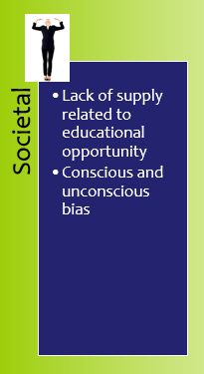
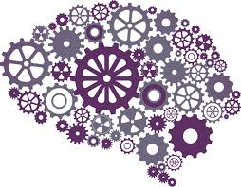
Unconscious Bias
Class
Religion
Income
Ethnicity
Mental
Ability
Sexual
Orientation
Culture
Education
Upbringing
Gender
Physical
Ability
Age
Unintentional and automatic people preferences which may lead us to favour some people over others and which bypass our self awareness.
© Tectre Ltd 2014
Notes:
Reflective system
Conscious, explicit
Effortful, requires motivation
Takes more time
Reflexive system Often unconscious, implicit
Requires little effort
Fast
These preferences lead us to favour some people over others in the way we behave. These preferences often bypass our self awareness because they operate automatically and without our conscious intention, and because we all have a bias blind spot where we can see bias in others but not in ourselves.
Unintentional and automatic people preferences. We ALL have them. We are ALL inclined to prefer people who look like ourselves, sound like ourselves and share our values and beliefs.
Unintentional and automatic people preferences. We ALL have them. We are ALL inclined to prefer people who look like ourselves, sound like ourselves and share our values and beliefs.
Unintentional and automatic people preferences. We ALL have them. We are ALL inclined to prefer people who look like ourselves, sound like ourselves and share our values and beliefs.
Natural defence mechanism – kept our species going
Risky when allowed to dominate business decisions
Need awareness – conscious mind overrides sub-conscious
Conscious versus unconscious biases?

Slide 8
Job Applications/Recruitment Practice – Hays: Research
1000+ Hiring Managers
1 CV
Simon
Susan
© Tectre Ltd 2014
Notes:
When presented with two equally qualified candidates, one male and one female, a study of hiring managers shows the man is more likely to get an interview.
In the study by recruiting experts Hays in conjunction with diversity and employee survey specialists, Insync Surveys, 1029 hiring managers were asked to review a CV then answer a series of questions about the candidate’s attributes, skills and probability they would be interviewed. 515 reviewed the CV of ‘Susan’ and 514 reviewed an identical CV but for one notable change – the name was altered to ‘Simon’.
The study found:
More recruitment experience means more bias
Survey respondents who hire more than 20 people a year were more likely to interview ‘Simon’ over ‘Susan’ (65 per cent versus 51 per cent).
For hiring managers who recruited less regularly, the gap between ‘Susan’ and ‘Simon’ reduced to just 3 per cent.
The bigger the business the bigger the bias
62 per cent of respondents from organisations with over 500 staff said it was extremely probable that they would interview ‘Simon’; 56 per cent would interview ‘Susan’.
In organisations with less than 500 staff this interview bias almost disappears.
We prefer candidates just like us – but still hire more men
Female respondents said ‘Susan’ matched 14 of the 20 attributes needed for the job extremely well, but ‘Simon’ only matched 6 of the 20 attributes extremely well.
Men said ‘Simon’ matched 14 of the 20 attributes extremely well, but ‘Susan’ matched only 6 of the 20 attributes extremely well.
Despite this, both genders were significantly more likely to interview and hire ‘Simon’ rather than ‘Susan’.
Public and not-for-profit bias towards women
31 per cent of public and not-for-profit respondents said ‘Simon’ had the leadership skills to do the job, compared to 42 per cent in the private sector.
Public and not-for-profit sector respondents were also more likely to see ‘Susan’ rather than ‘Simon’ as having the technical skills (36 per cent versus 30 per cent) and leadership skills (39 per cent versus 31 per cent) to perform the role.
Organisations are still not serious (enough) about gender diversity
56 per cent of hiring managers said plans and resources need to be put in place or improved to help achieve gender diversity in their organisation.
44 per cent said their CEO is not serious enough about achieving gender diversity in their organisation.
39 per cent said their senior executives need to be better role models of diversity and inclusiveness.
Implications for the world of work
“At Hays, we’ve seen countless cases of hiring managers who are presented with a gender diverse shortlist but select more men than women for interview,” says Nick Deligiannis, Managing Director of Hays in Australia & New Zealand.
“Few would admit to bias but our survey results show it does exist – particularly in Australia’s largest businesses.
“It is also more likely in those who hire most frequently. This is an interesting finding since unconscious bias is more likely to impact decisions that are made quickly. Such managers would say they rely on their experience but possibly their decisions are less deliberate and therefore when an unconscious bias exists it affects their hiring decisions. In comparison, people who do not have as much hiring experience are more considered in their decisions.
“We also found that there is bias towards women in the public and not-for-profit sector and men in the private sector. This reinforces stereotypes of women being better at ‘taking care’ and men at ‘doing business’ and ‘being decisive’.
“Having unconscious beliefs isn’t the problem”, says Nicholas Barnett, CEO at Insync Surveys. “All of us have them to some extent. Not knowing we have them, not acknowledging them and not seeking to challenge them is a problem. Research actually shows that people who say they don’t have unconscious beliefs make more biased decisions than those who acknowledge their unconscious beliefs.”
Nick Deligiannis says: “This study also shows that more needs to be done to educate hiring managers around gender diversity policies and to get commitment from senior executives to openly support gender diversity. But no amount of gender diversity policy promotion will, in isolation, overcome gender or affinity bias.
Certainly there are still questions to answer, but we hope our findings are a catalyst that sparks continued and important dialogue about gender diversity in Australia.”
For more, see the Hays/Insync Surveys report “Gender diversity: Why aren’t we getting it right”.
Hays, the world’s leading recruiting experts in qualified, professional and skilled people.
- Ends -

Slide 9
Hays – Research
1000+ Hiring Managers
1 CV
Respondents who hire more than 20 people a year were more likely to interview ‘Simon’ over ‘Susan’ (65% vs 51%).
62% of respondents from organisations with over 500 staff said it was extremely probable that they would interview ‘Simon’; 56% would interview ‘Susan’.
In organisations with less than 500 staff this interview bias almost disappears.
Female respondents said ‘Susan’ matched 14/20 of the attributes needed for the job extremely well, but ‘Simon’ only matched 6 of the 20 attributes extremely well.
Males said ‘Simon’ matched 14/20 of the attributes extremely well, but ‘Susan’ matched only 6 of the 20 attributes extremely well.
Despite this, both genders were significantly more likely to interview and hire ‘Simon’ rather than ‘Susan’.
Simon
Susan
© Tectre Ltd 2014
Notes:
When presented with two equally qualified candidates, one male and one female, a study of hiring managers shows the man is more likely to get an interview.
In the study by recruiting experts Hays in conjunction with diversity and employee survey specialists, Insync Surveys, 1029 hiring managers were asked to review a CV then answer a series of questions about the candidate’s attributes, skills and probability they would be interviewed. 515 reviewed the CV of ‘Susan’ and 514 reviewed an identical CV but for one notable change – the name was altered to ‘Simon’.
The study found:
More recruitment experience means more bias
Survey respondents who hire more than 20 people a year were more likely to interview ‘Simon’ over ‘Susan’ (65 per cent versus 51 per cent).
For hiring managers who recruited less regularly, the gap between ‘Susan’ and ‘Simon’ reduced to just 3 per cent.
The bigger the business the bigger the bias
62 per cent of respondents from organisations with over 500 staff said it was extremely probable that they would interview ‘Simon’; 56 per cent would interview ‘Susan’.
In organisations with less than 500 staff this interview bias almost disappears.
We prefer candidates just like us – but still hire more men
Female respondents said ‘Susan’ matched 14 of the 20 attributes needed for the job extremely well, but ‘Simon’ only matched 6 of the 20 attributes extremely well.
Men said ‘Simon’ matched 14 of the 20 attributes extremely well, but ‘Susan’ matched only 6 of the 20 attributes extremely well.
Despite this, both genders were significantly more likely to interview and hire ‘Simon’ rather than ‘Susan’.
Public and not-for-profit bias towards women
31 per cent of public and not-for-profit respondents said ‘Simon’ had the leadership skills to do the job, compared to 42 per cent in the private sector.
Public and not-for-profit sector respondents were also more likely to see ‘Susan’ rather than ‘Simon’ as having the technical skills (36 per cent versus 30 per cent) and leadership skills (39 per cent versus 31 per cent) to perform the role.
Organisations are still not serious (enough) about gender diversity
56 per cent of hiring managers said plans and resources need to be put in place or improved to help achieve gender diversity in their organisation.
44 per cent said their CEO is not serious enough about achieving gender diversity in their organisation.
39 per cent said their senior executives need to be better role models of diversity and inclusiveness.
Implications for the world of work
“At Hays, we’ve seen countless cases of hiring managers who are presented with a gender diverse shortlist but select more men than women for interview,” says Nick Deligiannis, Managing Director of Hays in Australia & New Zealand.
“Few would admit to bias but our survey results show it does exist – particularly in Australia’s largest businesses.
“It is also more likely in those who hire most frequently. This is an interesting finding since unconscious bias is more likely to impact decisions that are made quickly. Such managers would say they rely on their experience but possibly their decisions are less deliberate and therefore when an unconscious bias exists it affects their hiring decisions. In comparison, people who do not have as much hiring experience are more considered in their decisions.
“We also found that there is bias towards women in the public and not-for-profit sector and men in the private sector. This reinforces stereotypes of women being better at ‘taking care’ and men at ‘doing business’ and ‘being decisive’.
“Having unconscious beliefs isn’t the problem”, says Nicholas Barnett, CEO at Insync Surveys. “All of us have them to some extent. Not knowing we have them, not acknowledging them and not seeking to challenge them is a problem. Research actually shows that people who say they don’t have unconscious beliefs make more biased decisions than those who acknowledge their unconscious beliefs.”
Nick Deligiannis says: “This study also shows that more needs to be done to educate hiring managers around gender diversity policies and to get commitment from senior executives to openly support gender diversity. But no amount of gender diversity policy promotion will, in isolation, overcome gender or affinity bias.
Certainly there are still questions to answer, but we hope our findings are a catalyst that sparks continued and important dialogue about gender diversity in Australia.”
For more, see the Hays/Insync Surveys report “Gender diversity: Why aren’t we getting it right”.
Hays, the world’s leading recruiting experts in qualified, professional and skilled people.
- Ends -

Slide 10
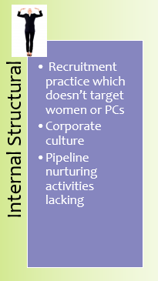
Micro Inequities
Micro-inequities are subtle, often unconscious, messages that devalue, discourage and impair workplace performance.
They are conveyed through facial expressions, gestures, tone of voice, choice of words, nuance and syntax.
Wikipedia - 2016
Examples: Confusing a black person of colour with another person of the same colour.
Checking emails or texting during a face-to-face conversation
Rolling your Eyes
Making jokes aimed at certain minority groups
Not registering a persons contributions
© Tectre Ltd 2014
Notes:
Psychology Today:
In 1973 Mary Rowe, while working for the President and Chancellor at MIT, coined the notion of micro-inequities, which she defined as “apparently small events which are often ephemeral and hard-to-prove, events which are covert, often unintentional, frequently unrecognized by the perpetrator, which occur wherever people are perceived to be ‘different.’ " Examples of micro-inequities include:
checking emails or texting during a face-to-face conversation
consistently mispronouncing a person's name
Saying ‘are you a man or a mouse’
interrupting a person mid-sentence
making eye-contact only with males while talking to a group containing both males and females
taking more questions from men than women
confusing a person of a certain ethnicity with another person of the same ethnicity
rolling your eyes
sighing loudly
raising your voice, even though the other person has no difficulties hearing you
mentioning the achievements of some people at a meeting but not others whose achievements are equally relevant
consistently ignoring a person's emails for no good reason
only reading half of a person's email and then asking the person about the content later
making jokes aimed at certain minority groups
being completely unpredictable in your grading of certain people's term papers
issuing invitations that are uncomfortable for certain groups (“Please feel free to bring your wife,” "There is a link below to childcare options for female speakers who plan to bring their children," “There will be a belly-dancer at the party,“ "Our annual Christmas party will be held on December 18,” "Please bring pork chops to the potluck dinner")
Rowe noted that micro-inequities often had serious cumulative, harmful effects, resulting in hostile work environments and continued minority discrimination in public and private workplaces and organizations. What makes micro-inequities particularly problematic is that they consist in micro-messages that are hard to recognize for victims, bystanders and perpetrators alike. When victims of micro-inequities do recognize the micro-messages, Rowe argues, it is exceedingly hard to explain to others why these small behaviors can be a huge problem.
In 2013, 40 years later, we still find micro-inequities in the workplace. There has, admittedly, been a wide range of efforts to call attention to micro-inequities through seminars and workshops. But the issue continues to be a major problem at least in the workplaces

Slide 11
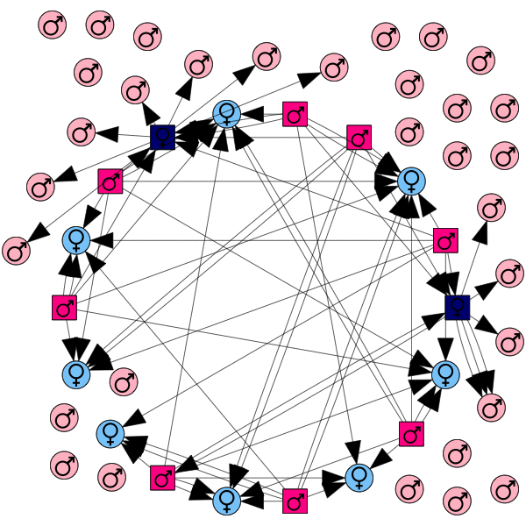
20% women is a gender ratio is 1:4
In our model organisation, everyone makes the same number of sexist remarks or micro-inequities to everyone else
4 times as many men do this, so 4 times as many remarks or micro-inequities are made to women as to men.
There are 4 times fewer women to receive remarks or micro-inequities, so each individual woman is four times as likely to receive them than an individual man is.
These effects multiply, so in this example the mean number of sexist remarks per woman is 16 times the number per man.
So – with a gender ratio of 1:n, women will receive n² times as many remarks or micro-inequities as men.
The Petrie Multiplier

Slide 12
Recruitment Practice
Positive Action
Take some risks
Challenge your recruiters
Educate the Hiring managers and address stereotypes
Supporting policies on CVs, Interviewing, Assessment
Advertising and Job Specs

Slide 13
Characteristics of successful Company Fixes
‘outreach, recruitment, and
Identification of potential leaders
are basic elements of any long-range
plan to eliminate the glass ceiling’
Organisation Specific
Programmes
CEO Support
Monitor and track progress
Addressing
Stereotypes
Everyone is accountable
Cultural and Management Training
Must be multifaceted programmes
‘single pronged programmes
have little effect on glass ceilings. Isolated
Interventions here or there, however
brilliant, do not result in lasting change.’
‘the top leadership team….must
communicate its desire down the line and
then support its message with clearly defined
expectations.’
Notes:
48% of men see themselves as “extremely or very ambitious” whilst only 35% of women have a comparable self image. (Harvard Business Review)
15% of highly qualified women aspire to positions of power as opposed to an average of 27% men. (Harvard Business Review)
The pay gap is partly caused by the under-valuing of part-time work, which is predominantly carried out by women. Women are therefore more likely to be held back in lower paid and lower status positions than men.”
Women make up 47% of pc users in Europe.
93% of women who have taken career breaks and intended to get back to work, only 74% managed to do so and only 40% found full time work (McKinsey)
Promote yourself and be assertive about your performance and ambitions
Recognise your talents, understand your own worth.
Get a group of trusted mentors
Look at role models constantly
Set your own objectives where there are none set for you
Join your professional organisations and take advantage (IET, IEE, REng, BCS, CIM)
Find an assertiveness course quickly and use the principles
Ask for a pay rise annually, ask for one at the start!
Take some risks
Evaluate your manager

Slide 14
70% of female respondents rate their own performance as equivalent to that of their co-worker while 70% of men rate themselves higher than co-workers
(McKinsey)
48% of men see themselves as “extremely or very ambitious” whilst only 35% of women have a comparable self image. (Harvard Business Review)
15% of highly qualified women aspire to positions of power as opposed to an average of 27% men. (Harvard Business Review)

Slide 15
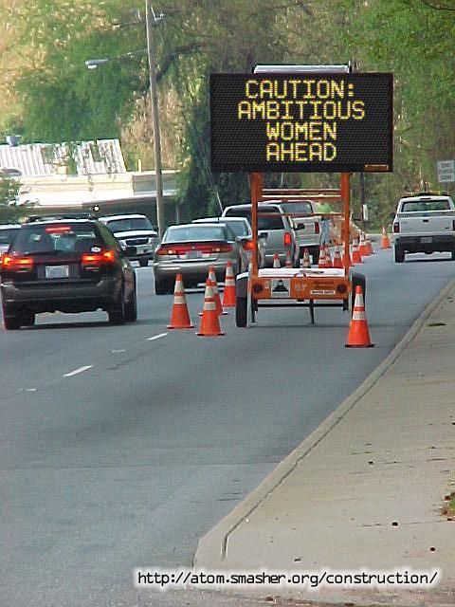
Breaking Through

