Slide 1
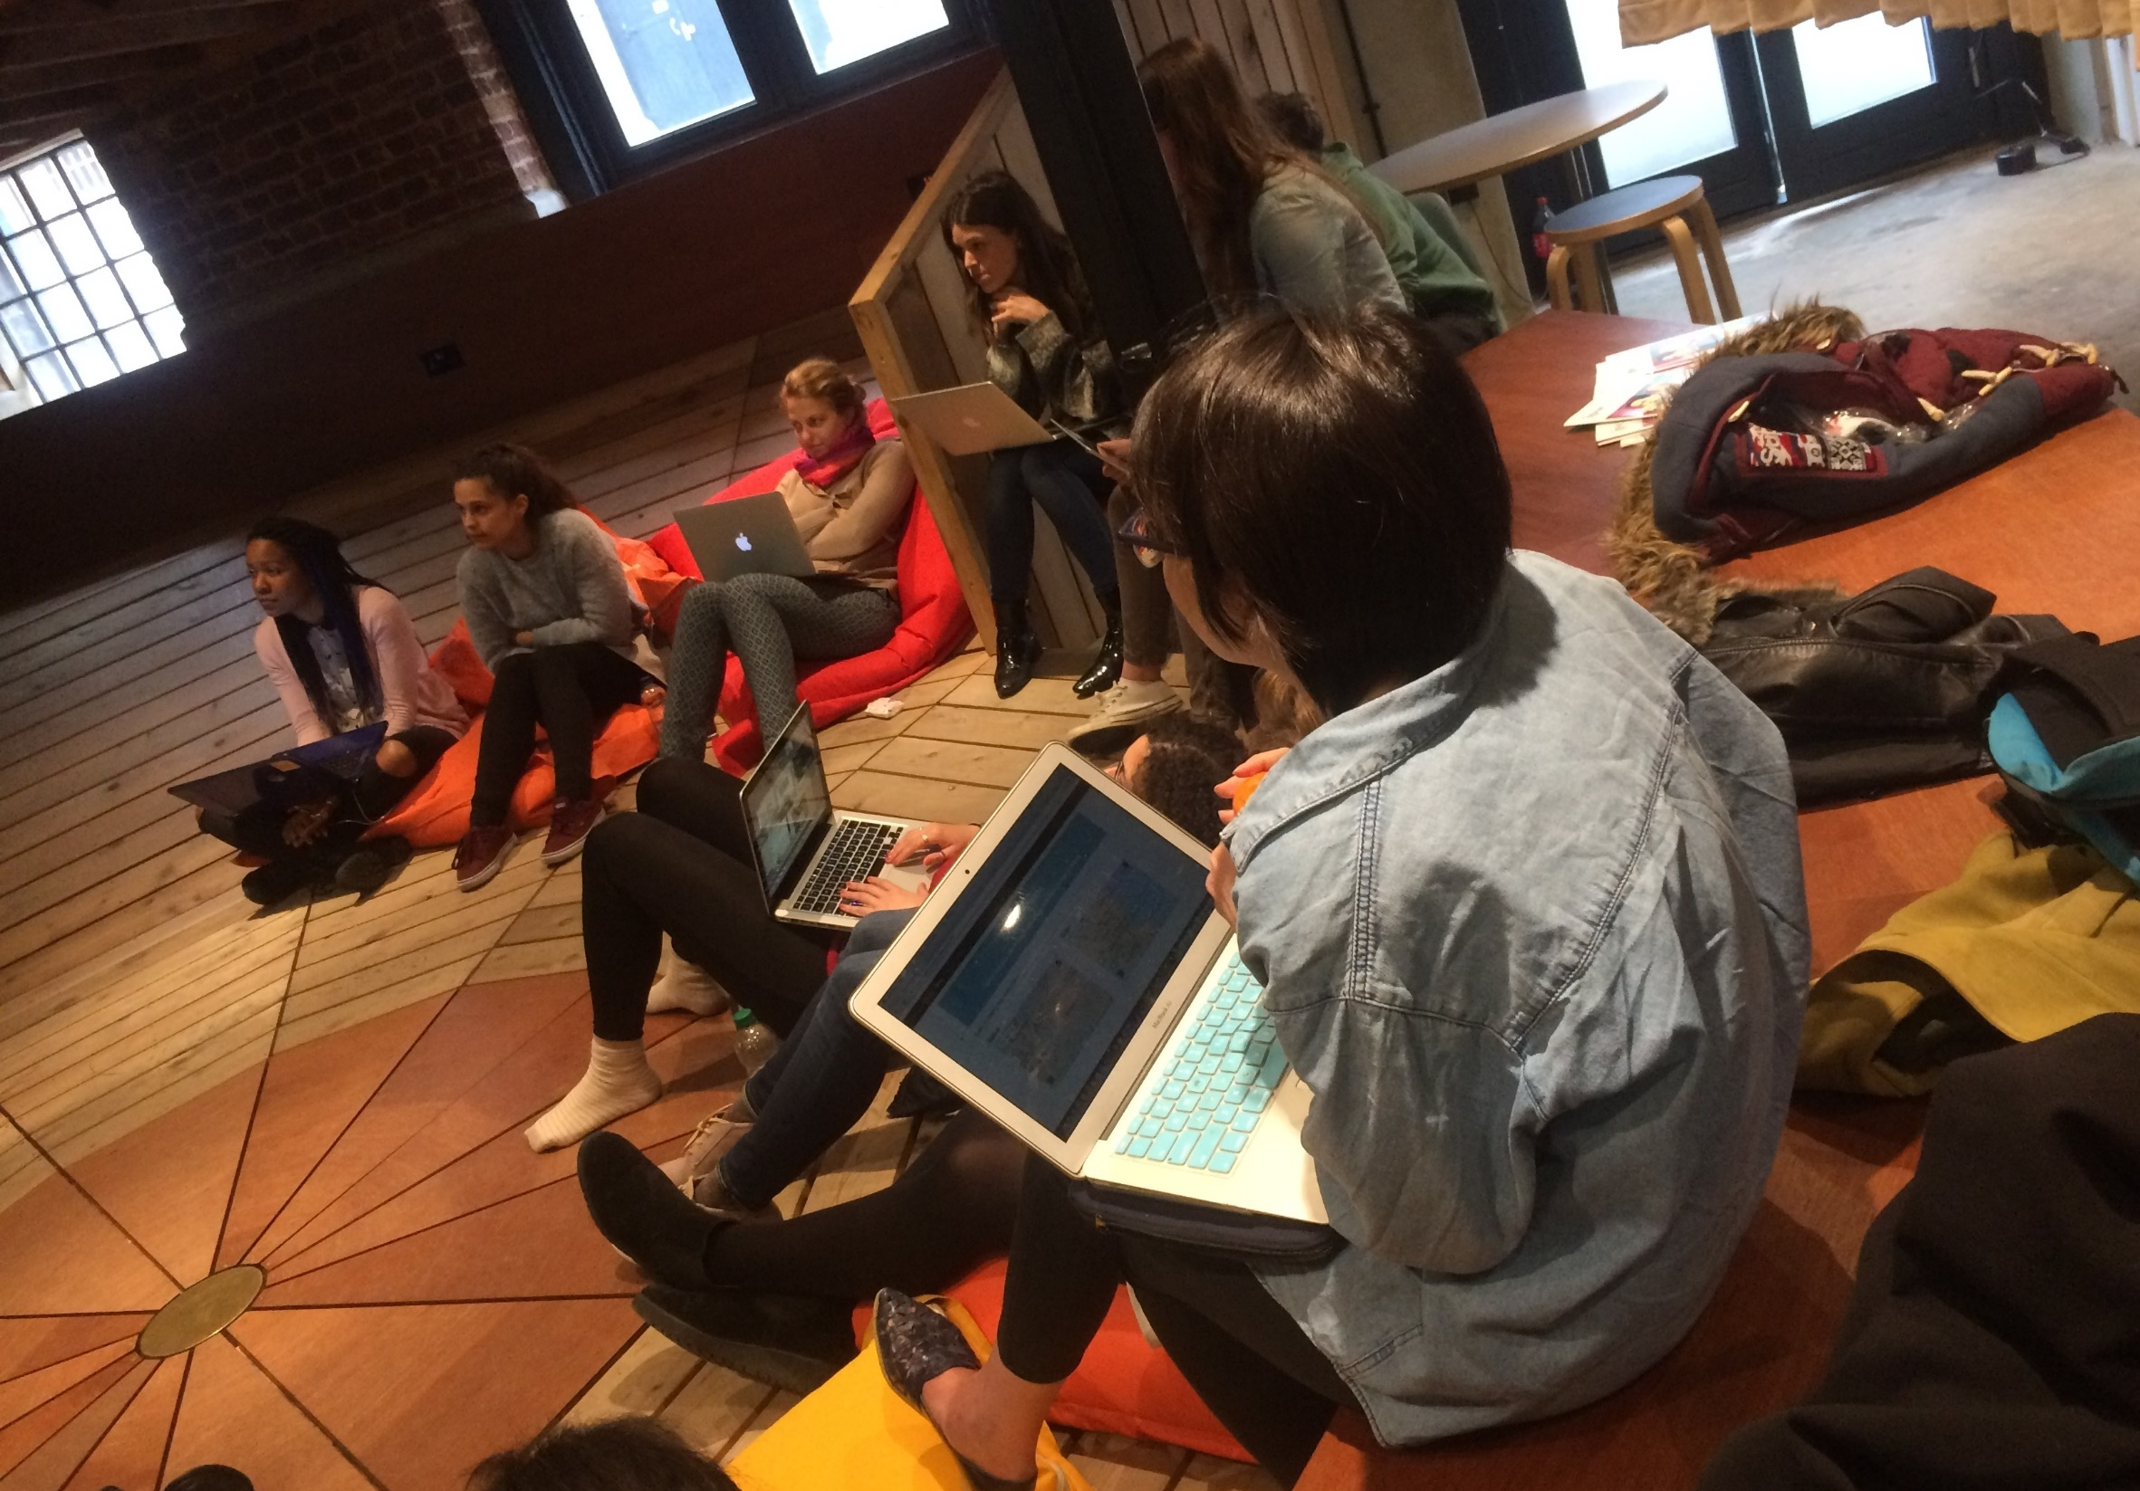
The Code First: Girls take: Building tech skills foundations
www.CodeFirstGirls.org.uk @CodeFirstGirls @amali_d
Notes:
Much has been said about how the tech sector has struggled to achieve inclusivity and gender diversity. But what contributions have women made to tech already? And why is it critical this continues and increases as tech becomes a foundation for our societies? Amali de Alwis, CEO of Code First: Girls explores.
Who are code first girls?
What contributions have women made to tech already?
And why is it critical this continues and increases as tech becomes a foundation for our societies

Slide 2
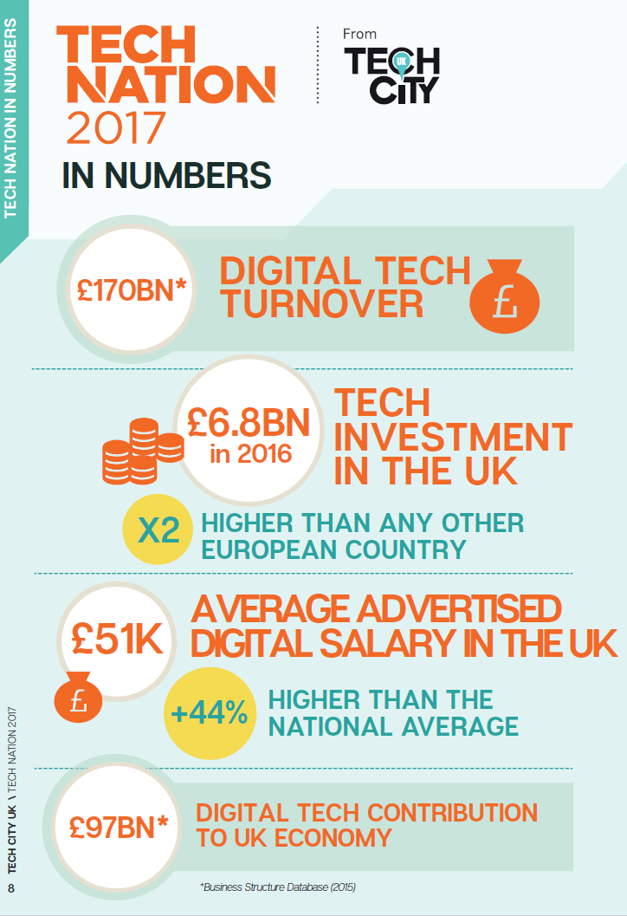
The UK Digital landscape
Source: Tech City UK
Notes:
In 2017 turnover of digital tech industries was £170 billion, up by 22% in five years.
The digital economy is growing 50% faster than the wider economy.
Digital tech businesses are dynamic - 17% are high growth, compared with just under 10% in the non-digital sector.
The average digital salary in the UK is £50,663 - 44% higher than the average non-digital salary.

Slide 3
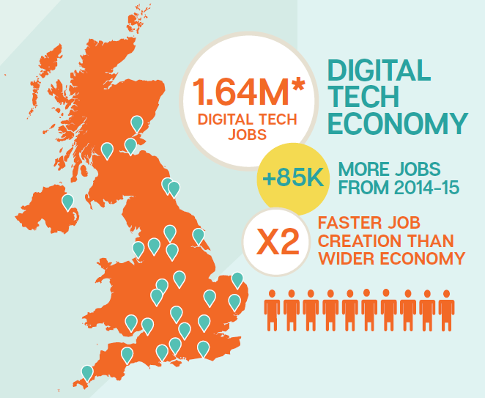
The UK Digital landscape
Source: Tech City UK
Notes:
- The UK has 1.64 million digital tech jobs. The growth rate of digital jobs was more than double that of non-digital jobs between 2011 and 2015.
More than 50% of digital tech businesses told them that talent supply is their number one growth challenge.
Over ⅓ of digital job adverts were for traditional industries, Burning Glass found over 1 million online adverts for digital jobs were placed in the first 9 months of 2015 alone.
Brexit - Thirteen percent of digital tech employees in the UK are from abroad, this rises to 31% in London and the South East.
To put that into perspective, in the UK in 2017, there was a total of 27,400 university students accepted onto a computer science course.
Of those, only 3,770 (13.7%) were women².

Slide 4
The current UK software industry
2017 ONS Data - Software professionals
Only 11.6% of software professionals in the UK are women.

Slide 5
Computer science pipeline
UCAS undergrad admissions data 2017
In 2017, of the 27,400 students enrolled on to Computer Science degree only 3,750 (13.7%) were women.
Notes:
For the analysis in this guide, we are focusing on degree apprenticeships (levels 6 and 7); however, these are a small proportion of all apprenticeships, making up 0.4 per cent of apprenticeship entrants in 2016-17.
Digital and Technology Solutions Professional - 515 from a total of 1745 (30%). Only a third of all degree apprenticeships are women, with an even smaller number in the tech apprenticeships

Slide 6
Careers that young men and women want to work in in the future
Technology was the most popular choice of future career for young men at 36% of responses, whilst Creative and design (26%) and Professions (36%) was most popular for young women.

Slide 7
So how can we tackle this issue?
Universities
Apprenticeship
providers
Talented individuals
who want to work in
tech and digital roles
Corporate training
programmes
Alternative training
providers

Slide 8
Who are CODE FIRST: Girls?
And what do they do?
CODE FIRST:Girls is a social enterprise which exists to get more women
into tech. That is our bottom line.
How do we do this? Through our 3-step operation…
1. Skills
We run free community courses to teach young women coding, programming & personal skills.
We run corporate courses in coding, to help upskill and demystify coding to existing junior and senior staff
We run courses in coding for working professionals, connecting with motivated working women, looking to upskill and change careers.
2. Community
Beyond the classroom we have built a community of >8000 talented women
We run events to stay in touch, build networks and demonstrate the range of opportunities available in tech
3. Talent
We connect our community with the best companies and the best jobs in tech.
In return we help companies connect to the best talent
We run tech talent workshops for companies to understand what they could do to encourage diversity their talent recruitment and retention processes

Slide 9
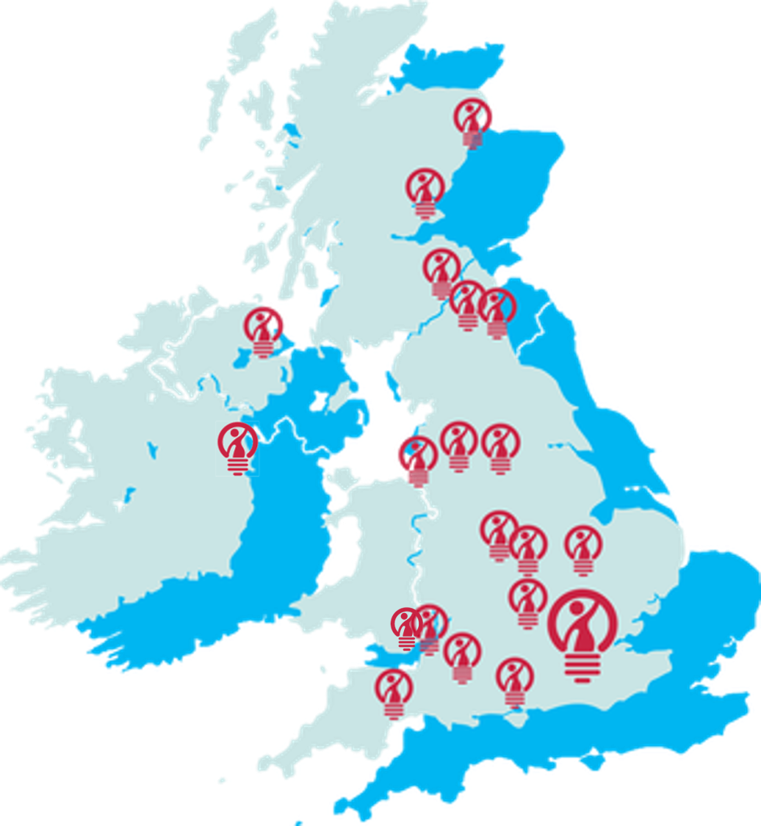
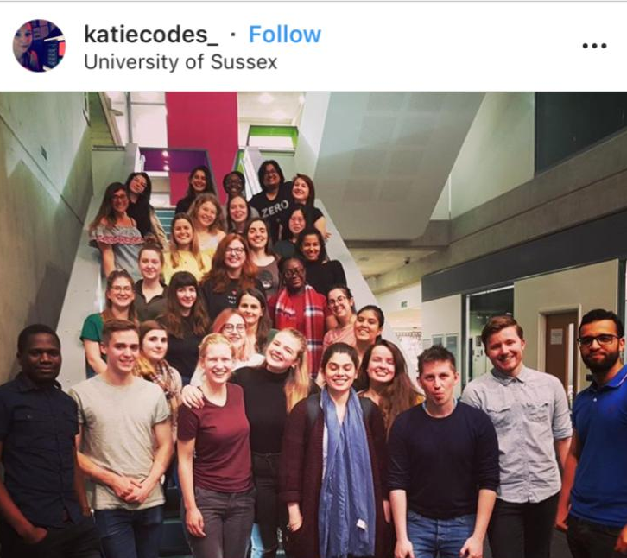
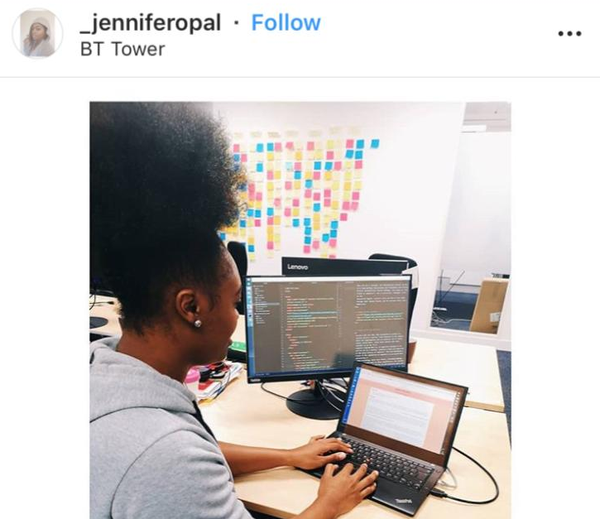
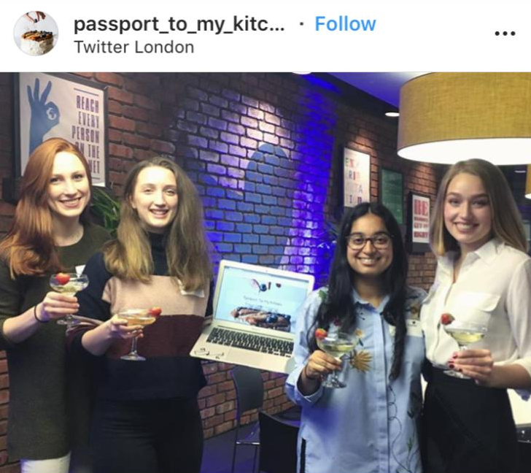
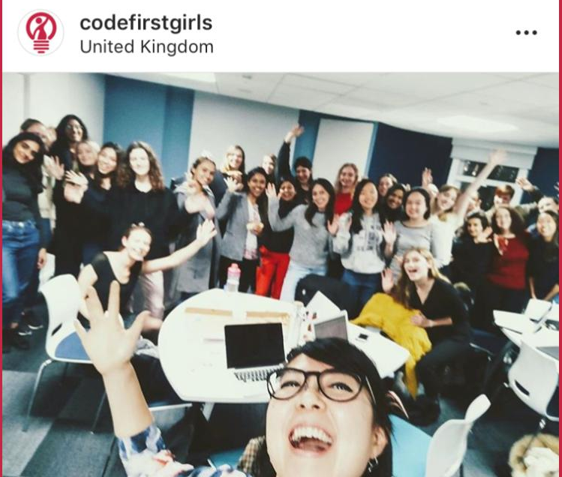
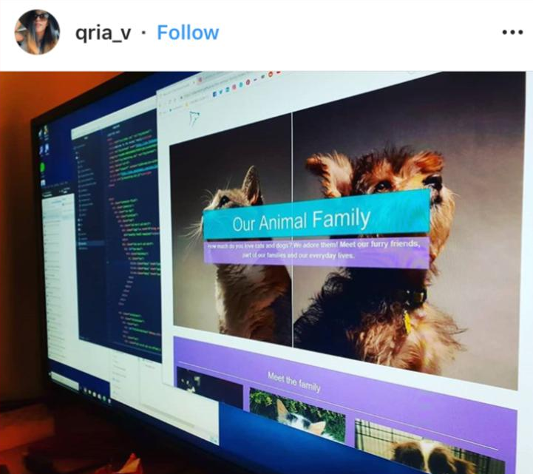
Since 2013 Code First: Girls has delivered £5.4m worth of free coding education to 8,000+ young women across the UK & Ireland
In 2018 alone, we taught 3,200 women to code, held 137 free coding courses with a volunteer instructor community of 140+ software and digital professionals
Our alumnae have gone on to work for a range of companies, from small-scale startups to global tech firms including...

Slide 10
How can Code First: Girls work with you?
Universities Host CF:G coding courses Inform our community about you HE options Involve your students as volunteer instructors | Corporate internal training Support you with running these Create bespoke programmes Support you with tech talent process and policies Train your staff | Apprenticeship providers Host CF:G coding courses Inform our community about you HE options Involve your students as volunteer instructors

Slide 11
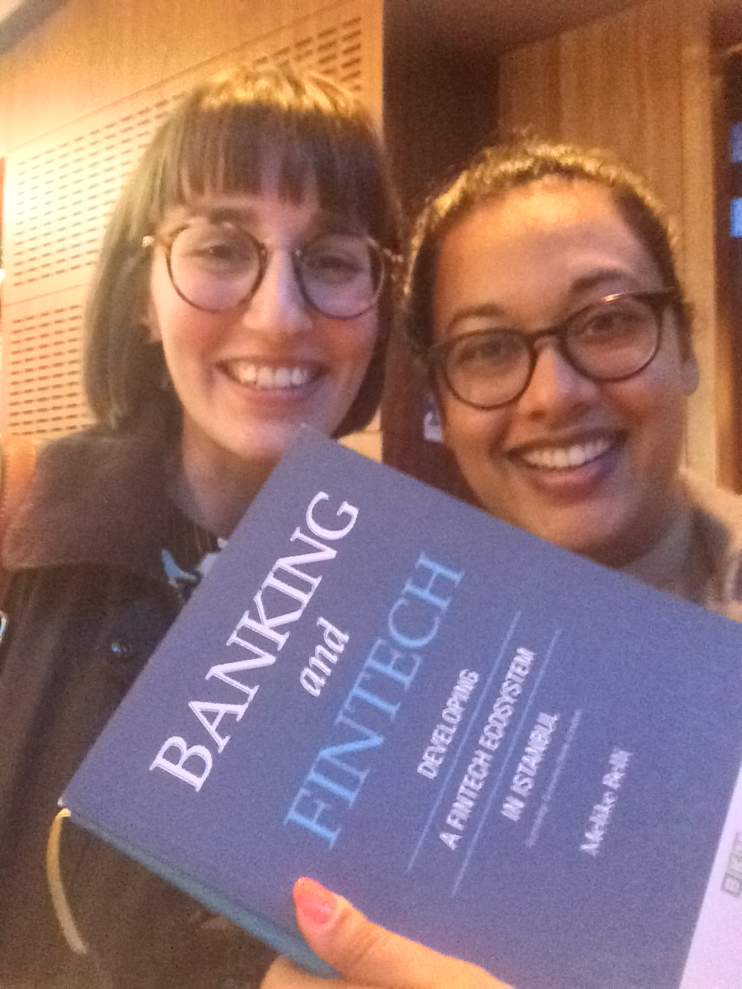
Case study 1:
Our community course alum
Notes:
Melike Belli
Business, Middle East Technical University, Turkey,
Masters, Banking and Finance, University of Nottingham
CFG L39 2015
Market Development Manager at Cybertonica Ltd. | Author of Banking and FinTech | Lecturer at FINTECH Circle Institute
http://bkm.com.tr/wp-content/uploads/2016/02/Banking-and-FinTech.pdf

Slide 12
Case study 2:
Our community course alum
Notes:
Clarice Hilton
Operations at food tech startup
VR & psychology researcher at UCL

Slide 13
Case study 3:
Our community course alum
Notes:
Dolly Eniola
Journalism & Politics, De Montfort University, CFG L39 2015
Cybersecurity Account Executive, Grey London
User Experience Researcher at Bud

Slide 14
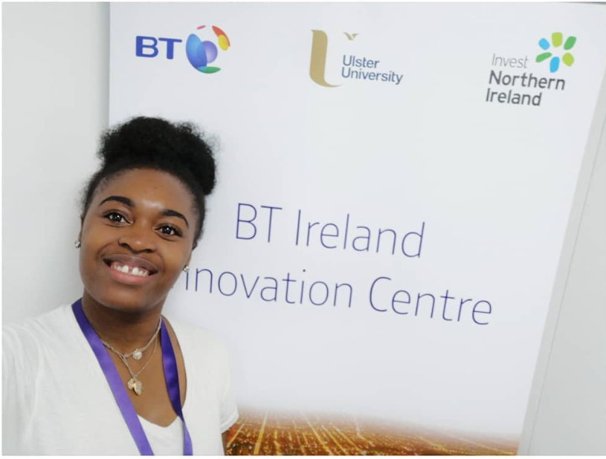
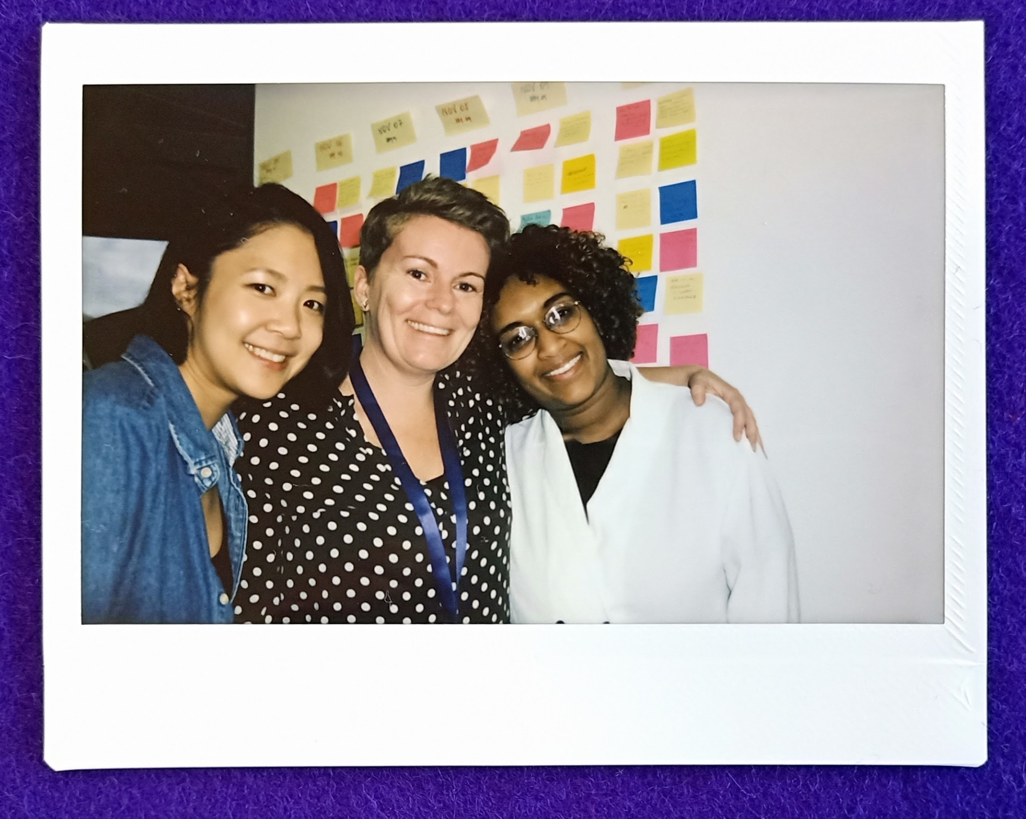
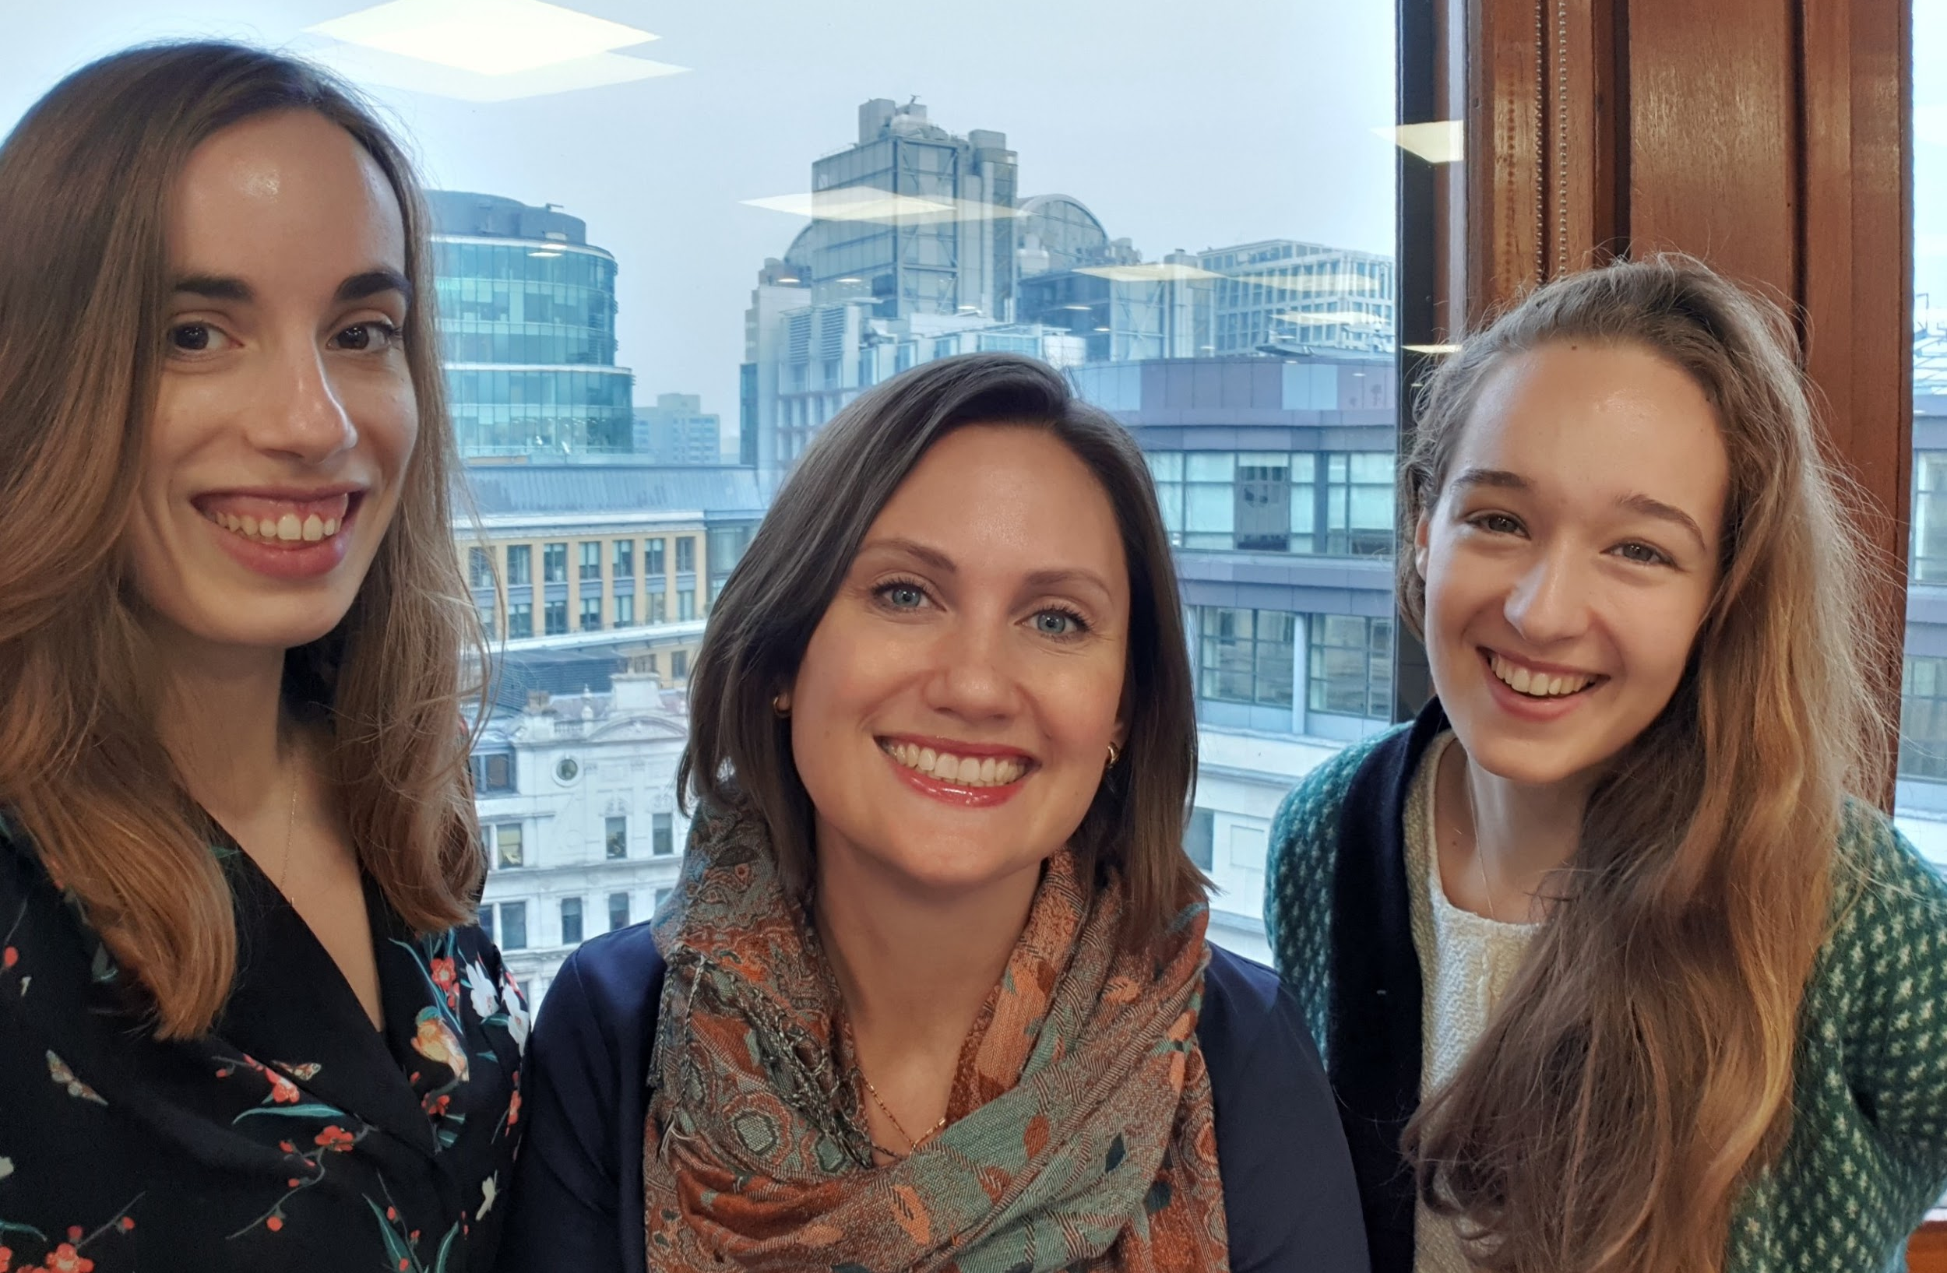
Case study 4 – the BT furtHER programme
The challenge?
BT were wishing to attract applications from more women to their tech teams across the UK. They wanted to expand beyond traditional graduate and apprenticeship schemes to offer opportunities to women who were keen to get into tech, but didn’t have a software development background.
The solution?
Code First: Girls worked with BT to launch a full-time coding bootcamp for 30 women who had limited or no coding experience. Code First: Girls undertook the programme recruitment, and delivered the training to bring the women up to the level of junior software developers, with BT guaranteeing a job offer to all who successfully completed the programme.
Photo credit: Jennifer Ingole and BT

Slide 15
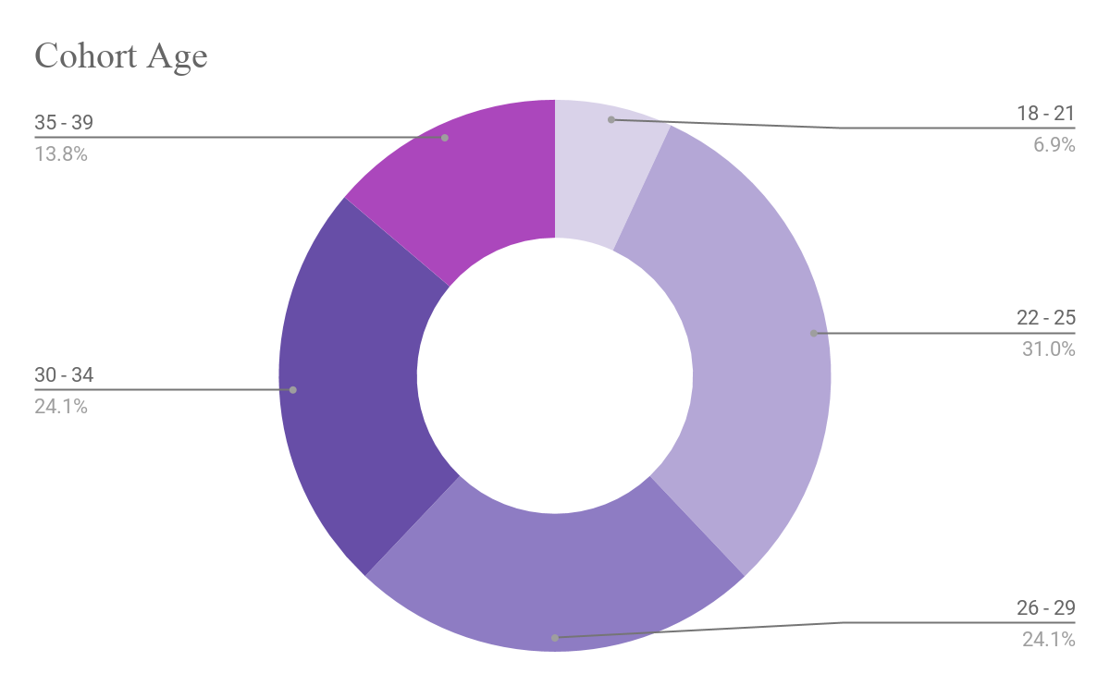
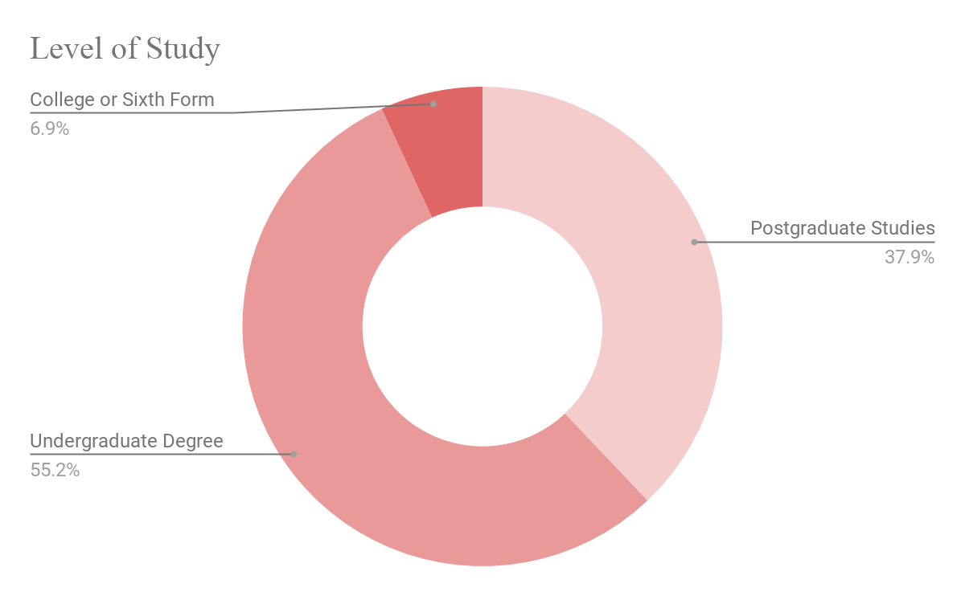
Case study – the BT furtHER programme
The Aim?
A diverse group of 30 newly trained Junior Software Developers for 4 different BT tech teams across the UK.
CF:G’s role
CF:G developed a bespoke coding curriculum for BT covering 4 modules, carefully tailored to BT’s needs. We then sourced and screened the candidates, managed the application process and onboarded the cohort, and delivered the full time training.

Slide 16
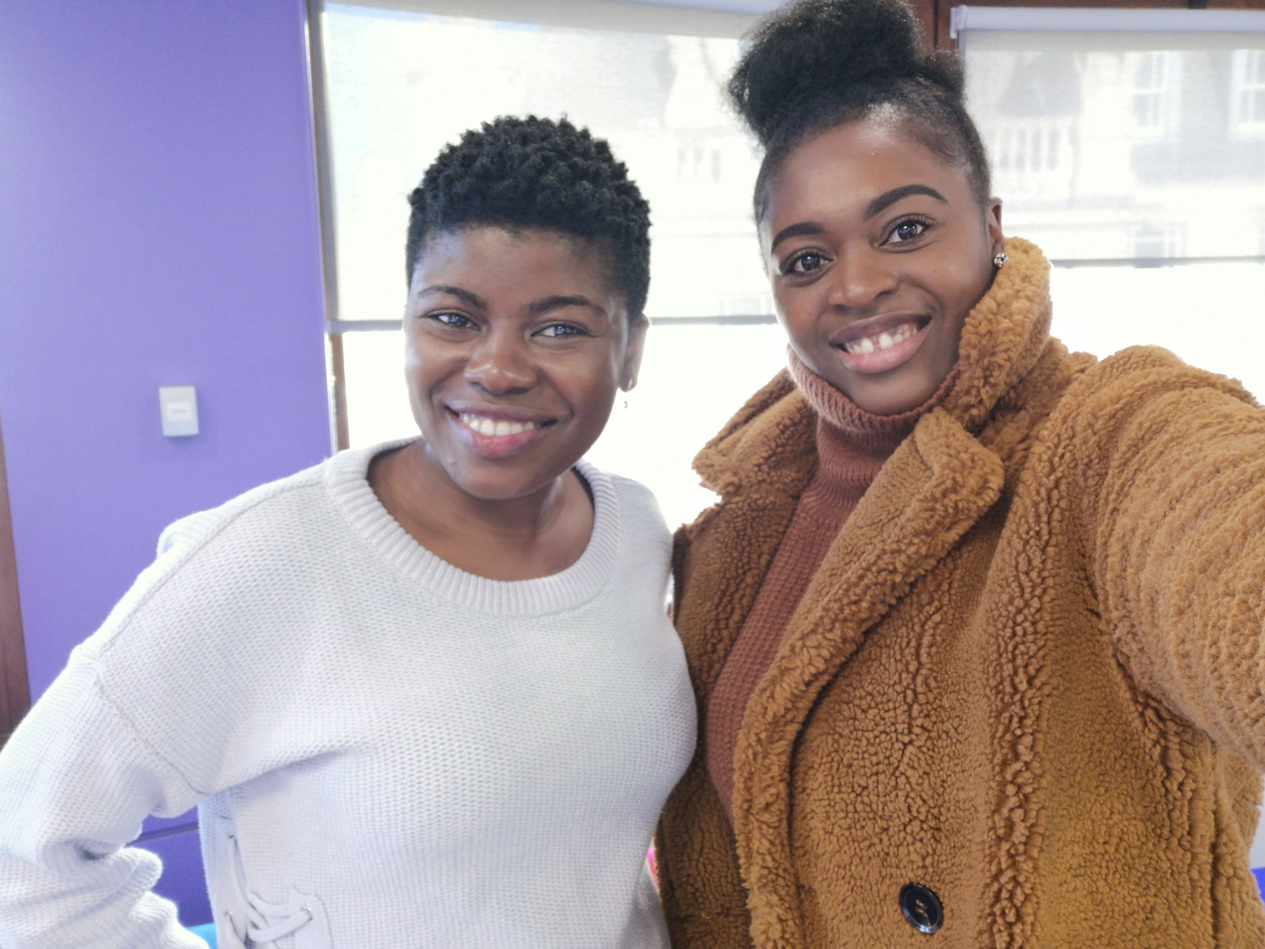
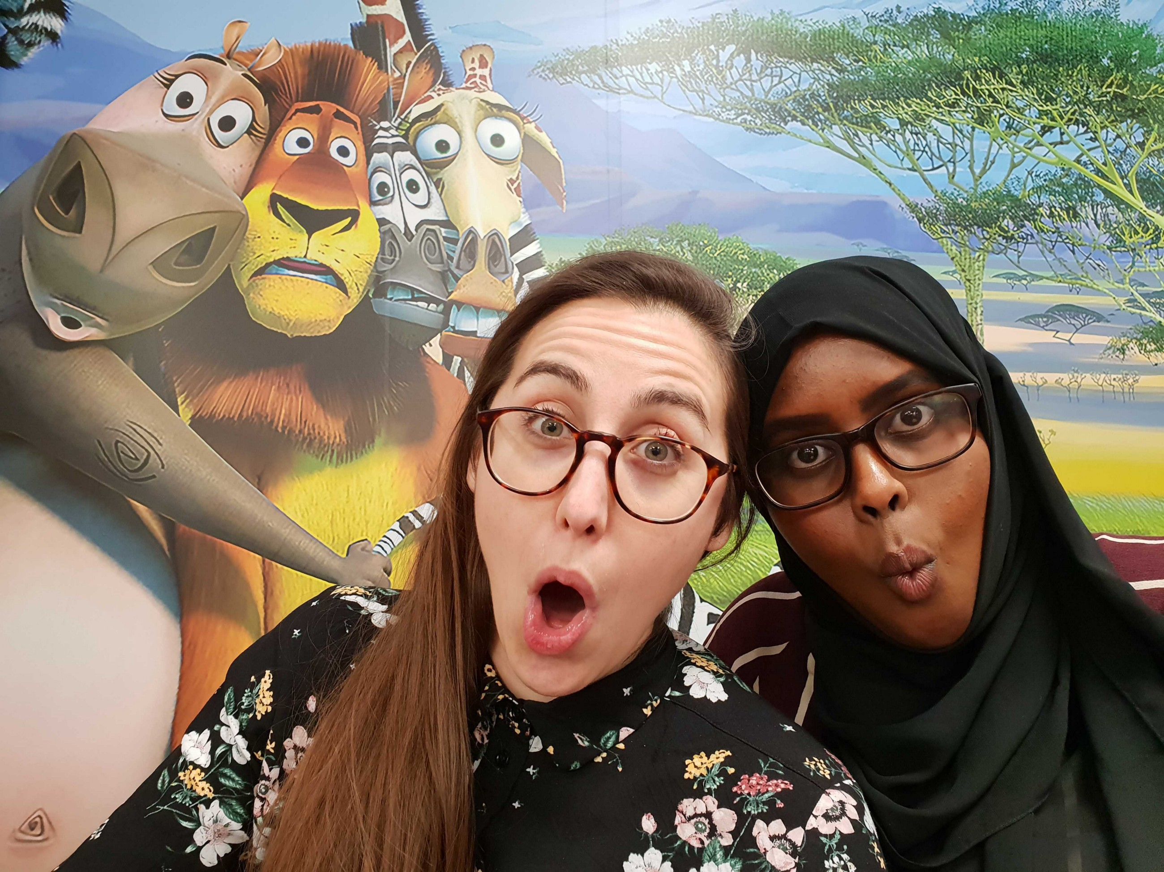
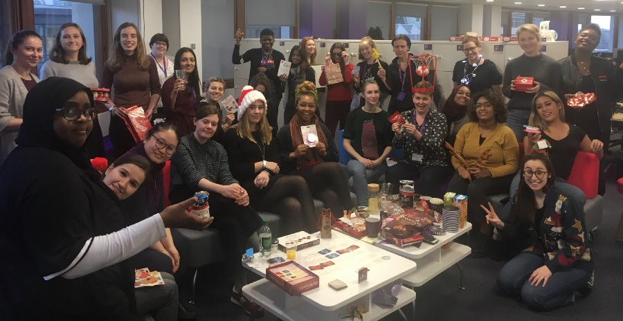
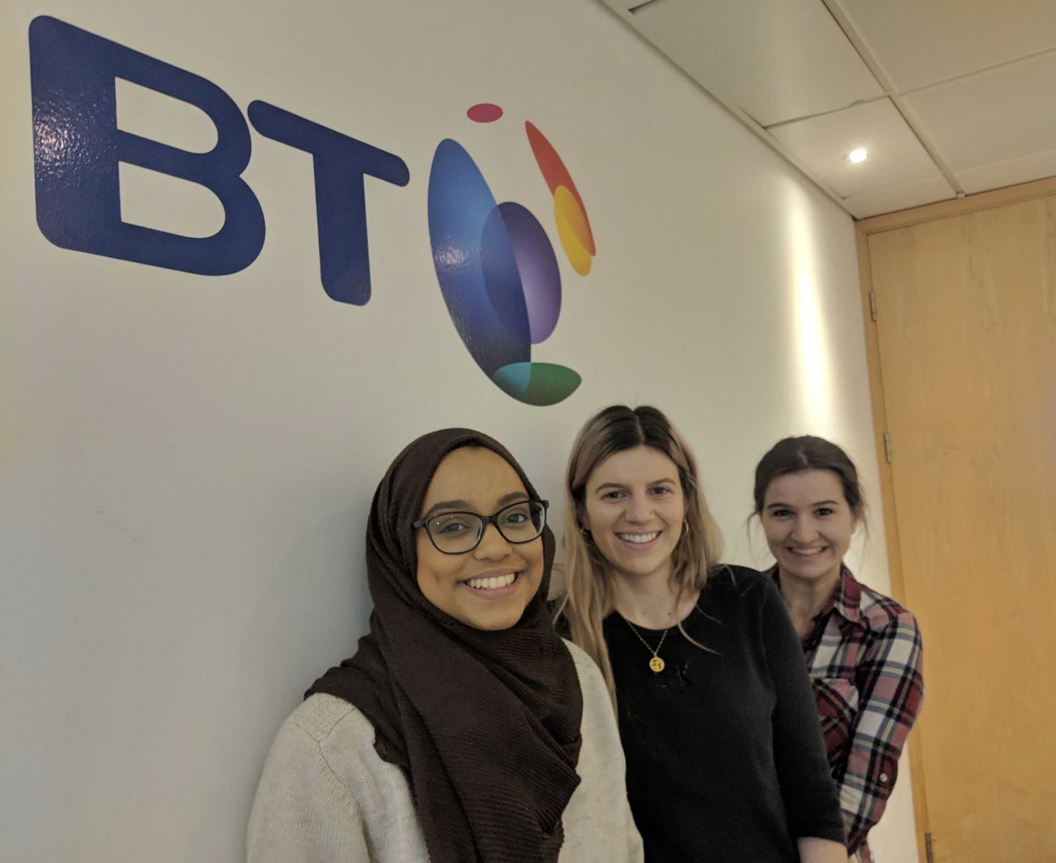
Case study 4
The BT furtHER programme outcome

Slide 17
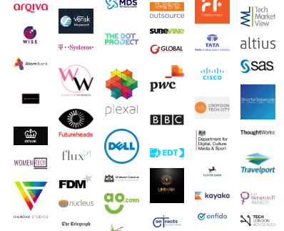
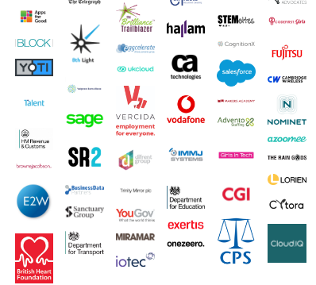
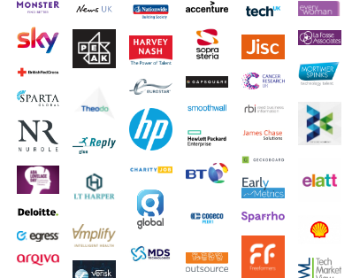
www.techtalentcharter.co.uk @techcharterUK
Notes:
The Tech Talent Charter (TTC) is a commitment by organisations to a set of undertakings that aim to deliver greater diversity in the tech workforce of the UK, one that better reflects the make-up of the population.
Signatories of the charter make a number of pledges in relation to their approach to recruitment and retention. Although it is very much an employer-led initiative, in March 2017 the TTC was supported in the government’s policy paper on the UK Digital Strategy, with DCMS and the Government more widely announcing their full commitment top tech talent charter at the start of the year.

Slide 18
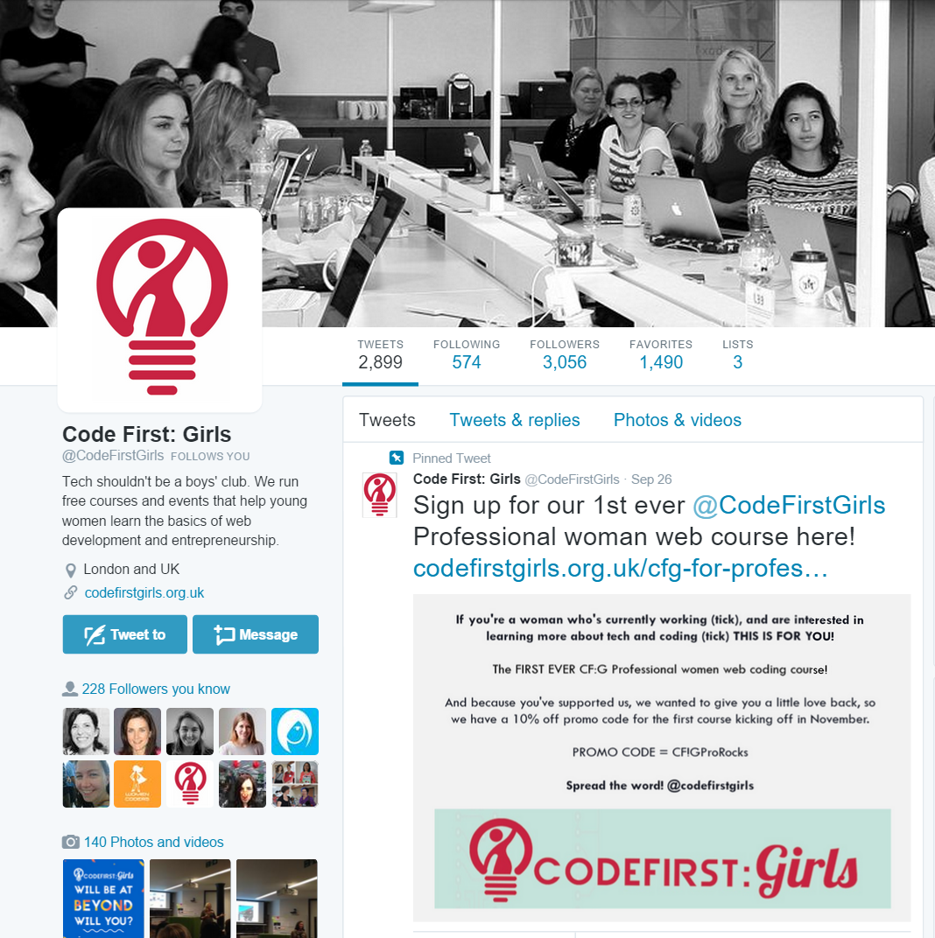
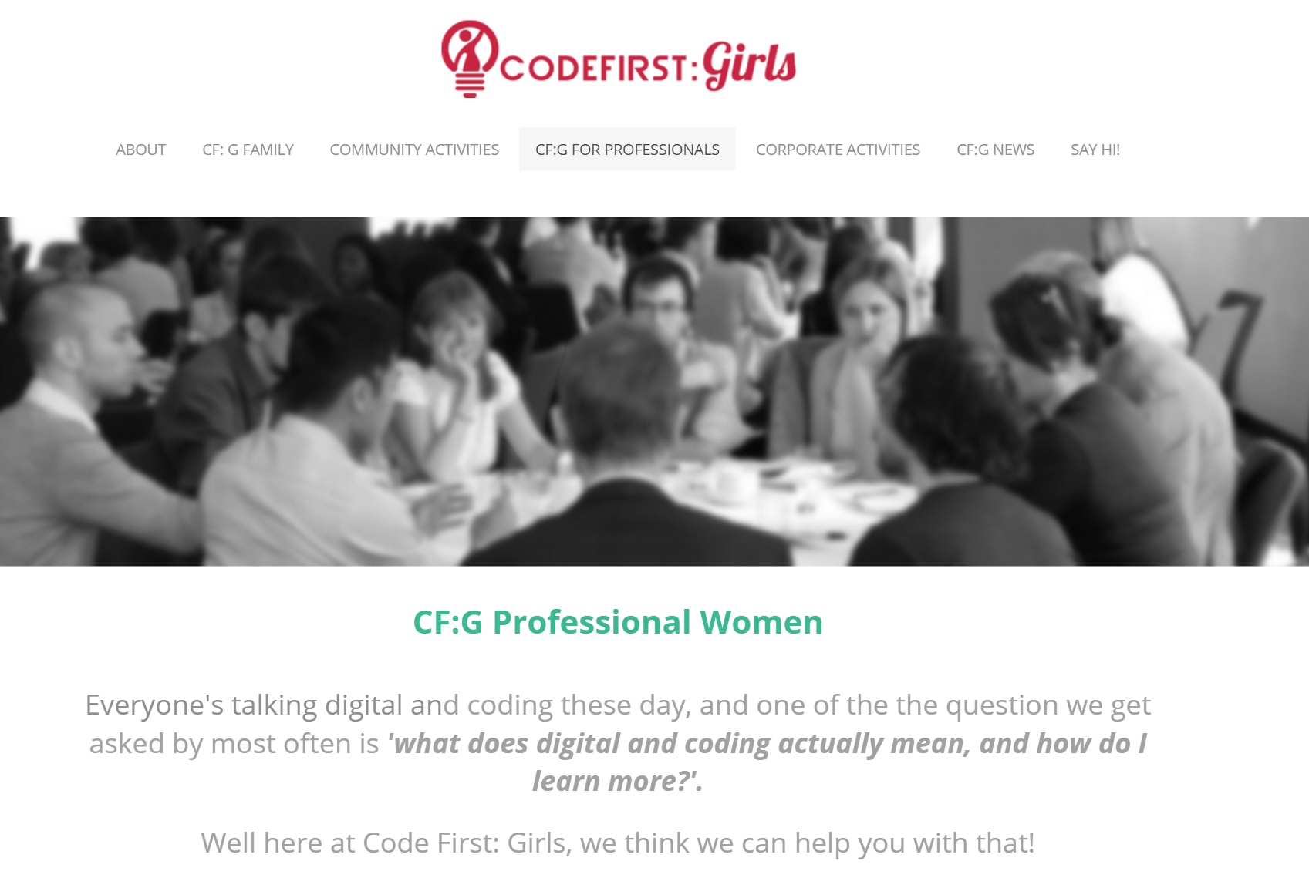
Thank you!
twitter.com/CodeFirstGirls
ww.codefirstgirls.org.uk

