Slide 1
The demographics of Computer Science (in HE)
Edmund Robinson
Queen Mary University of London

Slide 2
What this talk is about
What the data says about Computer Science generally.
Spread across universities
Diversity
Ethnicity
Gender

Slide 3
Data from HESA

Slide 4
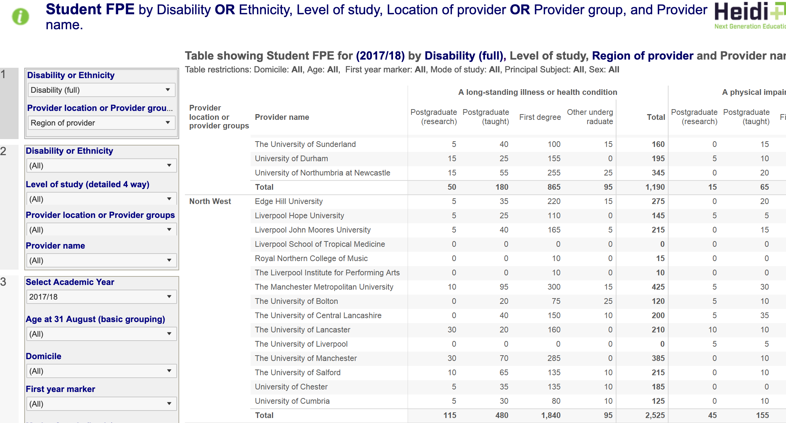

Slide 5
Spread across universities
Russell Group (24): research-intensive
University Alliance (16): universities engaged in building the workforce of tomorrow
Million Plus (23): the Association for Modern Universities

Slide 7
Student Nos | Physical Sciences | Maths | Computer Science | Engineer-ing | Total
Russell Group | 33945 | 18235 | 13065 | 40130 | 402320
University Alliance | 9130 | 3295 | 17025 | 19690 | 273035
Million Plus | 2475 | 180 | 10765 | 6945 | 155560
Total | 68075 | 31885 | 69075 | 103505 | 1430150

Slide 8
Most Physics (50%) or Maths (57%) students are at Russell Group universities
Nearly 40% of Engineering students are at Russell Group universities
So a typical Physics, Maths, Engineering student comes from a Russell Group university, or similar.

Slide 9
Most Physics or Maths students are at Russell Group universities
Nearly 40% of Engineering students are at Russell Group universities
So a typical Physics, Maths, Engineering student comes from a Russell Group university or similar.
Only 19% of Computer Science students are at Russell Group universities.
So a typical Computer Science student is not at one.

Slide 10
Most Physics or Maths students are at Russell Group universities
Nearly 40% of Engineering students are at Russell Group universities
So a typical Physics, Maths, Engineering student comes from a Russell Group university.
Only 19% of Computer Science students are at Russell Group universities.
So a typical Computer Science student is not at one.

Slide 11
Student Nos | Physical Sciences | Maths | Computer Science | Engineer-ing | Total
Russell Group | 33945 | 18235 | 13065 | 40130 | 402320
University Alliance | 9130 | 3295 | 17025 | 19690 | 273035
Million Plus | 2475 | 180 | 10765 | 6945 | 155560
Total | 68075 | 31885 | 69075 | 103505 | 1430150

Slide 12
CS is a small subject inside the Russell Group
CS has 3.2% of Russell Group students
Maths has 4.5%
Physical Sciences 8.4%
Engineering 10%

Slide 13
Putting stuff together

Slide 14
Is this number large or small,
given number of students in Million Plus and number of students taking CS overall?
Student Nos | Physical Sciences | Maths | Computer Science | Engineer-ing | Total
Russell Group | 33945 | 18235 | 13065 | 40130 | 402320
University Alliance | 9130 | 3295 | 17025 | 19690 | 273035
Million Plus | 2475 | 180 | 10765 | 6945 | 155560
Total | 68075 | 31885 | 69075 | 103505 | 1430150

Slide 15
“Likelihood ratio”
Probability of a Million Plus student taking CS is: P(CS|MP) (6.7%)
Want to compare this with probability of random student taking CS: P(CS) (4.8%)
Consider a form of likelihood ratio: P(CS|MP)/P(CS)
Gives the factor by which Million Plus students preferentially choose CS. (1.43)

Slide 16
“Likelihood ratio”
The factor by which Million Plus students preferentially choose CS. (1.43)
Check the definition: this is also the factor by which CS students preferentially choose Million Plus universities (P(MP|CS)/P(MP))

Slide 17
Likelihood Ratio | Physical Sciences | Mathematics | Computer Science | Engineering Science
Russell Group | 1.77 | 2.03 | 0.67 | 1.38
University Alliance | 0.70 | 0.54 | 1.29 | 1.00
Million Plus | 0.33 | 0.05 | 1.43 | 0.62

Slide 18
Likelihood Ratio | Physical Sciences | Mathematics | Computer Science | Engineering Science
Russell Group | 1.77 | 2.03 | 0.67 | 1.38
University Alliance | 0.70 | 0.54 | 1.29 | 1.00
Million Plus | 0.33 | 0.05 | 1.43 | 0.62

Slide 19
Diversity
We’ll get to the elephant in the room later
Start with an elephant that’s not in the room

Slide 20
Ethnicity
Computer Science is fairly ethnically diverse.
Evidence: likelihood ratios for different ethnic groupings.

Slide 21
Ethnicity - likelihood ratios for CS: P(CS|E)/P(CS)
White | Black or Black British - Caribbean | Black or Black British - African | Other Black background | Asian or Asian British - Indian
0.95 | 0.89 | 1.01 | 0.97 | 1.34
Asian or Asian British - Pakistani | Asian or Asian British - Bangladeshi | Other Asian background | Chinese | Other including mixed background
1.42 | 1.43 | 1.44 | 1.63 | 0.96

Slide 22
Ethnicity - likelihood ratios for CS: P(CS|E)/P(CS)
White | Black or Black British - Caribbean | Black or Black British - African | Other Black background | Asian or Asian British - Indian
0.95 | 0.89 | 1.01 | 0.97 | 1.34
Asian or Asian British - Pakistani | Asian or Asian British - Bangladeshi | Other Asian background | Chinese | Other including mixed background
1.42 | 1.43 | 1.44 | 1.63 | 0.96

Slide 23
Ethnicity - likelihood ratios for CS: P(CS|E)/P(CS)
White | Black or Black British - Caribbean | Black or Black British - African | Other Black background | Asian or Asian British - Indian
0.95 | 0.89 | 1.01 | 0.97 | 1.34
Asian or Asian British - Pakistani | Asian or Asian British - Bangladeshi | Other Asian background | Chinese | Other including mixed background
1.42 | 1.43 | 1.44 | 1.63 | 0.96

Slide 24
Ethnicity
Students from many minority groups have a stronger preference for Computer Science than white students.
This is particularly so for Asian (both South Asian and Chinese).

Slide 25
Ethnicity
Obvious exception is “Black or Black British – Caribbean”
The popular areas for these students are Mass Communications, Business and Law.
In STEM: subjects allied to Medicine do well, as does Biology. CS gets 0.89, but Engineering gets 0.51.

Slide 26
Ethnicity
WARNING: this is base-lined on the students already coming into university.

Slide 27
Gender

Slide 28
Gender
15% of UK CS undergraduates are women
56% of UK undergraduates are women
F
M

Slide 29
This makes gender the most serious diversity issue for CS
By severity of underrepresentation
By size of underrepresented population
There are similar issues in Europe and the US (see eg figures from Informatics Europe).

Slide 30
Gender + Ethnicity
Look at M/F ratio for each group.

Slide 31
 | White | Black or Black British - Caribbean | Black or Black British - African | Other Black Background | Asian or Asian Briitish - Indian | Asian or Asian Briitish - Pakistani | Asian or Asian Briitish - Bangladeshi
F | 1.02% | 1.11% | 1.22% | 1.09% | 2.69% | 1.92% | 1.71%
M | 9.41% | 10.21% | 9.96% | 9.80% | 10.55% | 12.40% | 12.45%
Ratio | 9.3 | 9.2 | 8.2 | 8.9 | 3.9 | 6.5 | 7.3
 | Chinese | Other Asian Background | Unknown/not applicable | Mixed | Other | Total
F | 2.82% | 2.24% | 2.13% | 1.11% | 1.60% | 1.33%
M | 13.23% | 12.07% | 8.88% | 8.62% | 9.91% | 9.60%
Ratio | 4.7 | 5.4 | 4.2 | 7.8 | 6.2 | 7.2

Slide 32
 | White | Black or Black British - Caribbean | Black or Black British - African | Other Black Background | Asian or Asian Briitish - Indian | Asian or Asian Briitish - Pakistani | Asian or Asian Briitish - Bangladeshi
F | 1.02% | 1.11% | 1.22% | 1.09% | 2.69% | 1.92% | 1.71%
M | 9.41% | 10.21% | 9.96% | 9.80% | 10.55% | 12.40% | 12.45%
Ratio | 9.3 | 9.2 | 8.2 | 8.9 | 3.9 | 6.5 | 7.3
 | Chinese | Other Asian Background | Unknown/not applicable | Mixed | Other | Total
F | 2.82% | 2.24% | 2.13% | 1.11% | 1.60% | 1.33%
M | 13.23% | 12.07% | 8.88% | 8.62% | 9.91% | 9.60%
Ratio | 4.7 | 5.4 | 4.2 | 7.8 | 6.2 | 7.2
Percentage of Black female students taking CS.

Slide 33
 | White | Black or Black British - Caribbean | Black or Black British - African | Other Black Background | Asian or Asian Briitish - Indian | Asian or Asian Briitish - Pakistani | Asian or Asian Briitish - Bangladeshi
F | 1.02% | 1.11% | 1.22% | 1.09% | 2.69% | 1.92% | 1.71%
M | 9.41% | 10.21% | 9.96% | 9.80% | 10.55% | 12.40% | 12.45%
Ratio | 9.3 | 9.2 | 8.2 | 8.9 | 3.9 | 6.5 | 7.3
 | Chinese | Other Asian Background | Unknown/not applicable | Mixed | Other | Total
F | 2.82% | 2.24% | 2.13% | 1.11% | 1.60% | 1.33%
M | 13.23% | 12.07% | 8.88% | 8.62% | 9.91% | 9.60%
Ratio | 4.7 | 5.4 | 4.2 | 7.8 | 6.2 | 7.2
Ratio varies radically between groups

Slide 34
 | White | Black or Black British - Caribbean | Black or Black British - African | Other Black Background | Asian or Asian Briitish - Indian | Asian or Asian Briitish - Pakistani | Asian or Asian Briitish - Bangladeshi
F | 1.02% | 1.11% | 1.22% | 1.09% | 2.69% | 1.92% | 1.71%
M | 9.41% | 10.21% | 9.96% | 9.80% | 10.55% | 12.40% | 12.45%
Ratio | 9.3 | 9.2 | 8.2 | 8.9 | 3.9 | 6.5 | 7.3
 | Chinese | Other Asian Background | Unknown/not applicable | Mixed | Other | Total
F | 2.82% | 2.24% | 2.13% | 1.11% | 1.60% | 1.33%
M | 13.23% | 12.07% | 8.88% | 8.62% | 9.91% | 9.60%
Ratio | 4.7 | 5.4 | 4.2 | 7.8 | 6.2 | 7.2

Slide 35
Gender + Ethnicity
Asian groupings are relatively less discriminatory.
Black and White groupings relatively worse.

Slide 36
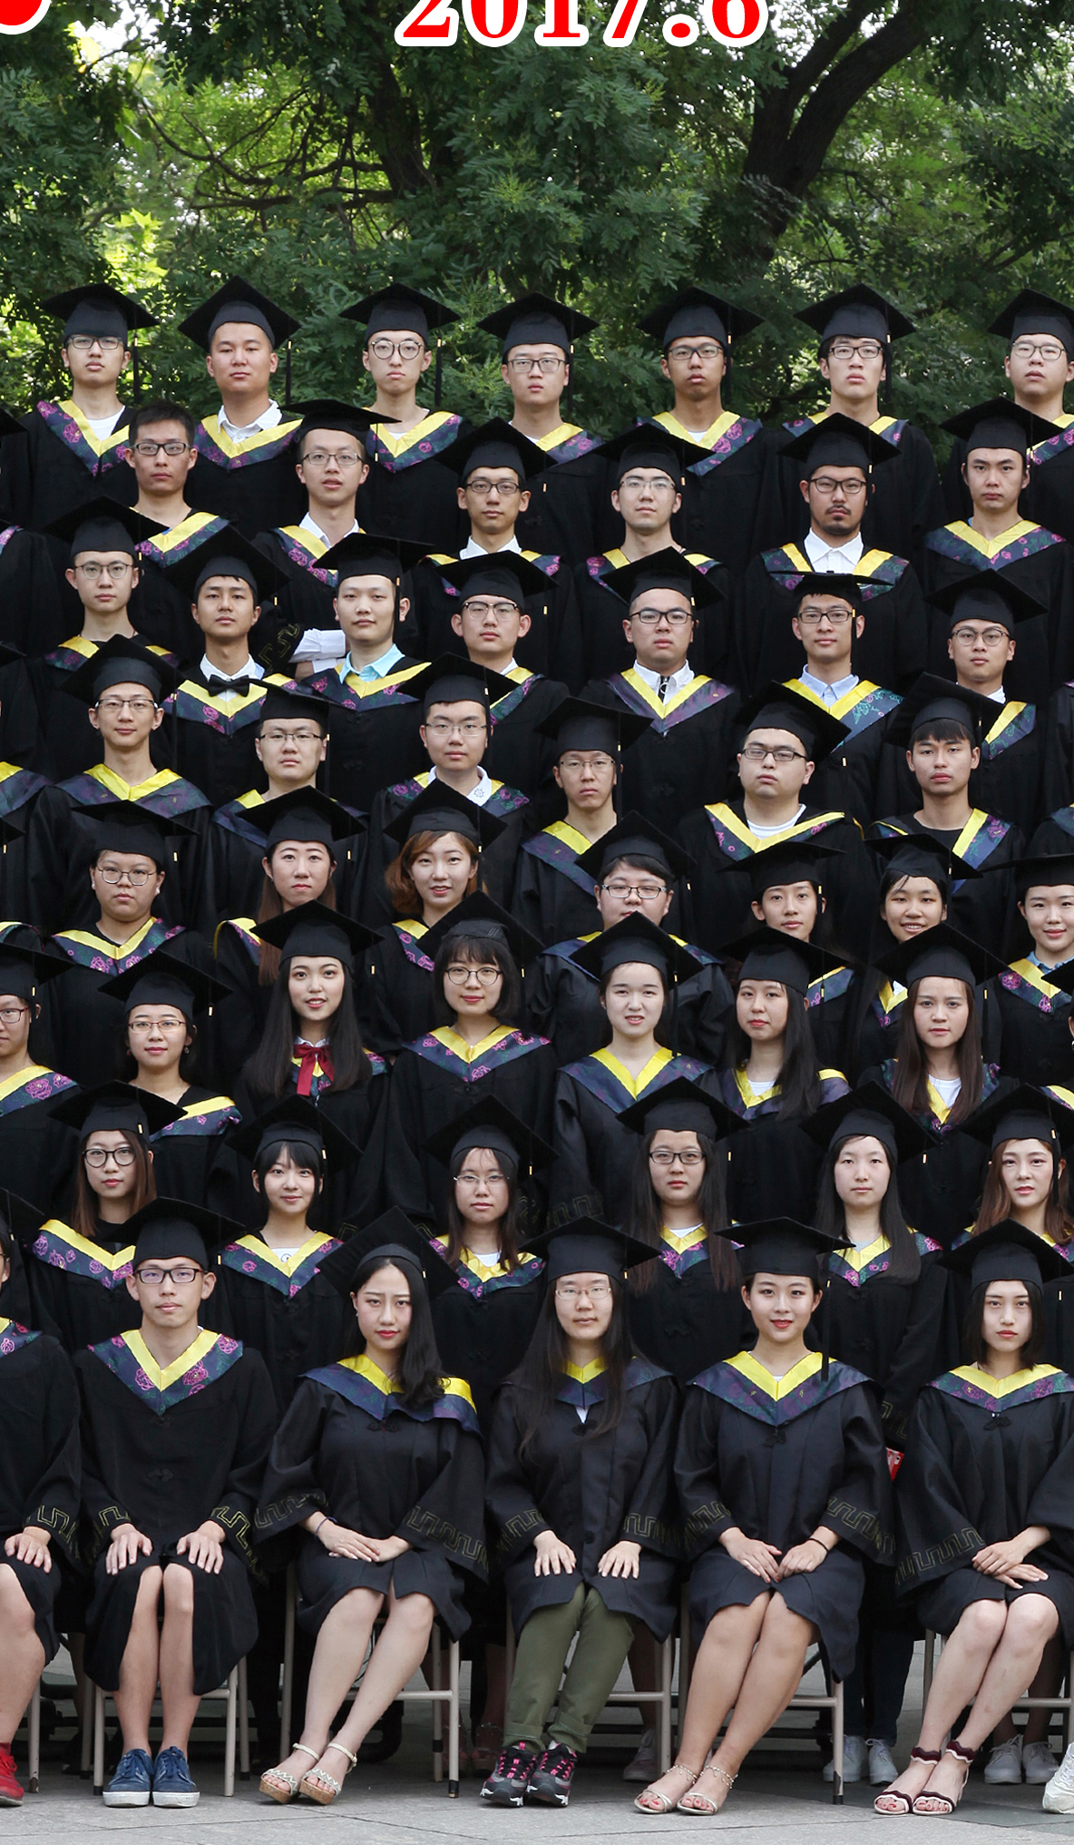
Meanwhile in China…

Slide 37
Subject Area | White | Black or Black British - Caribbean | Black or Black British - African | Other Black background | Asian or Asian British - Indian | Asian or Asian British - Pakistani | Asian or Asian British - Bangladeshi | Other Asian background | Chinese | Other including mixed background
(1) Medicine & dentistry | 0.82 | 0.28 | 0.59 | 0.31 | 3.50 | 1.94 | 1.05 | 2.18 | 2.79 | 1.38
(2) Subjects allied to medicine | 0.95 | 0.98 | 1.65 | 1.11 | 1.13 | 1.11 | 0.82 | 1.58 | 0.72 | 0.76
(3) Biological sciences | 1.03 | 1.21 | 0.81 | 1.02 | 0.77 | 0.95 | 0.89 | 0.84 | 0.70 | 1.06
(4) Veterinary science | 1.23 | 0.15 | 0.02 | 0.00 | 0.27 | 0.04 | 0.00 | 0.16 | 0.86 | 0.55
(5) Agriculture & related subjects | 1.23 | 0.35 | 0.18 | 0.19 | 0.16 | 0.10 | 0.05 | 0.20 | 0.23 | 0.41
(6) Physical sciences | 1.11 | 0.34 | 0.37 | 0.45 | 0.78 | 0.55 | 0.57 | 0.65 | 1.20 | 0.85
(7) Mathematical sciences | 0.99 | 0.39 | 0.56 | 0.62 | 1.65 | 0.88 | 1.22 | 1.44 | 2.95 | 0.93
(8) Computer science | 0.95 | 0.89 | 1.01 | 0.97 | 1.34 | 1.42 | 1.43 | 1.44 | 1.63 | 0.96
(9) Engineering & technology | 0.96 | 0.51 | 1.09 | 0.74 | 1.24 | 1.21 | 0.96 | 1.59 | 1.60 | 1.09
(A) Architecture, building & planning | 1.01 | 0.87 | 0.98 | 0.83 | 0.88 | 0.77 | 0.70 | 1.23 | 1.31 | 1.14
Total - Science subject areas | 0.99 | 0.82 | 1.03 | 0.86 | 1.17 | 1.06 | 0.90 | 1.29 | 1.19 | 0.95
(B) Social studies | 0.96 | 1.45 | 1.39 | 1.27 | 1.02 | 1.03 | 1.21 | 0.69 | 0.70 | 1.12
(C) Law | 0.85 | 1.42 | 1.52 | 1.51 | 1.32 | 2.26 | 1.84 | 1.11 | 0.90 | 1.27
(D) Business & administrative studies | 0.87 | 1.38 | 1.62 | 1.63 | 1.47 | 1.54 | 1.91 | 1.34 | 1.39 | 1.10
(E) Mass communications & documentation | 1.04 | 1.55 | 0.99 | 1.32 | 0.55 | 0.42 | 0.48 | 0.54 | 0.56 | 1.19
(F) Languages | 1.11 | 0.59 | 0.35 | 0.63 | 0.53 | 0.50 | 0.59 | 0.41 | 0.67 | 1.13
(G) Historical & philosophical studies | 1.15 | 0.44 | 0.33 | 0.37 | 0.45 | 0.39 | 0.49 | 0.27 | 0.39 | 0.87
(H) Creative arts & design | 1.10 | 1.21 | 0.47 | 0.89 | 0.37 | 0.25 | 0.31 | 0.62 | 0.92 | 1.13
(I) Education | 1.08 | 1.10 | 0.63 | 1.01 | 0.53 | 1.06 | 1.49 | 0.36 | 0.32 | 0.66
(J) Combined | 1.17 | 0.76 | 0.32 | 0.85 | 0.35 | 0.35 | 0.26 | 0.40 | 0.59 | 0.58
Total - Non-science subject areas | 1.01 | 1.17 | 0.97 | 1.13 | 0.84 | 0.94 | 1.09 | 0.73 | 0.83 | 1.04
Total - All subject areas | 1,154,180 | 23,070 | 77,390 | 5,550 | 50,170 | 46,760 | 20,720 | 31,575 | 11,815 | 79,610

